Slide 1
NATIONAL BOARD AGAINST COUNTERFEITING, HUNGARY
Regional Seminar for Enforcers
Budapest, 11-13 November 2015
Roberta Pal, Deputy-Secretary
Secretariat of the National Board Against Counterfeiting
Hungarian Intellectual Property Office

Slide 2
Contents
Introduction of the National Board Against Counterfeiting (NBAC)
Structure
Main action areas
Activities of the NBAC
„Counterfeiting in Hungary”- consumer survey
Existing initiatives, programmes - examples
Summary

Slide 3
National Board Against Counterfeiting
Consultative, opinion-giving and advisory body with 21 members
Cooperation of the public and private sector
ministries, NGOs, interest groups
Governmental
Ministry of Justice
Hungarian Intellectual Property Office
Ministry of Human Resources
State Secretariat for Health
State Secretariat for Culture
State Secretariat for Education
Ministry of Rural Development
Ministry for National Economy
National Tax and Customs Authority
Headquarters of the National Police
National Office for Consumer Protection
National Media and Infocommunications Authority
Non-Governmental
Hungarian Association of Brands
Hungarian Association for the Protection of Industrial Property and Copyright
Hungarian Publishers & Booksellers’ Association
Hungarian Pharmaceutical Manufacturers´ Association
Hungarian Trademark Association
ICT Association of Hungary
Hungarian Marketing Association
Hungarian Professional Automotive Association
ProArt Association for the Protection of Copyright
National Association of Entrepreneurs and Employers

Slide 4
Responsibilities
drafting and enforcing the national strategy and action plans against counterfeiting;
coordination and support of the government activities relating to international and European initiatives and programs against counterfeiting;
analysis and systemization of statistical data regarding counterfeiting;
launching and coordinating awareness-raising and information campaigns, and monitoring the implementation thereof;
training the officials of law enforcement agencies;
participation in drafting legislative amendments regarding IPR enforcement.

Slide 5
Organization of NBAC
WORKING GROUPS
Secretariat - HIPO
PLENARY (21)
OPERATIVE MANAGEMENT BOARD (7)
WG Enforcement
WG
Trade and Industry
WG
medicine
WG
works of art
WG
Developing Public Awareness
WG
Infocom

Slide 6
Action plan 2011-2015
Main objectives
More efficient enforcement! – to reduce offline and online supply of counterfeit products
Better-informed consumers and internet users! – to reduce demand for counterfeit products
Proving the economic importance of fighting against counterfeiting and helping enterprises in their enforcement activities

Slide 7
I. REDUCING SUPPLY
II. REDUCING DEMAND
Strategic directions of the NBAC action plan
GENERAL
Fight against counterfeits
from third countries
(border measures)
Fight against
counterfeits domestically
Public awareness raising
Awareness raising of the youth
1
2
9
10
Fight against online infringements
3
Capacity building (training, infrastructure)
4
III. ECONOMIC ASPECTS
SECTORIAL
Creative industries
Food, pesticides
Medicine
Works of art
5
6
7
8
Macroeconomic monitoring
Awareness raising of entrepreneurs
11
12

Slide 8
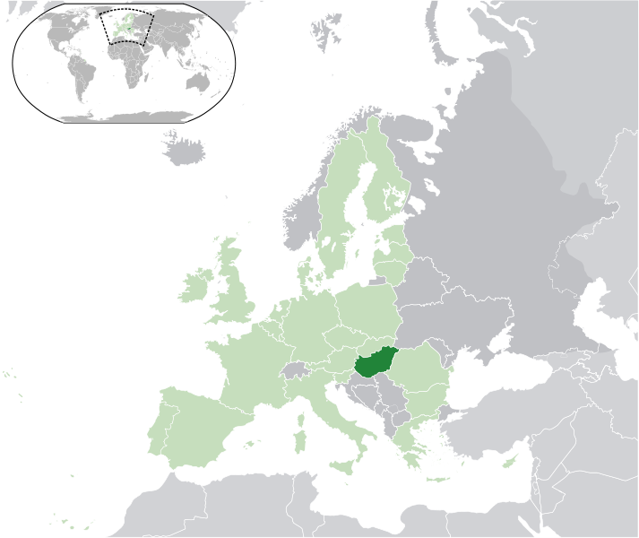
Hungary - Facts
Population 9,85 million
Population of Budapest 1.7 million
Average net salary 500 €
Prices
Cinema ticket 5-7 €
CD 18 €
VAT 27%
Source: wikipedia.com

Slide 9
“Counterfeiting in Hungary“ consumer survey
Nationwide representative consumer survey – yearly since 2009
Omnibus survey – TÁRKI Social Research Institute
Sample size of 1000 representative individuals aged 18+
Personal interviews
Main questions
Consumer attitudes “Would you consciously buy…?”
Consumer purchases “Did you buy …?”
Consumers’ attitudes and consumption in relation to contents under copyright protected on the Internet
Consumers’ awareness in relation to the consequences of counterfeiting

Slide 10
Attitude 2013 - 2015: Would you consciously buy counterfeit products (illegal, copied, of a non-reliable source, illegally downloaded)?
The number of Hungarians decreased who are willing to buy counterfeit products.
Yes, any time + maybe
= willing to buy counterfeit products
[in %]

Slide 11
Purchases: Did you buy counterfeit (illegal, copied, acquired from un-certain source, illegally downloaded) product in the past year?
18% of Hungarian consumers bought fakes last year- more than before!
Young people and inhabitants of Budapest bought more fakes.
2013
2014
2015
[in %]

Slide 12
Attitude and Consumption / Internet 2015: Knowledge of legal online services
Legal online services are getting used more often in Hungary amongst those who are aware of them.
In 2012 only 45% of the respondents knew sources on the internet where it is possible to listen to or download music legally and in 2014 this proportion went up to 70%!
but in 2015, this result dropped to 59% only again…
while in 2012 70% of those, who know such web sites, used them, in 2014 this was 82%
only 36% of the respondents think that it is recognizable that music, movies or other content have been posted on the internet by legal means (in 2013: 29%)

Slide 13
Attitude and Consumption / Internet 2015: Would you be willing to pay for downloading content from a legal source on the Internet?
Almost half of the respondents would not pay for downloading content from the Internet
[in %]

Slide 14
Consumers' awareness in relation to the consequences of counterfeiting
“Counterfeit products are as good in quality as originals”
“In the long run it is more profitable to choose an original product”
[in %]

Slide 15
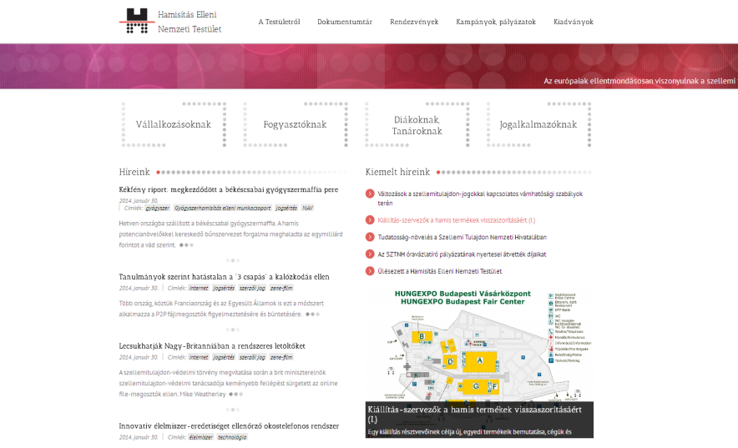
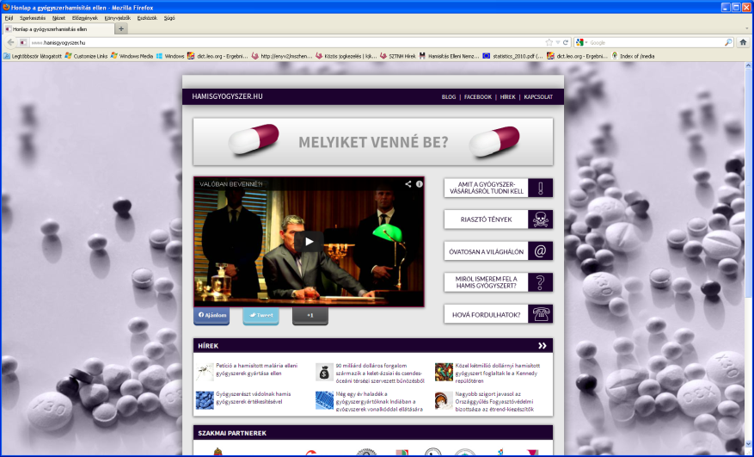
NBAC’s website - www.hamisitasellen.hu
For whom?
Information and news portal
NBAC members
Governmental organisations
NGOs
Enterprises
Consumers
Students
Media
Programs, exhibitions, conferences
Reports, surveys
Law sources
FAQ for consumers and for enterprises
What to do guide
News about counterfeiting in Hungary and abroad

Slide 16
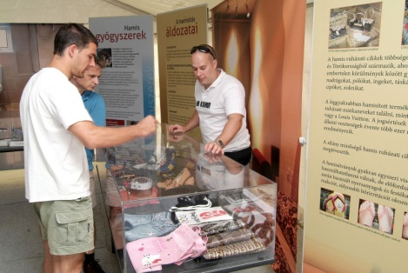
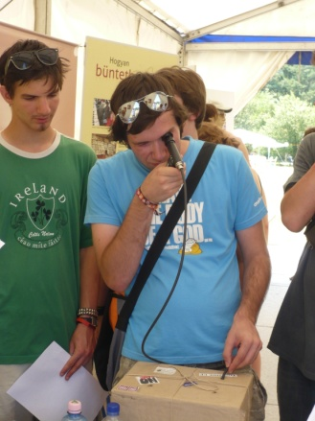
Awareness raising
Daily newsletters
Distribution of flyers and labels at retailers of consumer electronics
Applied art competition for secondary school students
Web 2.0. campaigns
Blog
Facebook
Campaign against medicine counterfeiting
Exhibition
Anti-counterfeiting roadshow
Online campaign
Facebook.com/NoKamu
http://nokamu.postr.hu/

Slide 17
More efficient enforcement!
Training of enforcement authorities
Seminar for customs officers on the application of the new EU Customs Regulation effective as of January 1, 2014
IPR training for the staff of the Hungarian Investment Promotion Angency (HITA)
Training of 60 customs officers (IPR search, databases)

Slide 18
Better-informed consumers and internet users!
Priority target group: Youngsters
Video spot competition, creative competitions
Teacher’s competition: outline teaching materials on IP
Seminar on IPR enforcement at ELTE upon the invitation of Civil Departement
‘Webshops, online pharmacies – online sale of health related products’ 2nd National Conference – NBAC presentation
Distribution of flyers and labels at retailers of consumer electronics
Campaign against medicine counterfeiting

Slide 19
Cooperation
New Cooperation Agreements with the National Food Chain Safety Office, Professional Association of Hungarian Car Industry, with the Media Service Support and Trustee Fund and the Hungarian Marks Association
BSA – NBAC Campaign against the illegal use of softwares
HIPAvilon Intellectual Property Agency – Design Week Budapest – IP advice with the NBAC
International Operation Pangea VIII with the assistance of the NBAC June (NBAC, Police, Customs, OGYÉI - Pharmaceutical Institution)
MOU against fake medicines was singned in 2015 with 8 parties

Slide 20
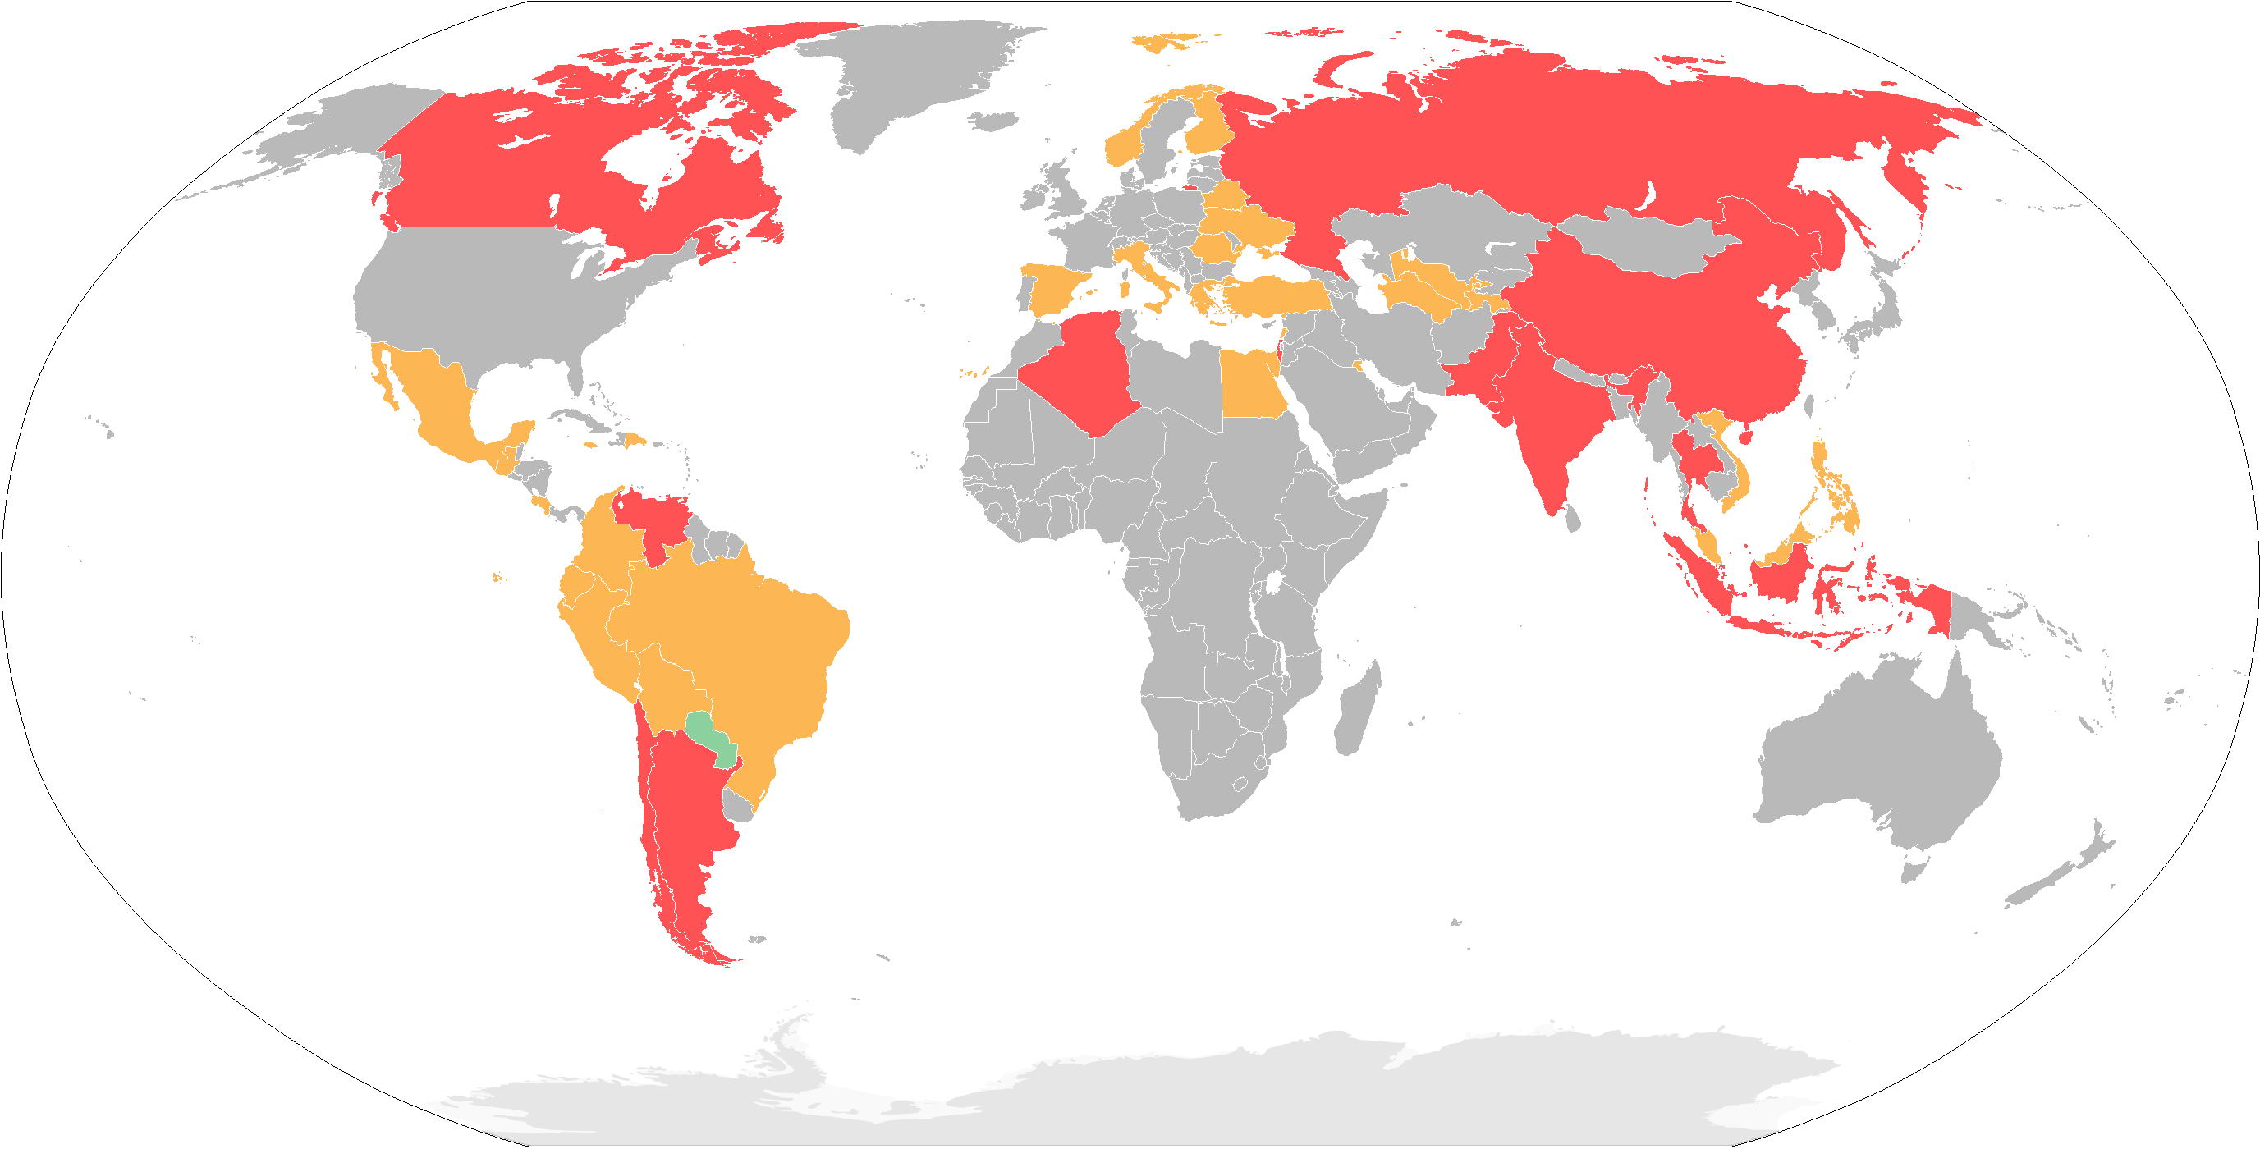
2010: Hungary is off the list! Special 301 Report (2010)
Priority Watch List
Watch List
http://www.google.hu/imgres?q=2011+Special+301+Report&hl=hu&safe=active&gbv=2&tbm=isch&tbnid=di-63y0MO4rbdM:&imgrefurl=http://en.wikipedia.org/wiki/File:2011_Special_301_Report_%28World_Map%29.png&docid=_yaygiwSHkB-9M&imgurl=http://upload.wikimedia.org/wikipedia/commons/4/4c/2011_Special_301_Report_%28World_Map%29.png&w=2753&h=1400&ei=kG_MT_T5GujP4QTNvr0n&zoom=1&iact=hc&vpx=163&vpy=60&dur=6625&hovh=160&hovw=315&tx=146&ty=83&sig=105321278013851185171&page=1&tbnh=102&tbnw=201&start=0&ndsp=24&ved=1t:429,r:0,s:0,i:69&biw=1280&bih=830
Notes:
The Office of the US Trade Representative releases its “Special 301” Report on the adequacy and effectiveness of U.S. trading partners’ protection of intellectual property rights (IPR) every year.
The Special 301 Report provides a means for the United States to communicate its concerns about the need to protect and enforce IPR. Hungary has been removed from the list in 2010.

Slide 21
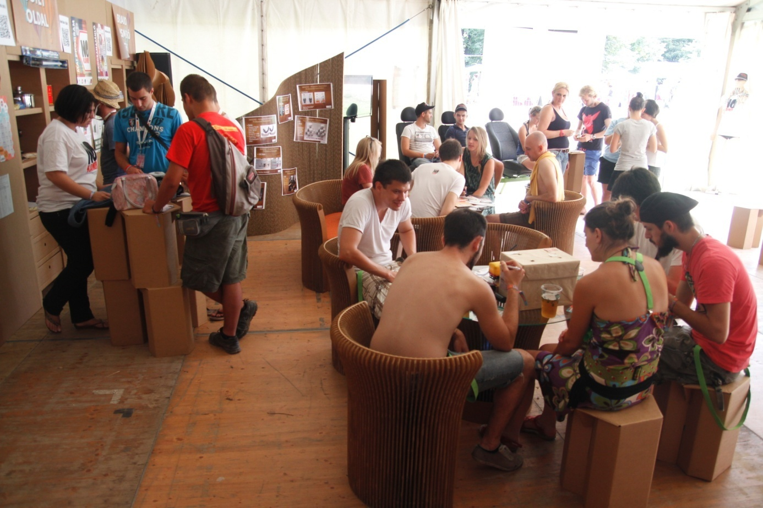
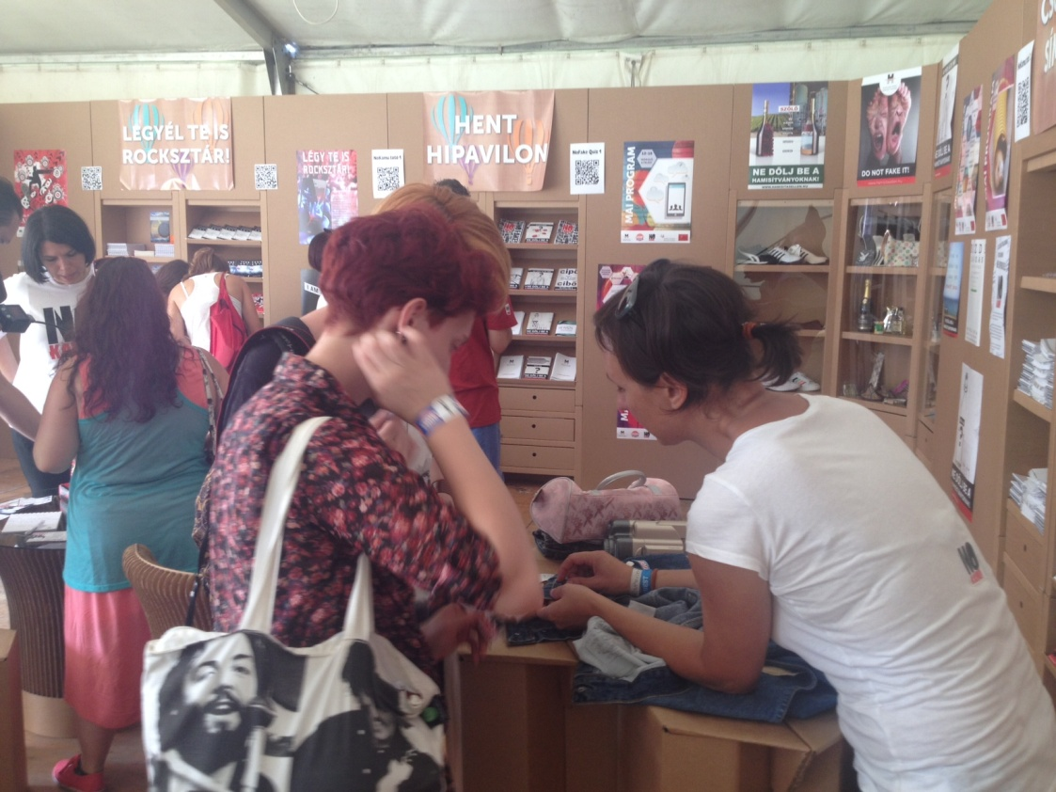
Better informed customers & internet users!
https://www.youtube.com/watch?v=Z5tdlb-grbg&feature=youtu.be

Slide 22
Thank you for your attention
roberta.pal@hipo.gov.hu
+36 1 474 5791
hent@hipo.gov.hu
www.hamisitasellen.hu
www.hipo.gov.hu

