Slide 1
MINISTRY OF FINANCE OF THE REPUBLIC OF CROATIA CUSTOMS DIRECTORATE – CENTRAL OFFICE
CROATIAN CUSTOMS EXPERIENCE AGAINST COUNTERFEITING
Regional Seminar on Enforcement of Intellectual Property Rights
Budapest, Hungary, November 11 – 13, 2015

Slide 2
summary
role of enforcement agencies
trends in counterfeiting
trademark enforcement in transit
cooperation model in Croatia
CROATIAN CUSTOMS EXPERIENCE AGAINST COUNTERFEITING

Slide 3
enforcement role
Role of the enforcement agencies:
to prevent fakes enter the market
to effectively eliminate fakes from the market
CROATIAN CUSTOMS EXPERIENCE AGAINST COUNTERFEITING
Notes:
3

Slide 4
our opponents
organised criminal groups
with increasing knowledge on legislation
with no financial worries
swiftly adapt to external conditions
ready to do anything to preserve their „business”
CROATIAN CUSTOMS EXPERIENCE AGAINST COUNTERFEITING

Slide 5
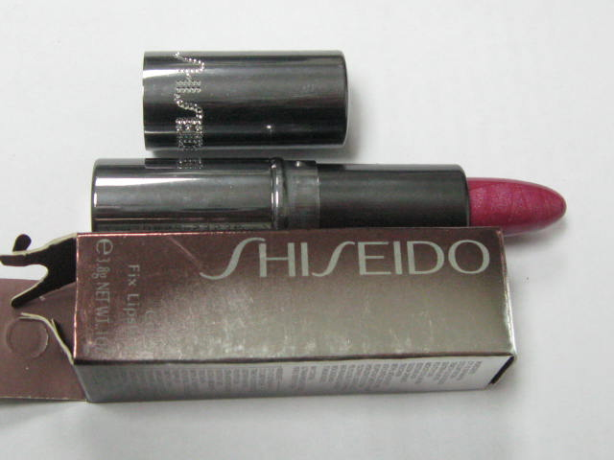
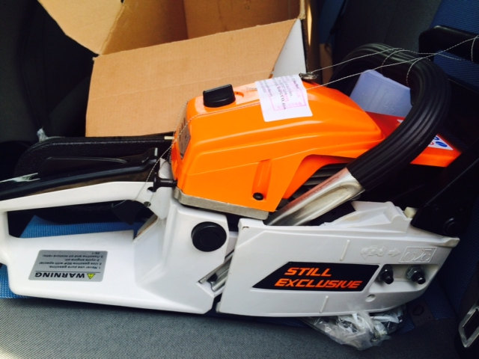
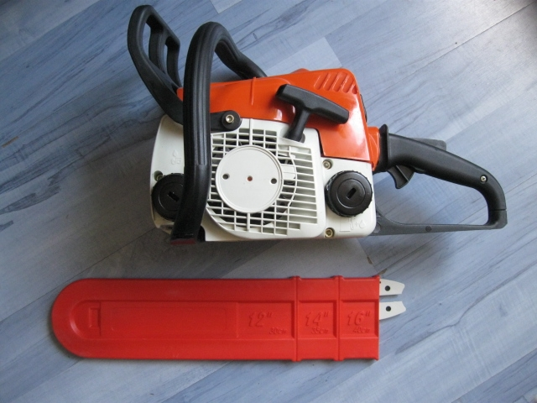
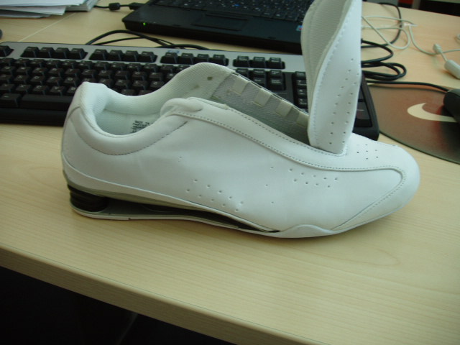
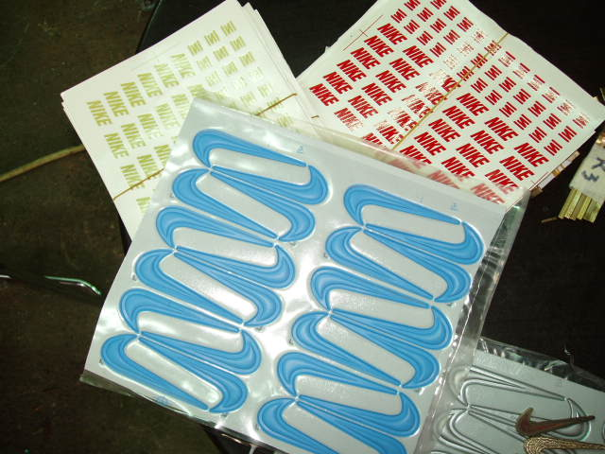
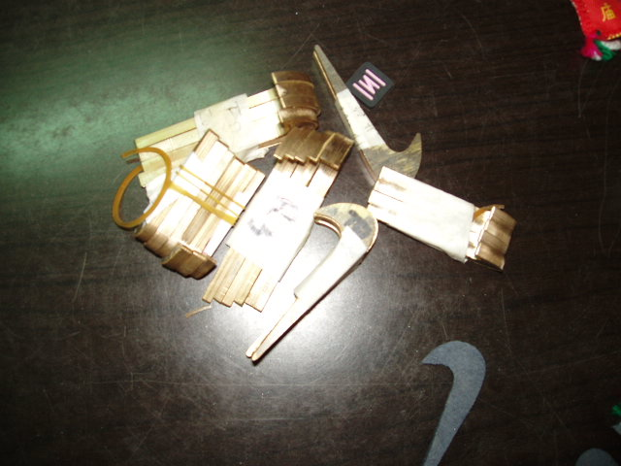
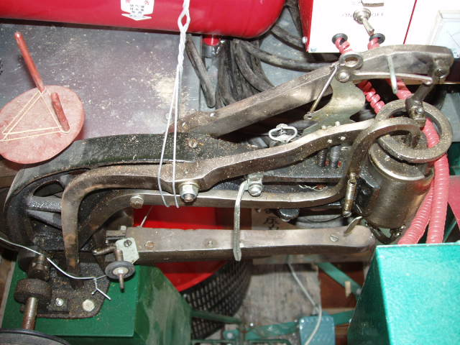
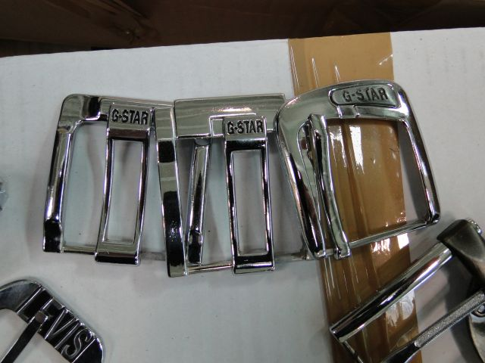
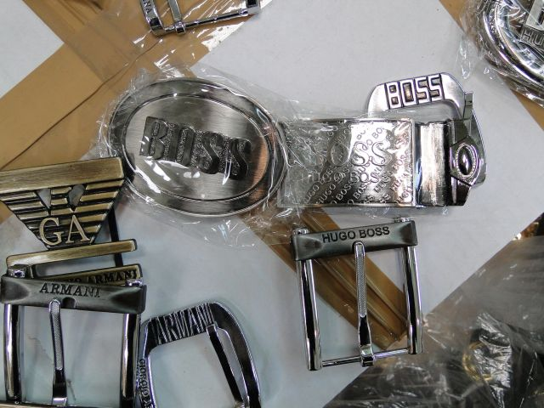
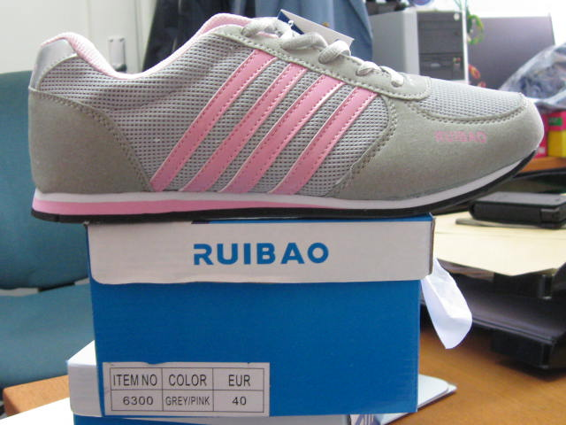
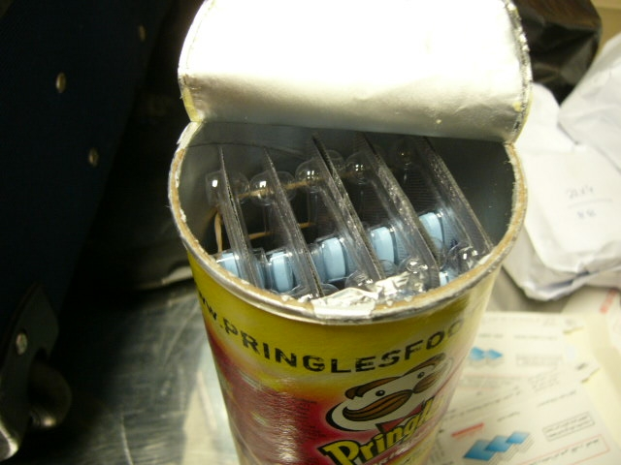
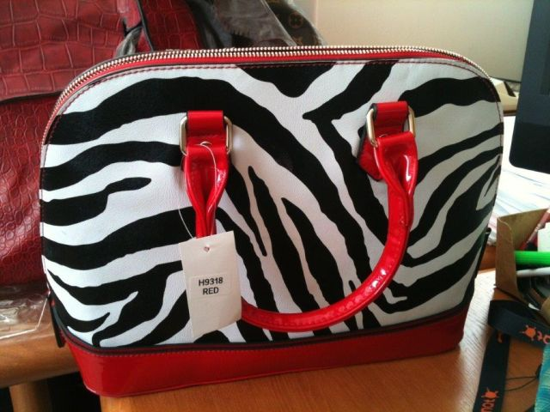
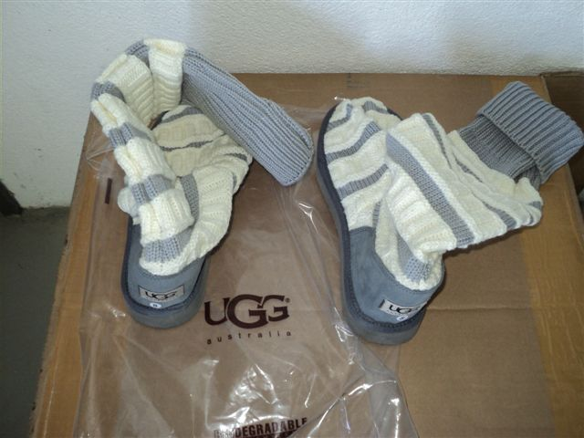
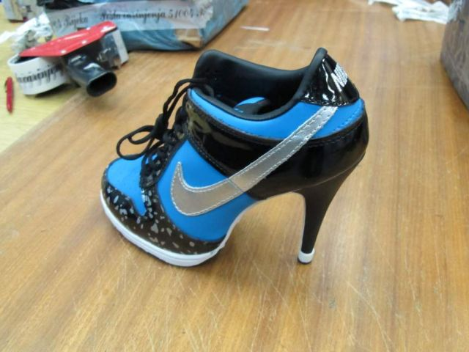
trends
clearly infringing goods
changing routes
hidden labels and tools
domestic production
misuse of IPR legislation
trademarks altered
concealment
internet purchases
CROATIAN CUSTOMS EXPERIENCE AGAINST COUNTERFEITING

Slide 6
transit
Philips and Nokia cases
EK – Guidelines for goods in transit
so, can we act?
exchange of information
with EU MS – Regulation (EC) 515/97
with third countries – agreements on mutual cooperation in customs matters
CROATIAN CUSTOMS EXPERIENCE AGAINST COUNTERFEITING

Slide 7
one case (summer 2015)
Free Zone Split – 3 containers with fake goods – notify party UE forwarding agent
1st – route HR–HU–UE SI driver (stopped near SI) – INF case closed
2nd – route HR-SI-AT-CZ-PL-LT-LV-BY for KG PL driver – stopped by CZ customs near DE fined and escorted to PL – INF case in PL
3rd – stopped in Split – INF case open (court)
CROATIAN CUSTOMS EXPERIENCE AGAINST COUNTERFEITING

Slide 8
internal cooperation case
truck stopped at HR – ME border
exporter was based in Split (our regular „client” from 2008 – 2010)
driver revealed location of the storage
immediate information to Mobile Unit Split
9 secret storages for 3 companies
59 + 297 + 120 + 117 brands
more than 350.000 fake products in total
CROATIAN CUSTOMS EXPERIENCE AGAINST COUNTERFEITING

Slide 9
interagency cooperation
STEERING COMMITTEE ON IPR ENFORCEMENT
COORDINATION COMMITTEE ON IPR ENFORCEMENT
JOINT OPERATIVE GROUP ON COOPERATION IN IPR ENFORCEMENT
GROUP ON COOPERATION WITH THE RIGHT-HOLDERS
REGIONAL OPERATIVE GROUP ZAGREB
WORKING GROUP ON RISING PUBLIC AWARENESS
REGIONAL OPERATIVE GROUP OSIJEK
WORKING GROUP ON STATISTICS
REGIONAL OPERATIVE GROUP RIJEKA
STRATEGIC LEVEL
COORDINATION LEVEL
OPERATIVE LEVEL
WORKING GROUP ON NORMATIVE ACTIVITIES AND IMPLEMENTATION OF LEGISLATION
REGIONAL OPERATIVE GROUP SPLIT
CROATIAN CUSTOMS EXPERIENCE AGAINST COUNTERFEITING
Notes:
9

Slide 10
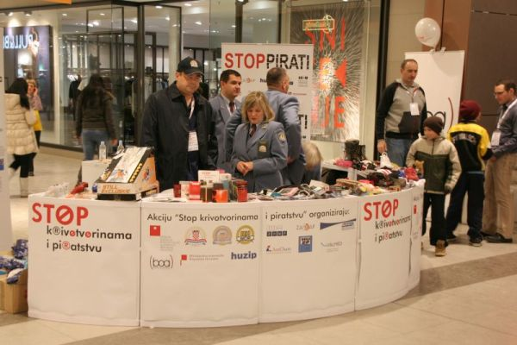
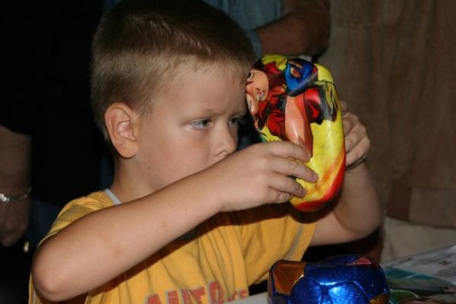
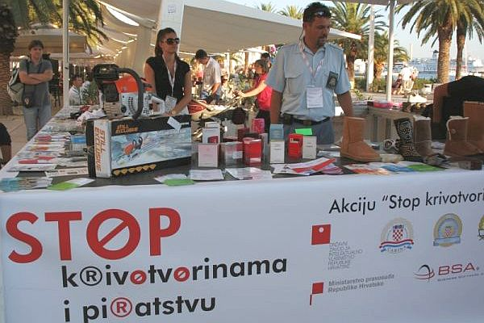
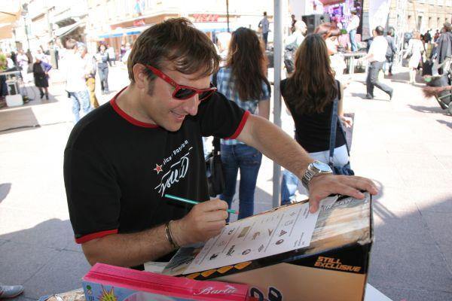
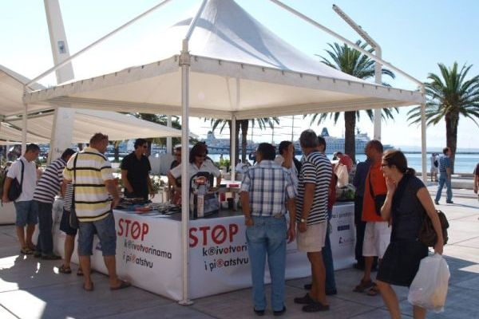
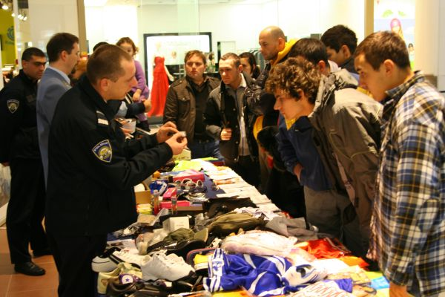
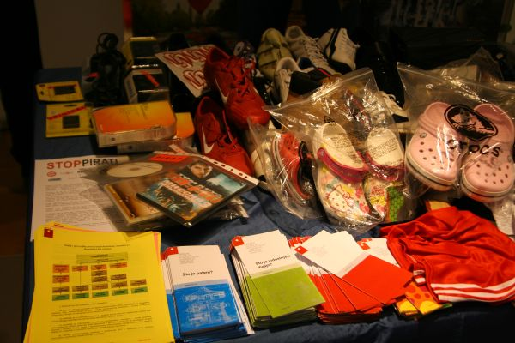
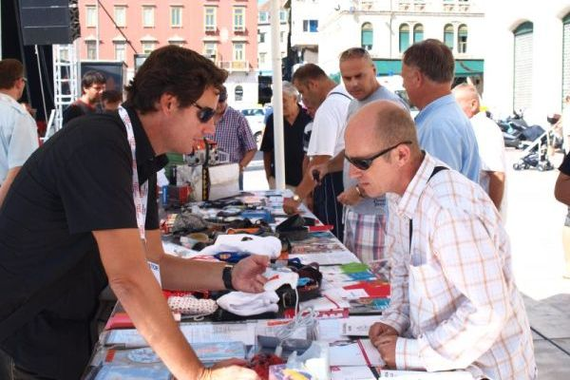
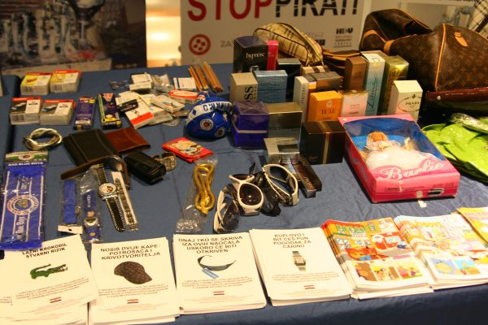
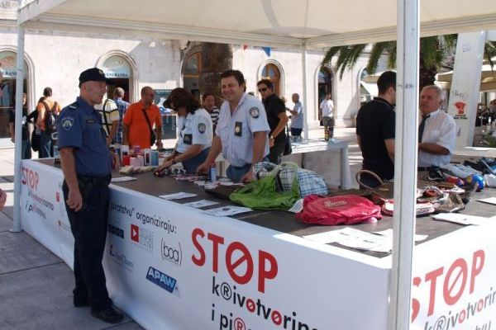
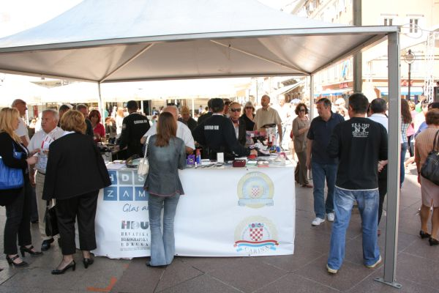
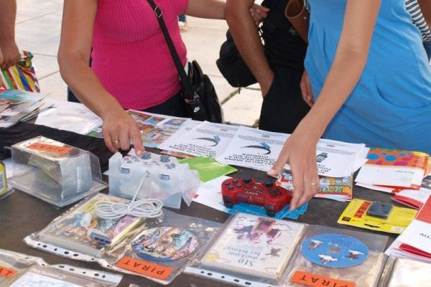
rising public awareness
CROATIAN CUSTOMS EXPERIENCE AGAINST COUNTERFEITING
Notes:
10

Slide 11
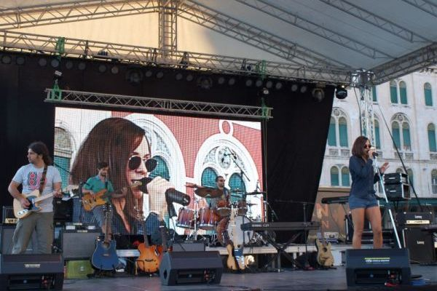
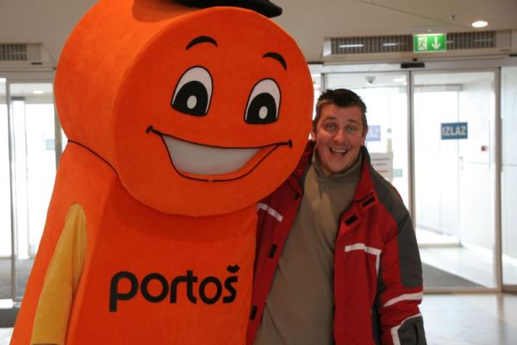
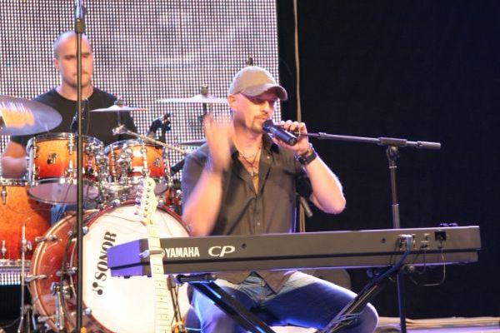
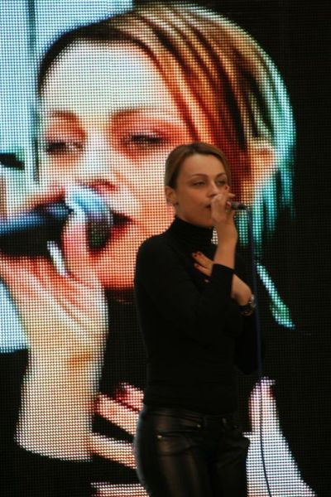
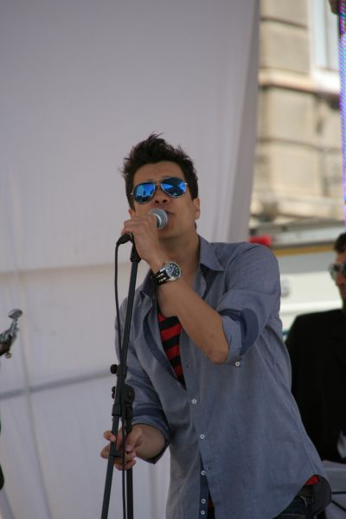
rising public awareness
CROATIAN CUSTOMS EXPERIENCE AGAINST COUNTERFEITING
Notes:
11

Slide 12
cooperation
cooperation between enforcement agencies
cooperation with the industry
exchange of information
more efficient enforcement
better results
CROATIAN CUSTOMS EXPERIENCE AGAINST COUNTERFEITING

Slide 13
contacts
Ministry of Finance of the Republic of Croatia
Customs Directorate – Central Office
Sector for Customs System and Procedures
Service for Trade, Unregistered Business, Charges and IPR
Charges and IPR Department
Zagreb, Alexandera von Humboldta 4a
Fax +385 1 6211 009
www.carina.hr
ipr@carina.hr
Ninoslav Babić
senior administrative advisor
Tel. +385 1 6211 403
Mob. +385 91 3455 004
ninoslav.babic@carina.hr
THANK YOU FOR YOUR ATTENTION!
ANY QUESTIONS?

