Slide 1
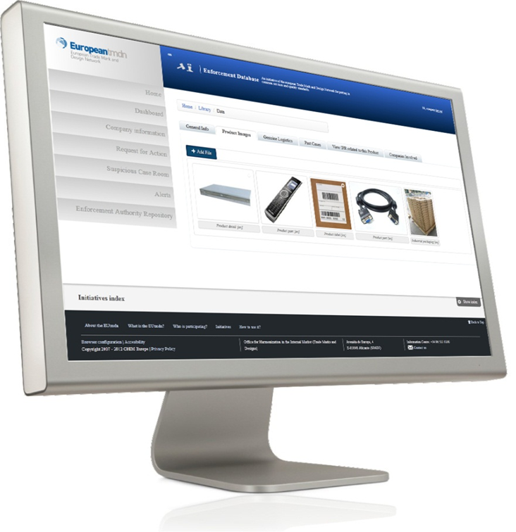
The EU Observatory’s tools for enforcement
EDB
ACIST
Massimo Antonelli
European Observatory on infringements of IP rights
Operations&Projects

Slide 2
Enforcement Database (EDB)

Slide 3
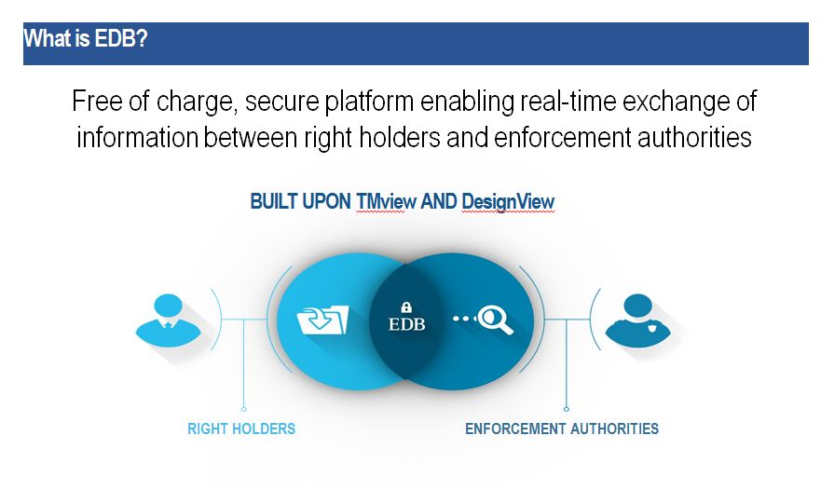

Slide 4
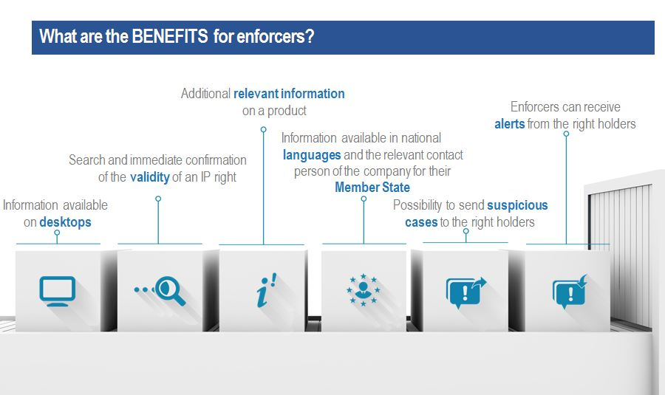

Slide 5
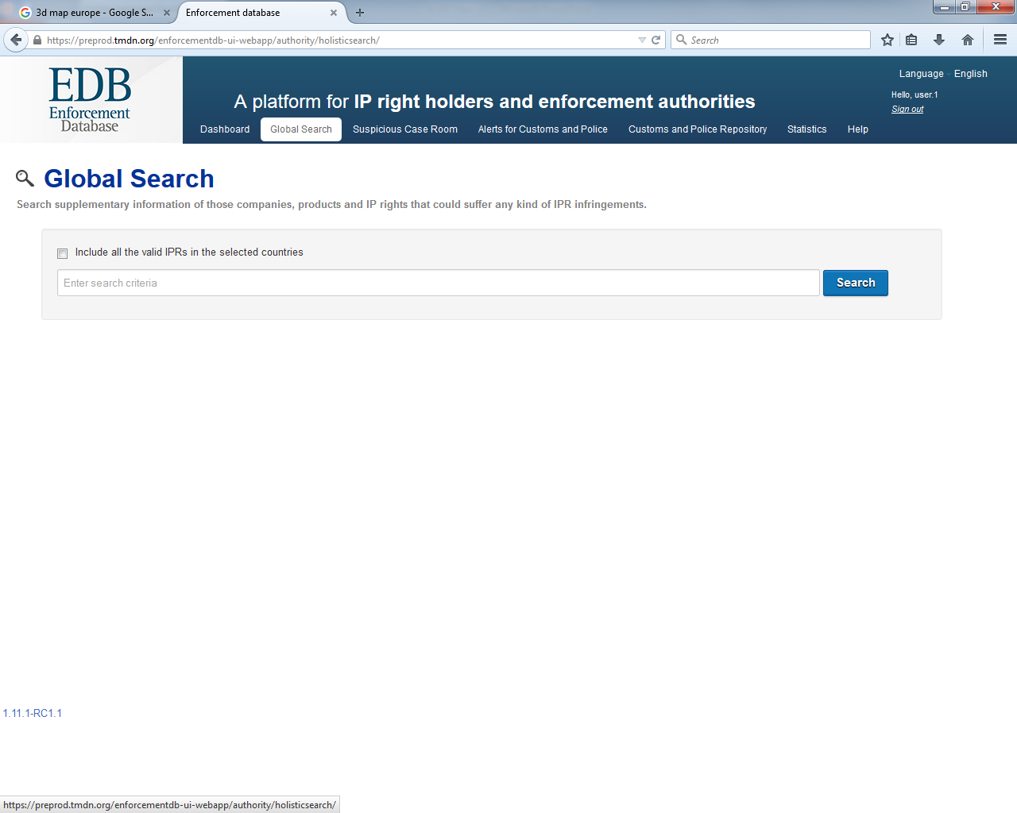
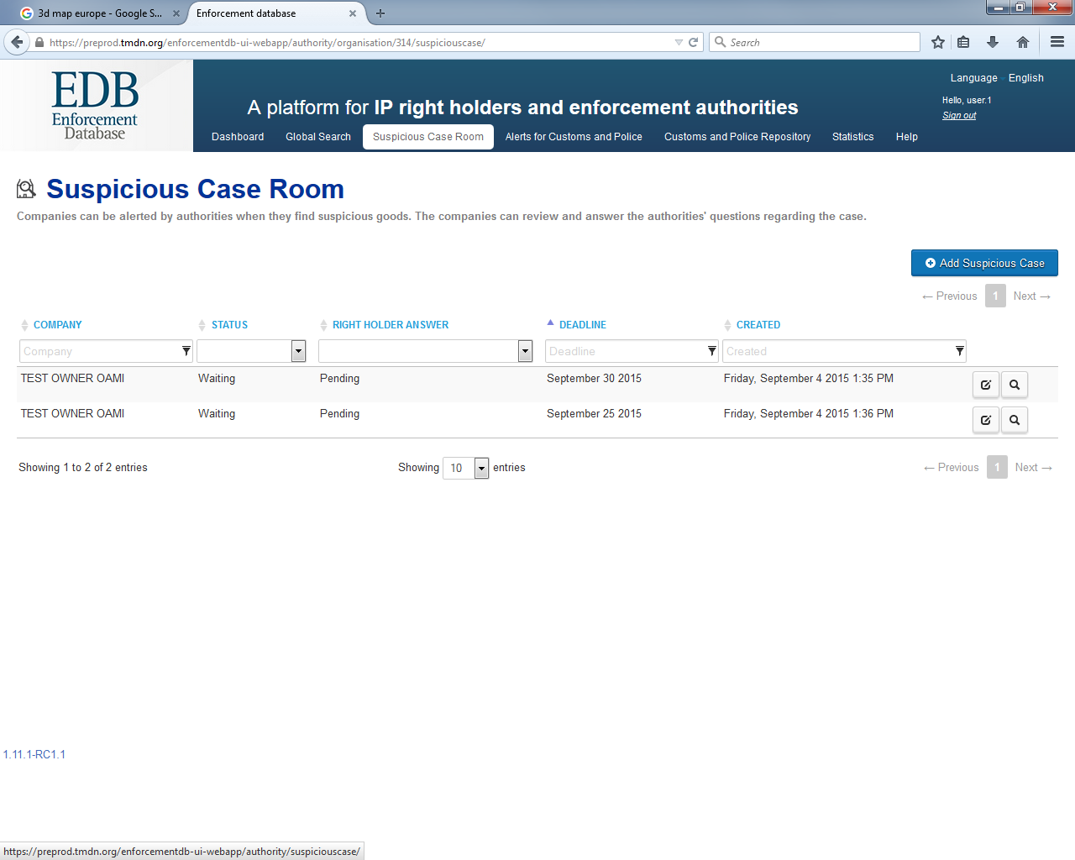
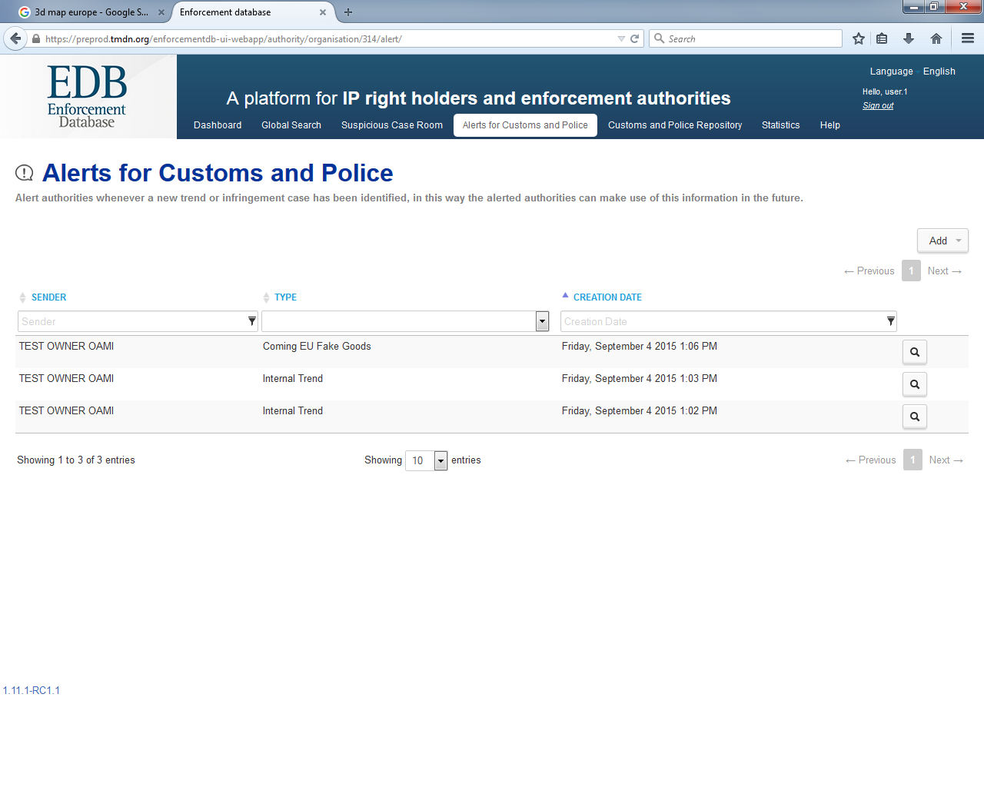
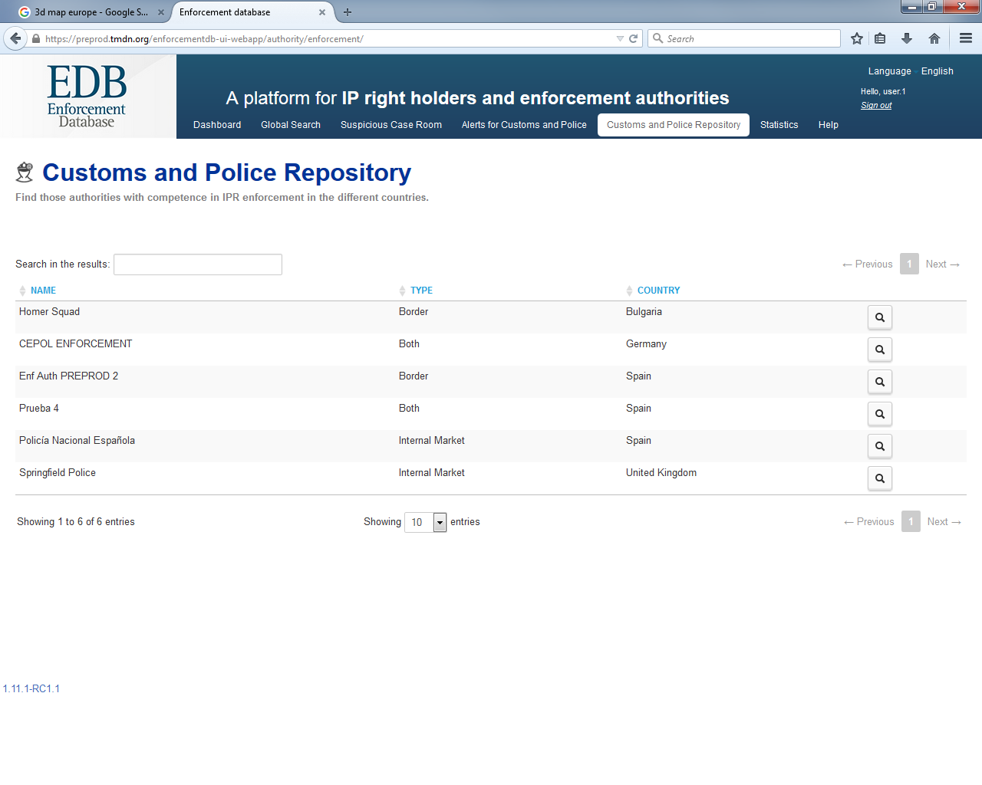
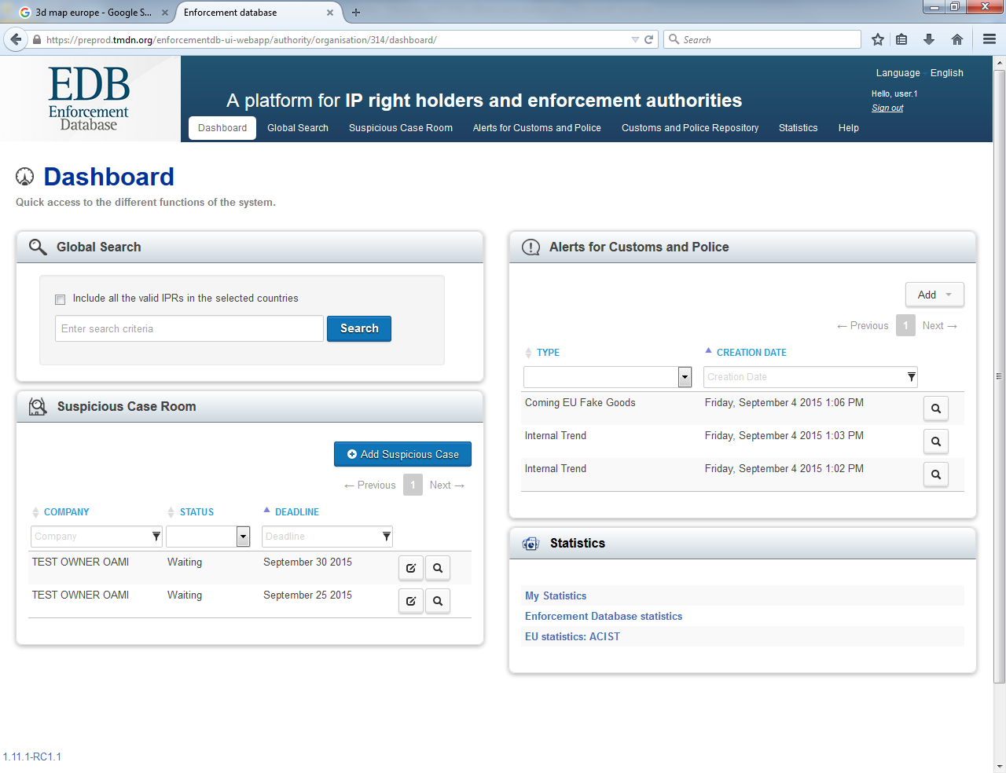
SUSPICIOUS CASE ROOM
ALERTS FOR CUSTOMS & POLICE
CUSTOMS & POLICE REPOSITORY
DASHBOARD
GLOBAL SEARCH

Slide 6
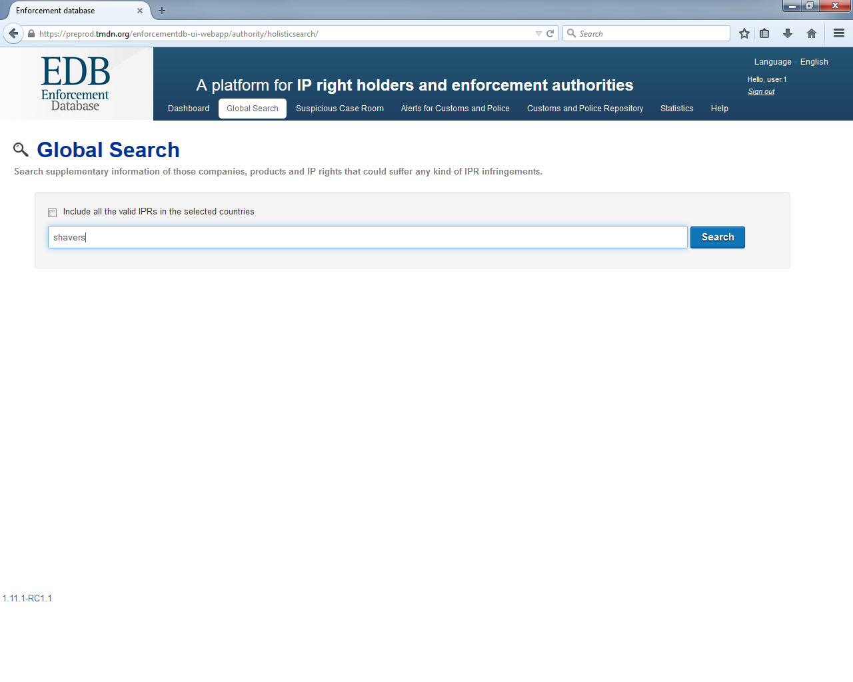
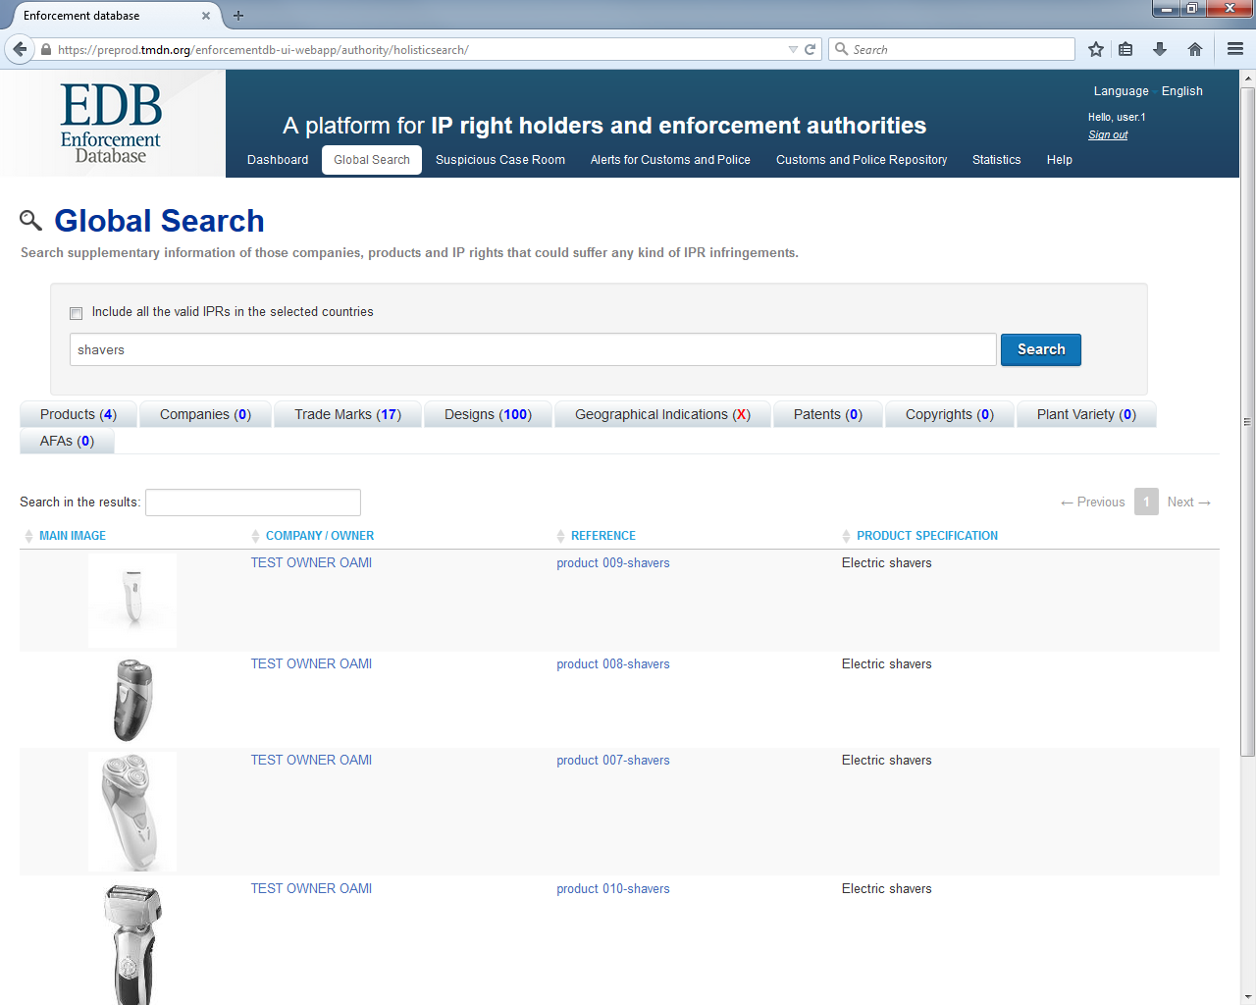
key in a key-word: product category «SHAVER»

Slide 7
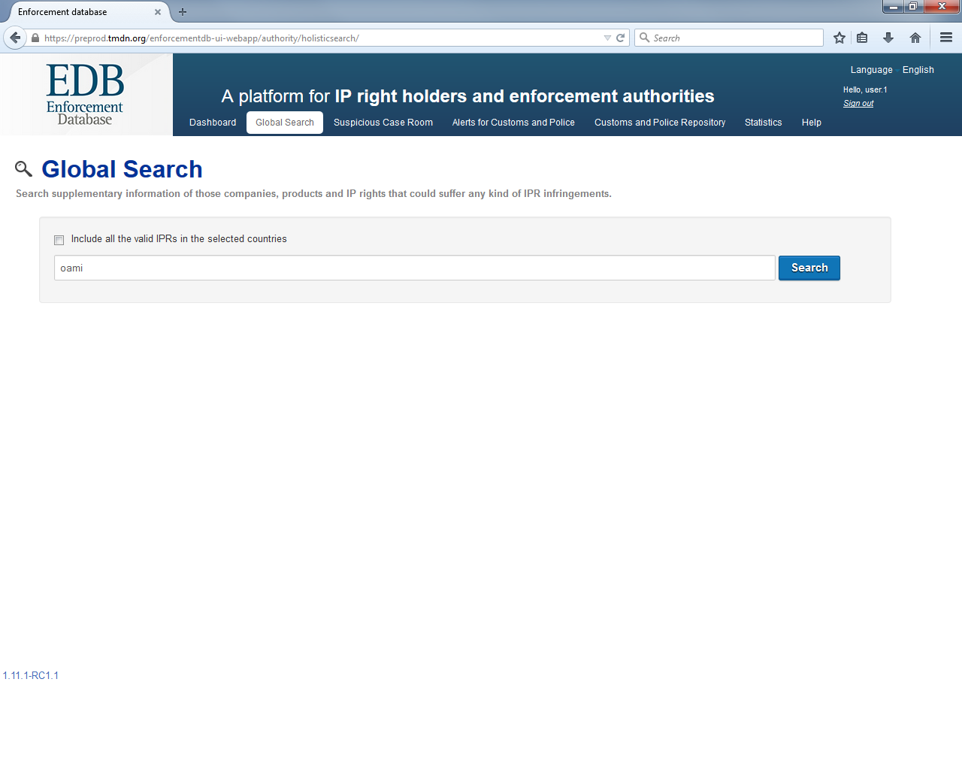
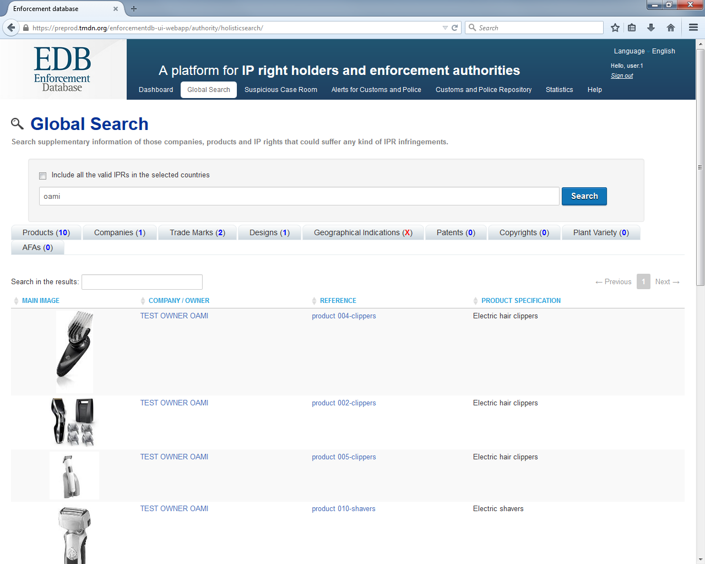
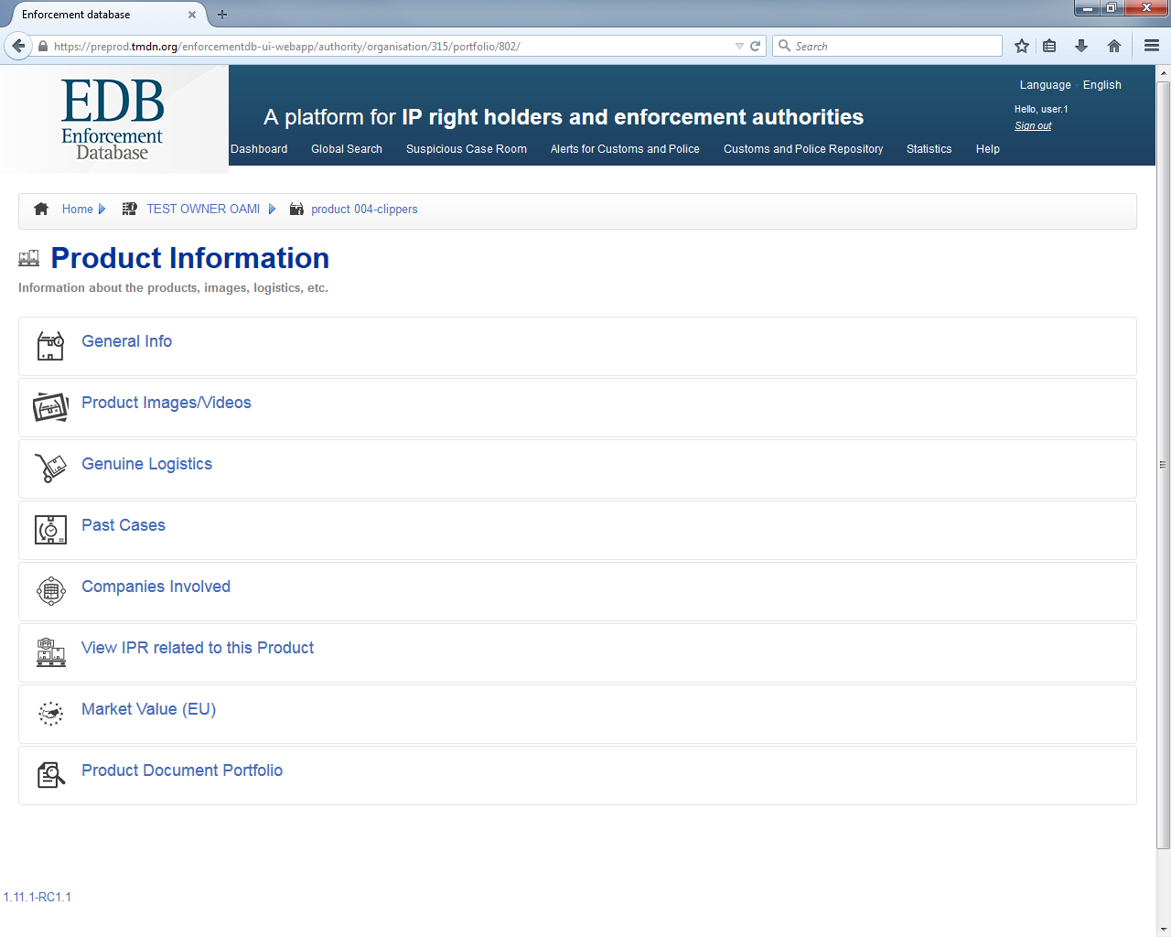
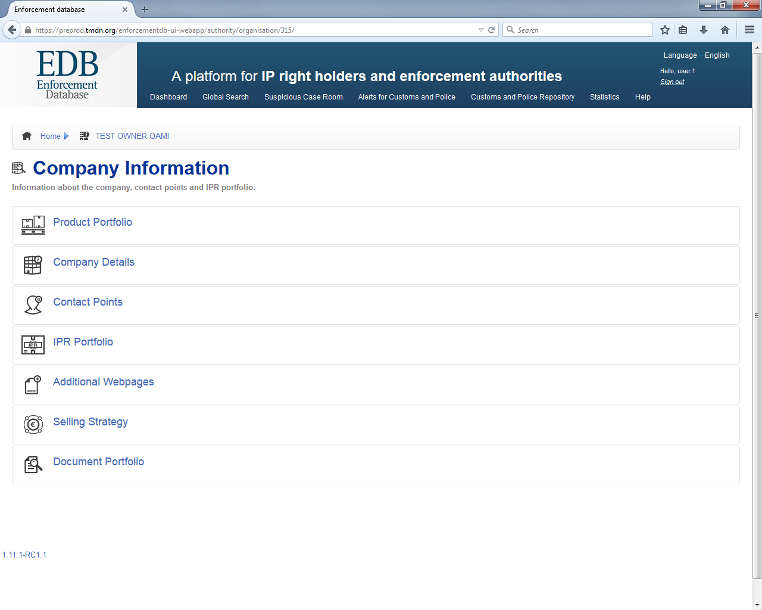
browse to product details…
browse to company details…
key in a key-word: name of company «OAMI»

Slide 8
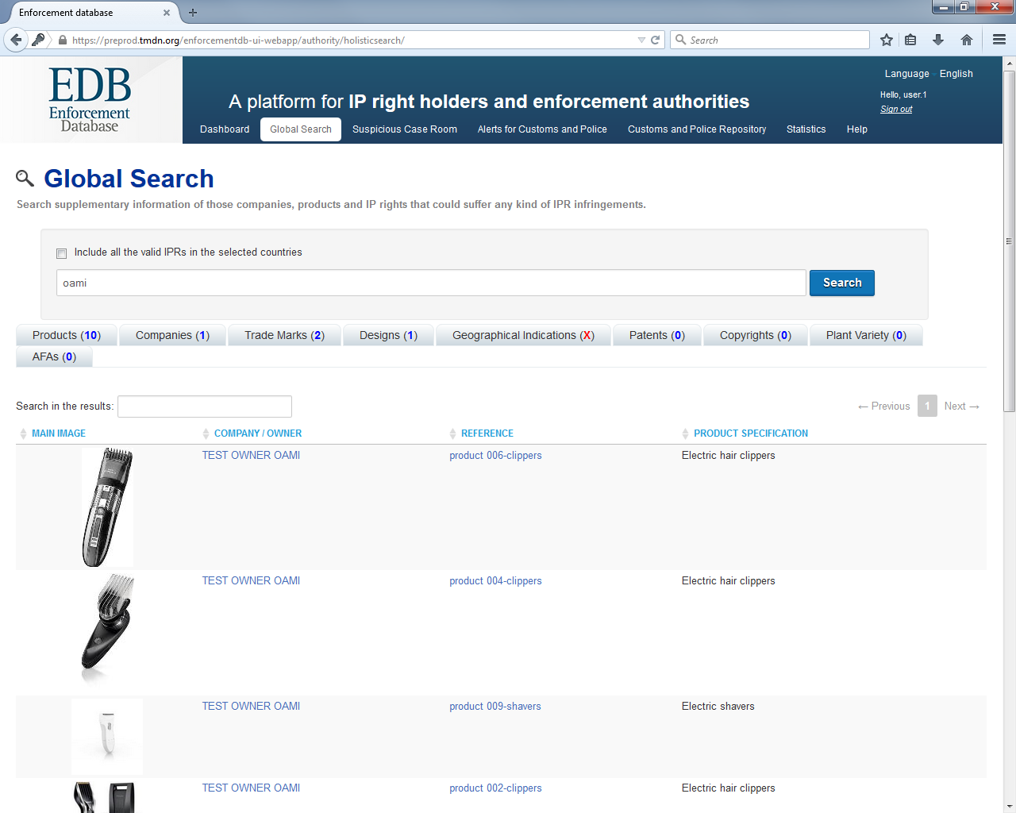
remember
only info which has been disclosed to the logged in authority by the IPR holder is visible;
but TM and rDM are always visible
through the link with the OHIM’s Databases

Slide 9
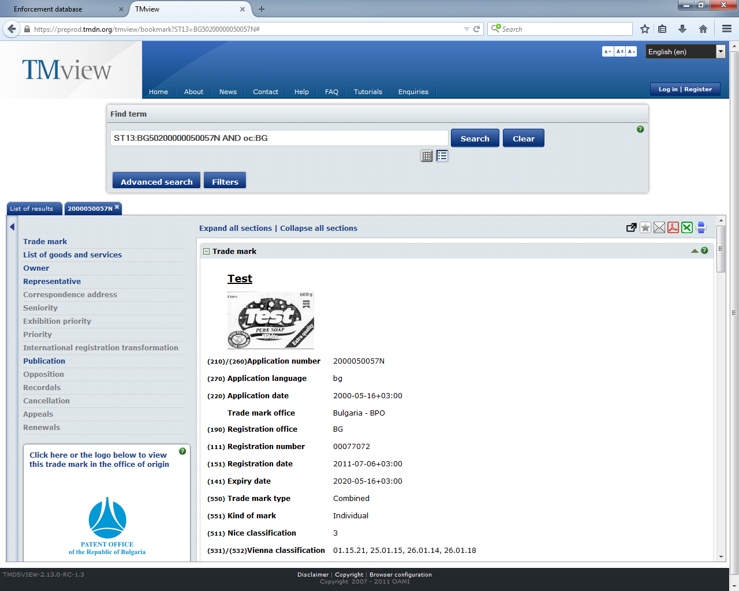
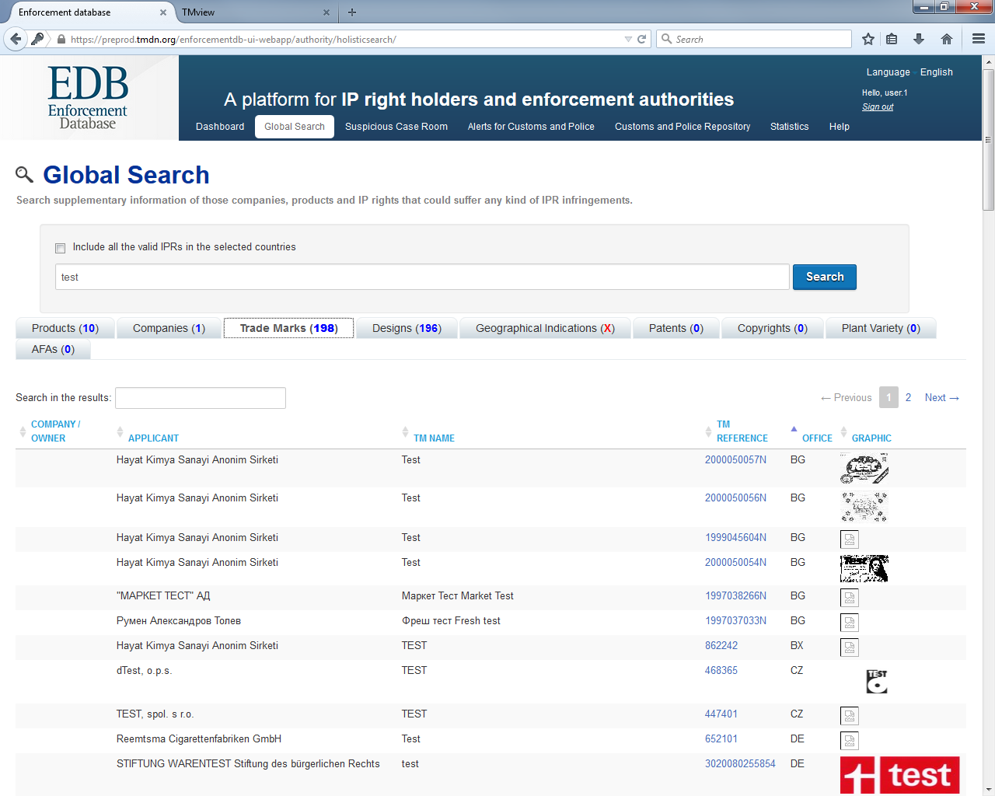
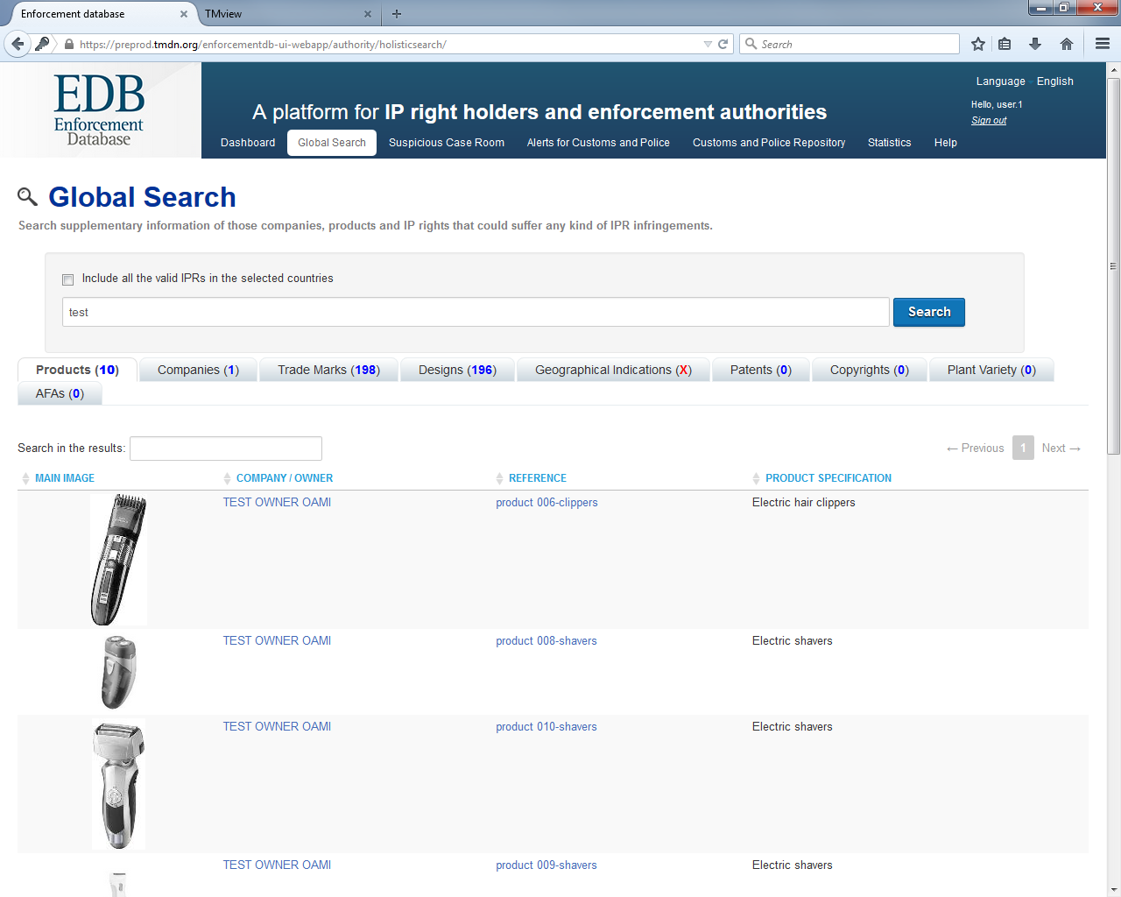
only for training purposes!
check IPR through its ref. number in TMViews
looking for information about IPR

Slide 10
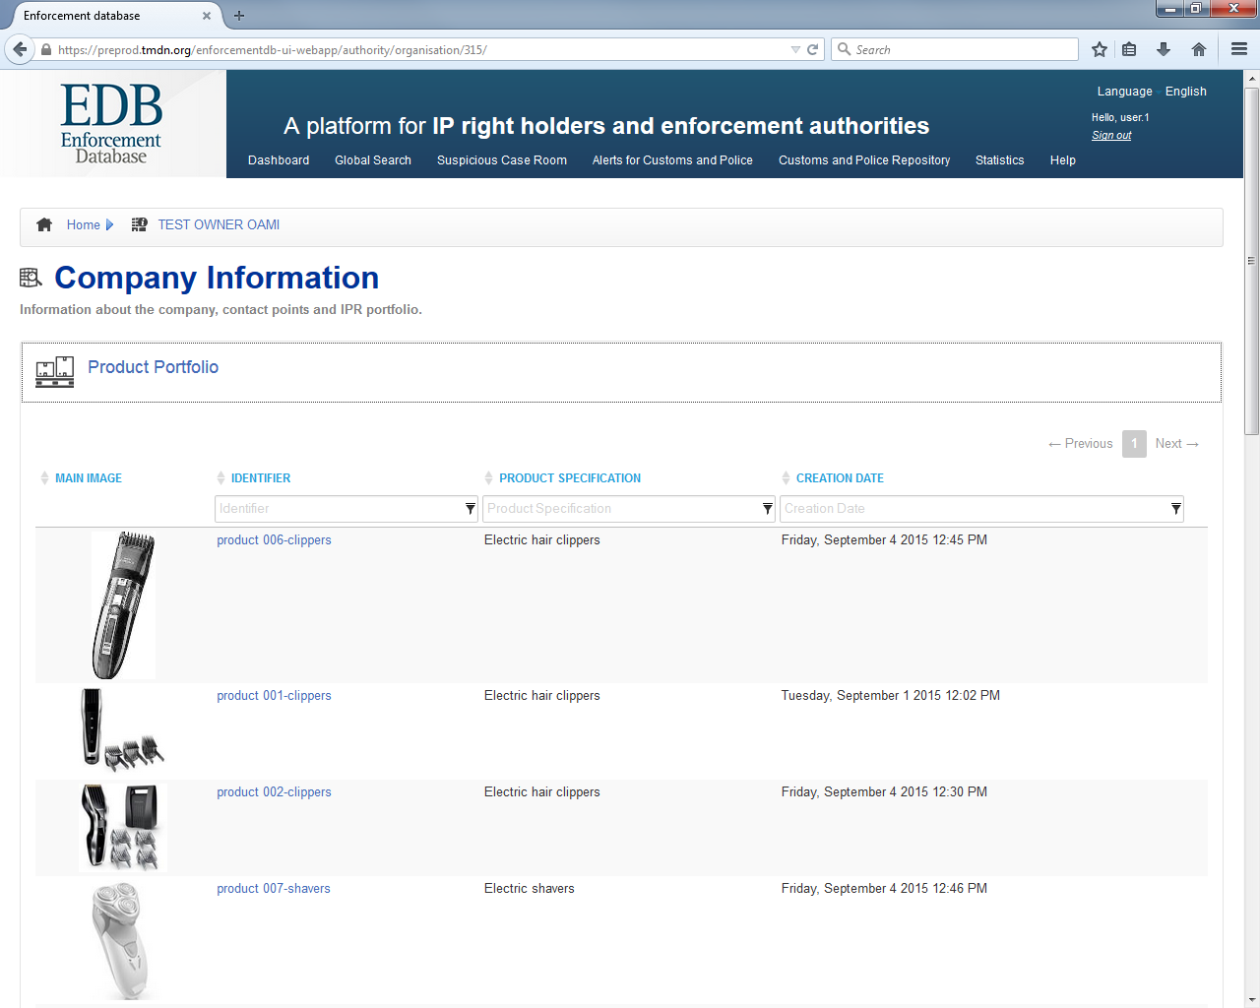
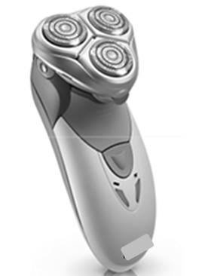
PRODUCT PORTFOLIO
I want to know everything about shaver «007»: click on it
I want to know everything about the company’s products: open its portfolio
product 007- shaver

Slide 11
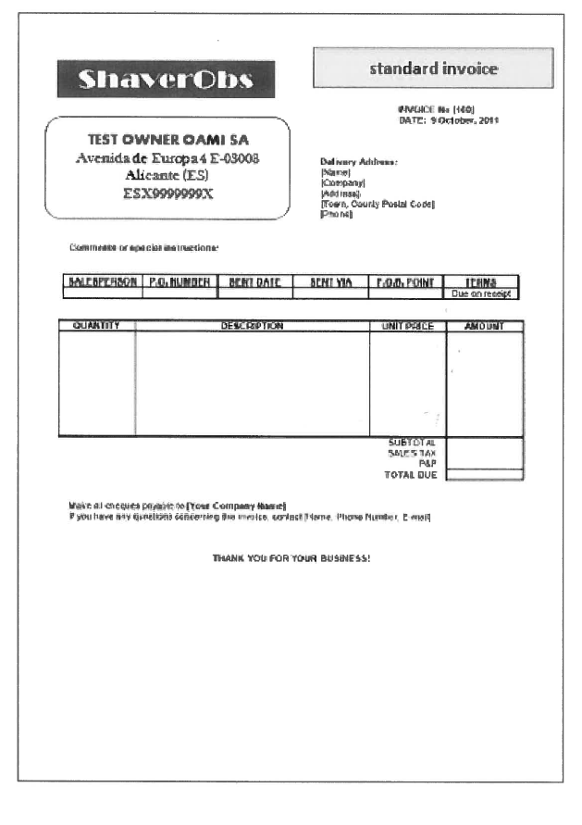
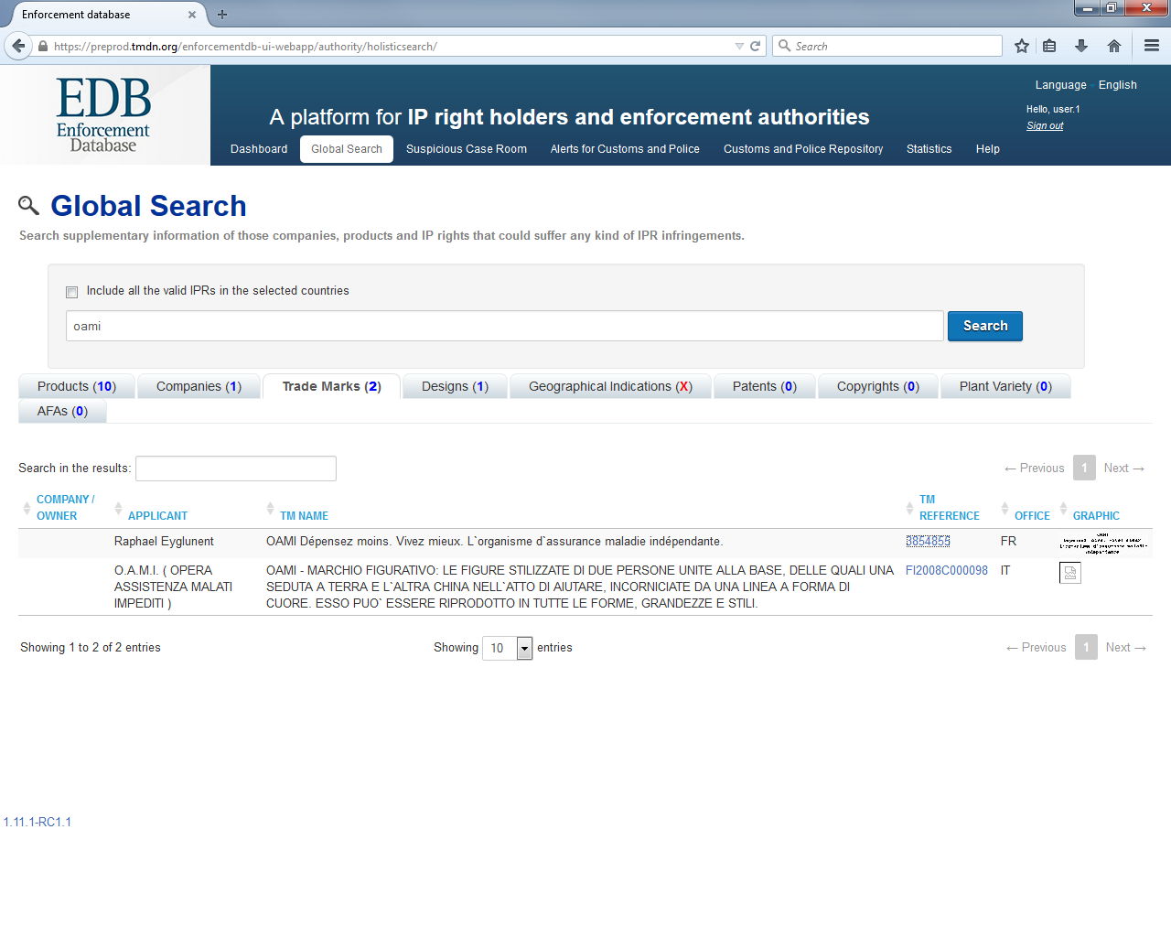
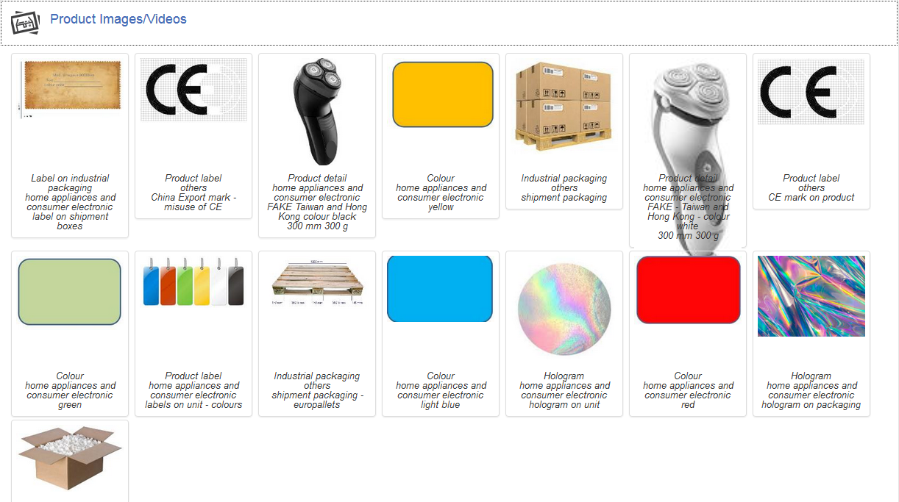
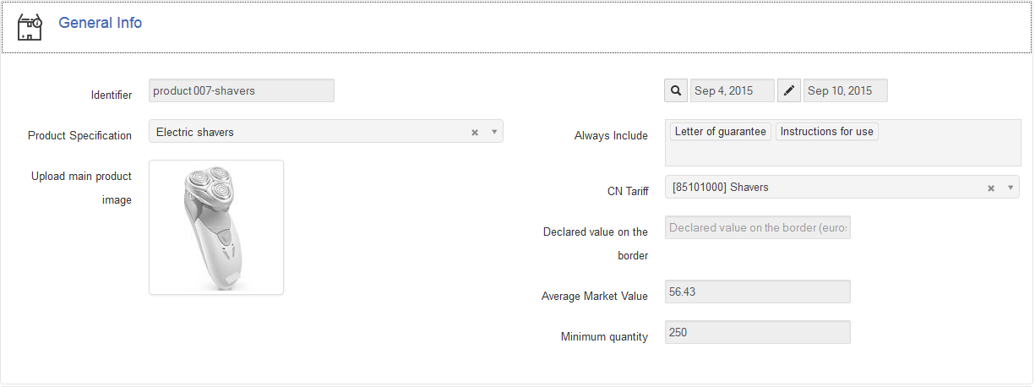
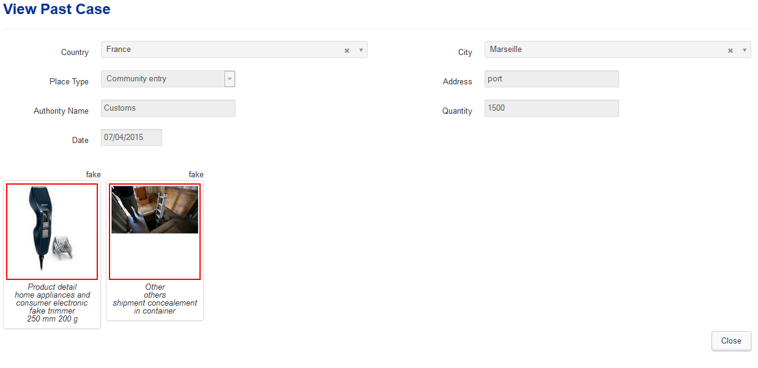
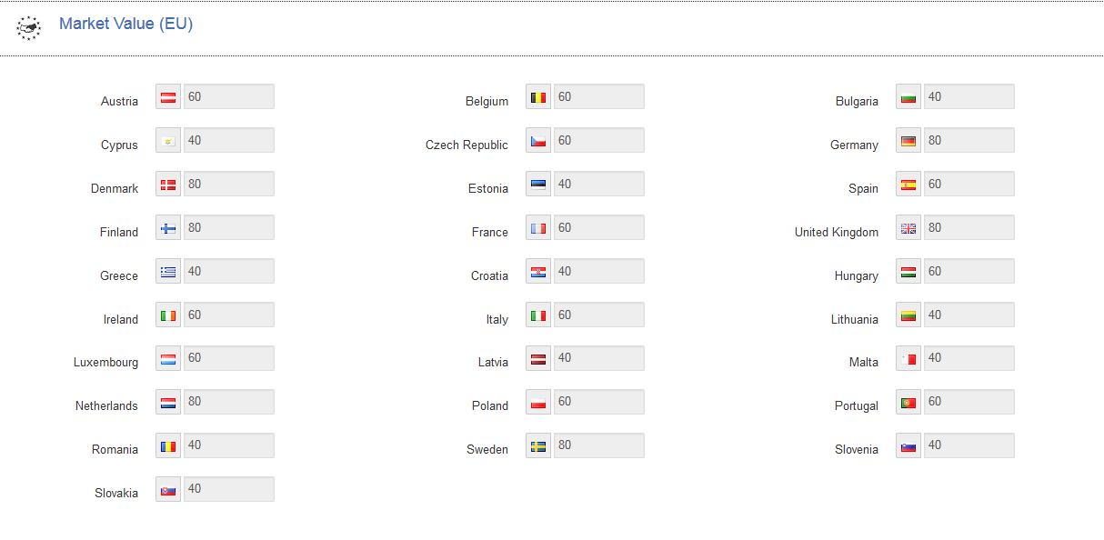
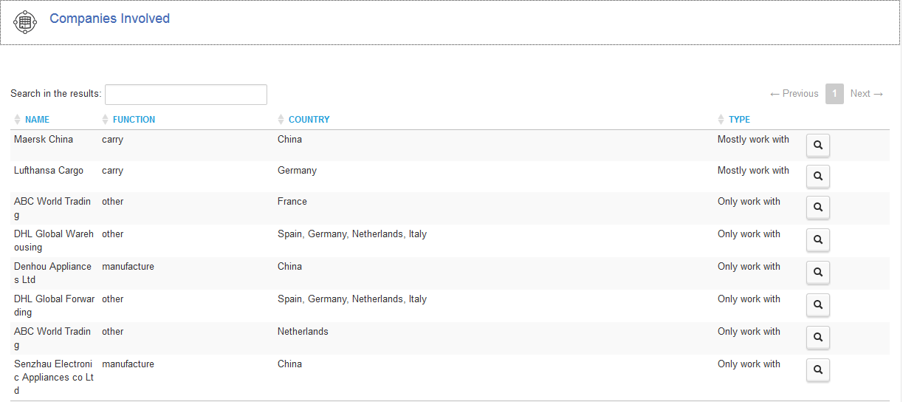
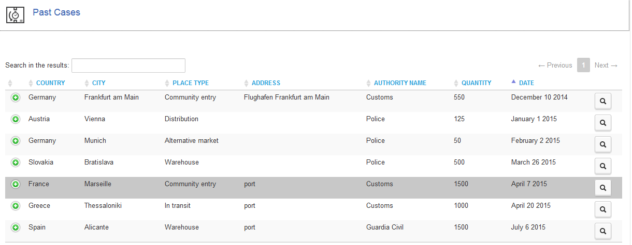
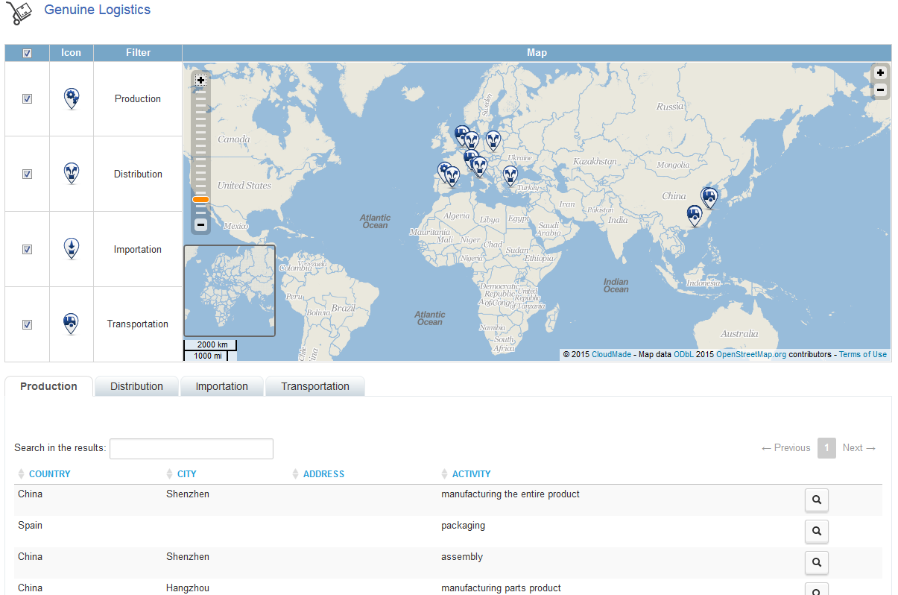
General Info
Product Images/Videos
Genuine Logistics
Companies Involved
Past Cases
Product Document Portfolio
Market Value
only for training purposes!
no heading on the invoice: is it ok? check documents portfolio
is there something more that I should know on the shaver?
is the operation compliant with the regular supply chain?
which are the genuine routes usually followed?
any previous case I should consider?
is the price credible?
is there any IP right related to this product?

Slide 12
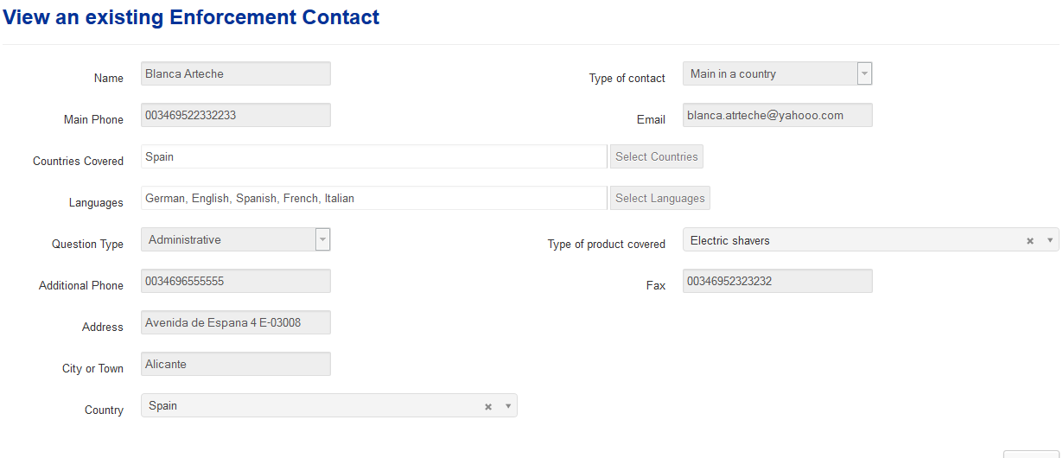
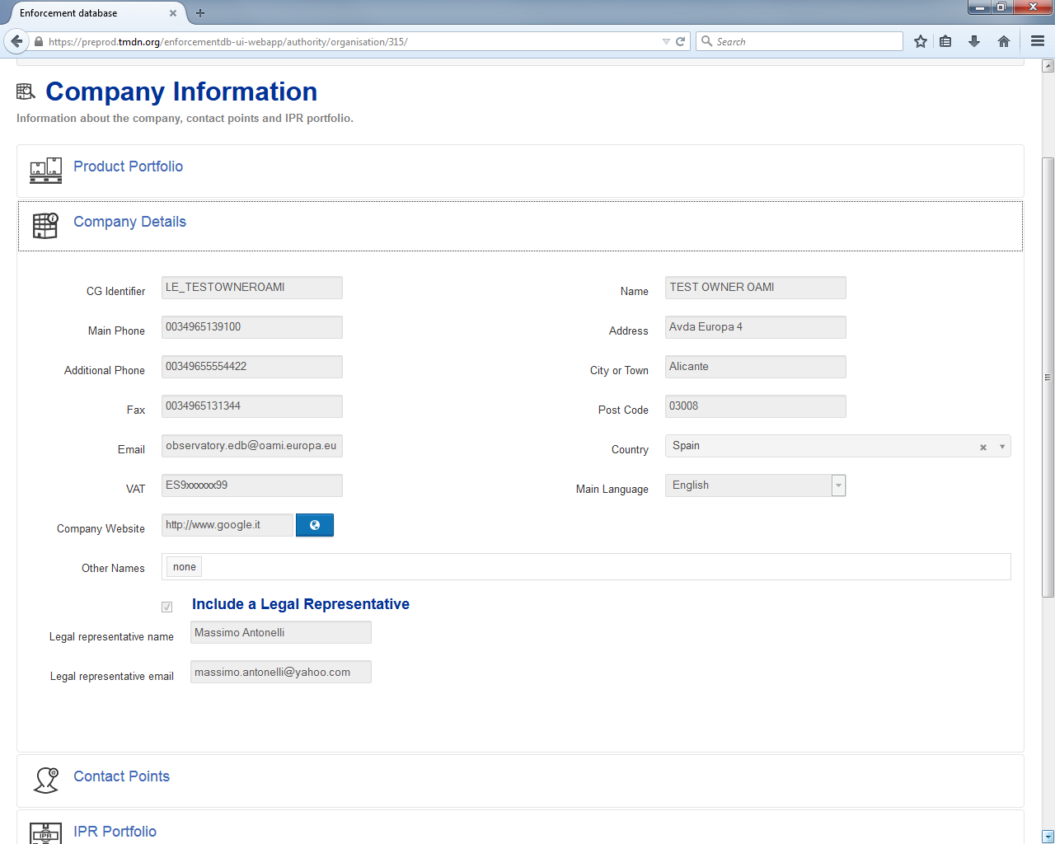
COMPANY DETAILS
CONTACT POINTS
I need to make contact with the company
I am in Spain! who is available here?

Slide 13
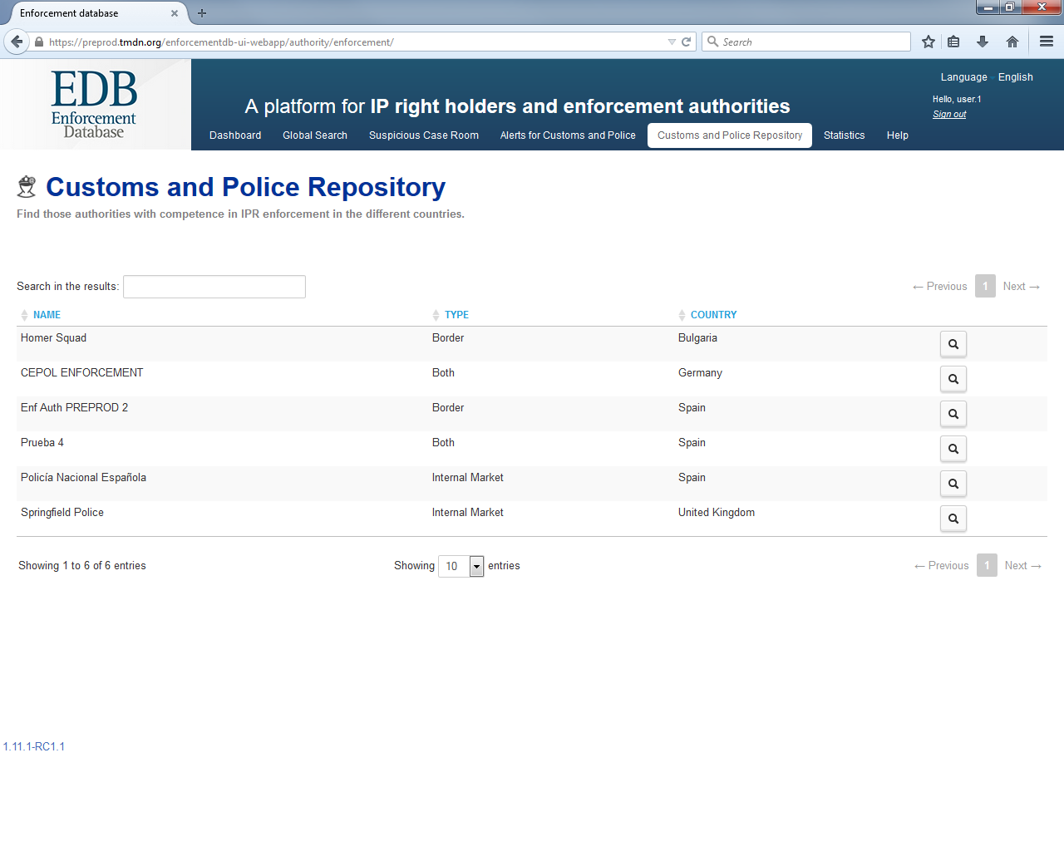
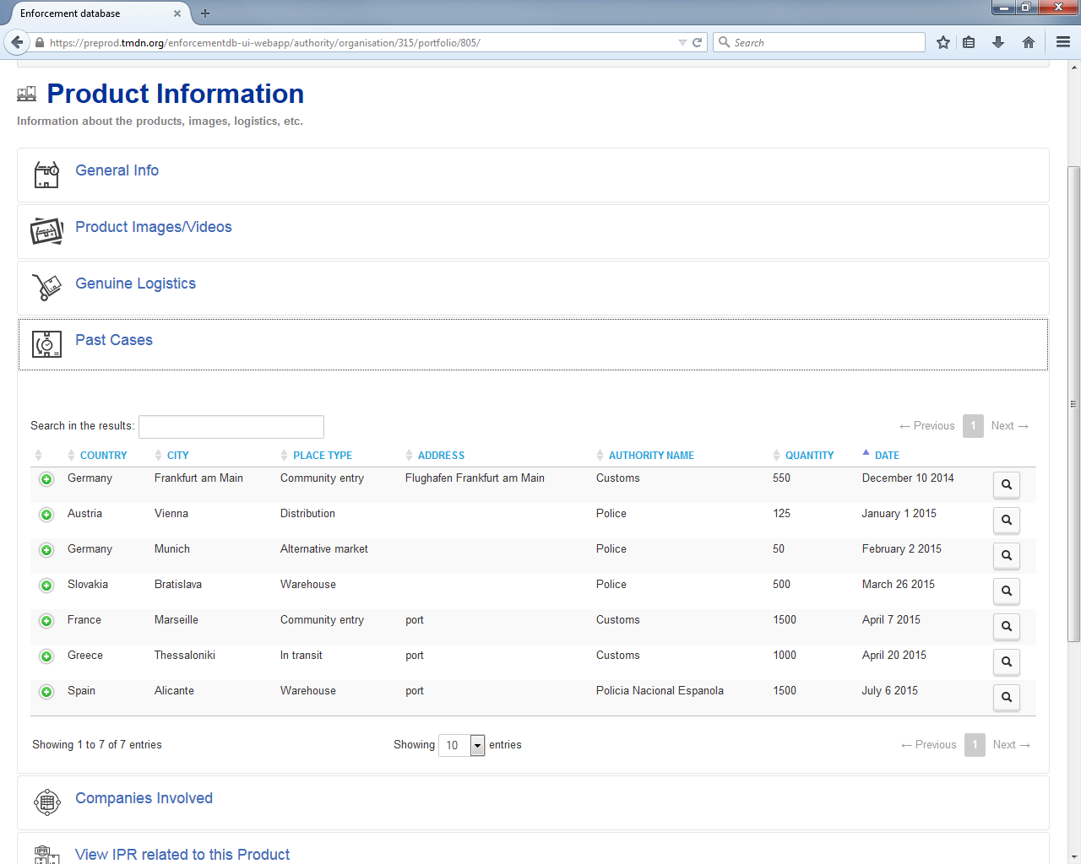
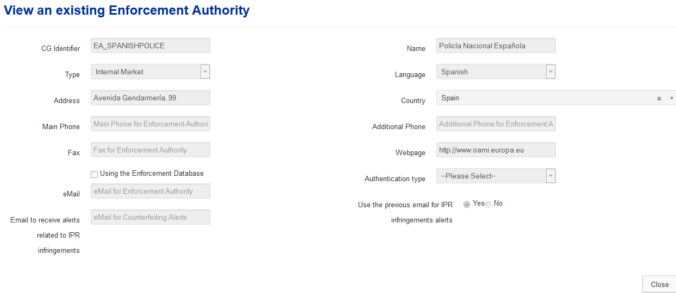
CUSTOMS AND POLICE REPOSITORY
there was a case in Spain: need to know more!

Slide 14
ACIST
ANTI-COUNTERFEITING
INTELLIGENCE SUPPORT TOOL
Providing reliable data to support enforcement

Slide 15
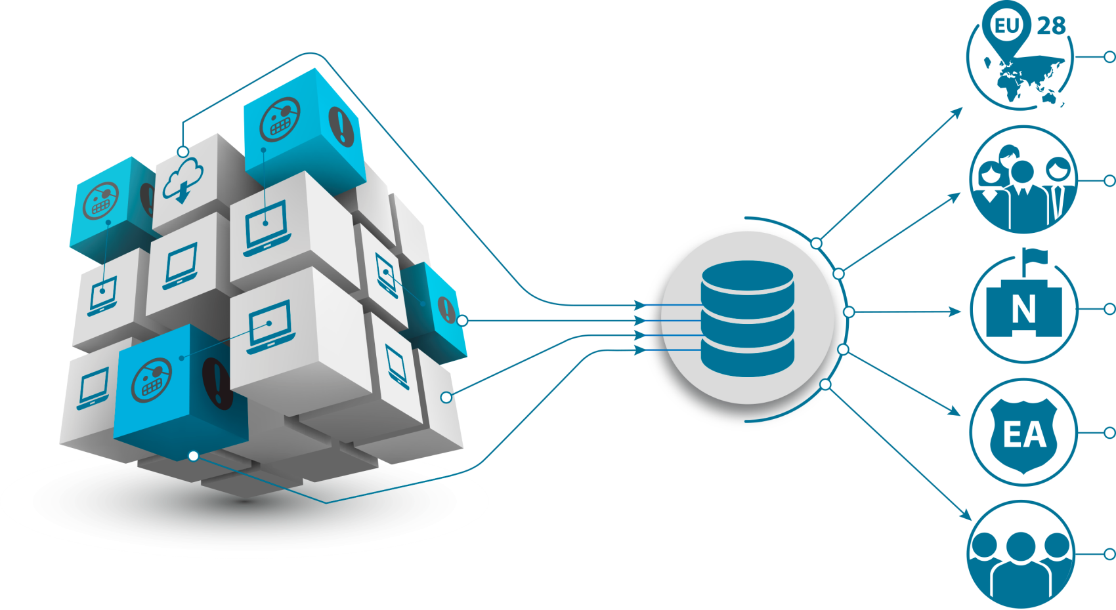
What is the purpose of ACIST?
What?
28 MEMBER STATES
RIGHT-HOLDERS
NATIONAL
IP OFFICES
ENFORCEMENT
AUTHORITIES
GENERAL
PUBLIC
Notes:
It is a tool to provide available, reliable and comparable data on seizures of counterfeit goods in the EU, both at the borders and in the internal market.
This data collection is made available to a number of different subjects differently pinvolved in comabting counterfeitng:
MS LEAs, Customs and Police
Other public bodies
Private stakeholders
Whoever can be interested in the data for the business interest and for policy making.

Slide 16
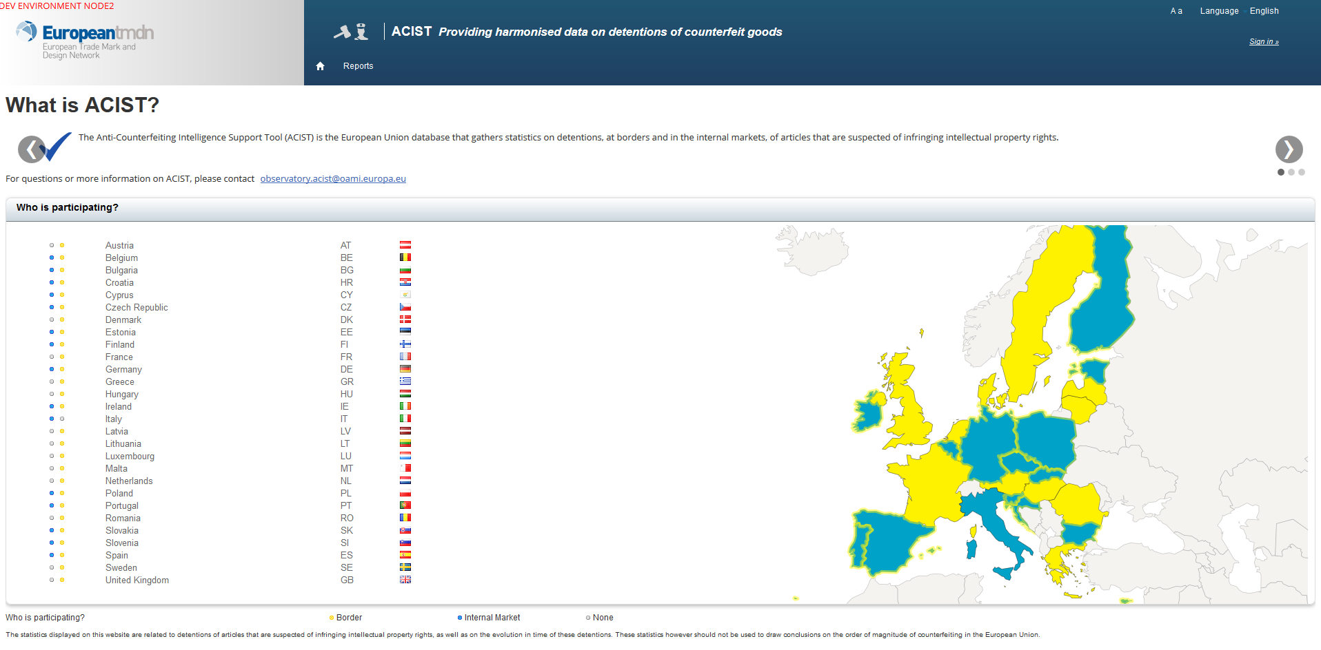
Who is on ACIST?
Notes:
All Customs of the 28 MS are present in ACIST and an increasing number of Police authorities are coming on-board.
From this dashboard, the user can immediately selcect which is the Authorities whose data he/she is interested to. Or the same selection can be done in the relevant section.

Slide 17
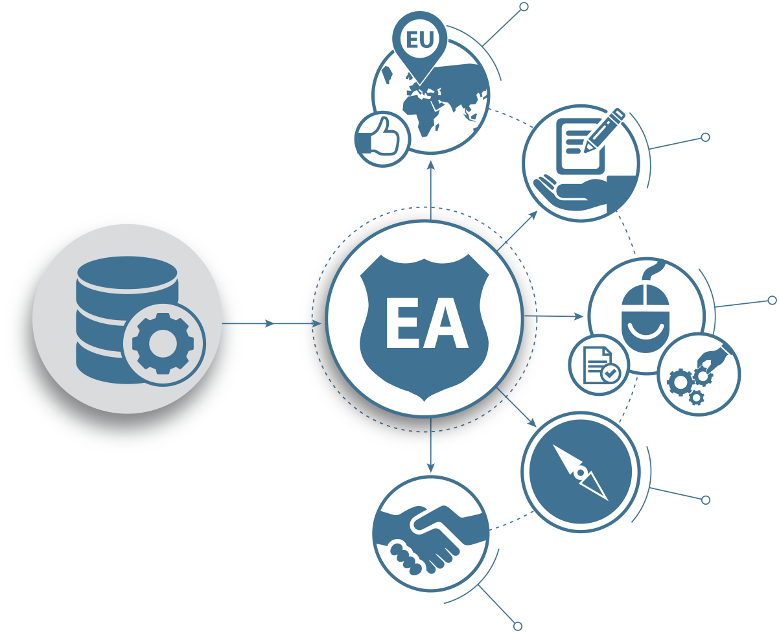
Which are the benefits for Enforcers?
Identification of best practices for data collection in 28 Member States
Reliable and independent data for policy-making
User-friendly tool for registration and management of own detentions
Tool for planning of detention strategy (goods routing, trends, etc.)
Enabler for cross-border and inter-agency coordination and cooperation
Notes:
Only mentioning:
Have a complete view on both what is seized in importation and what is seized in the internal market and who is doing what.
It is a tool to analyse goods routing and trends, and therefore to plan control activities
It is a tool to support inter-agency cooperation through exchange of data on seizures, to foster cooperation
It can provide to police a support to easy collection and reporting of data in daily work.

Slide 18
ACIST in practice
How to consult detentions Reports?
How to upload detentions Reports?

Slide 19
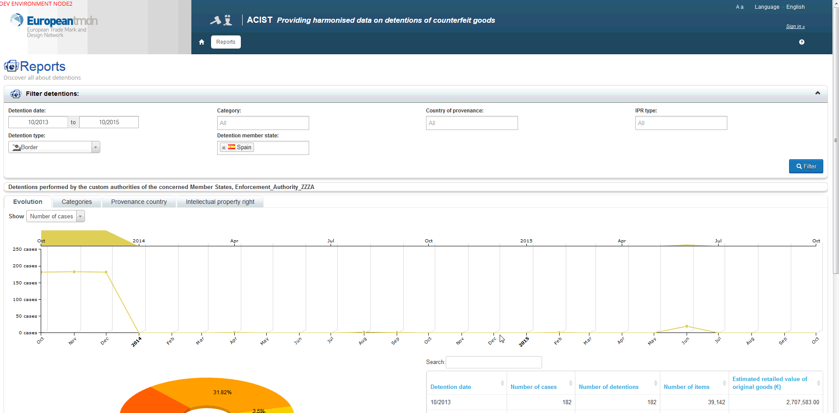
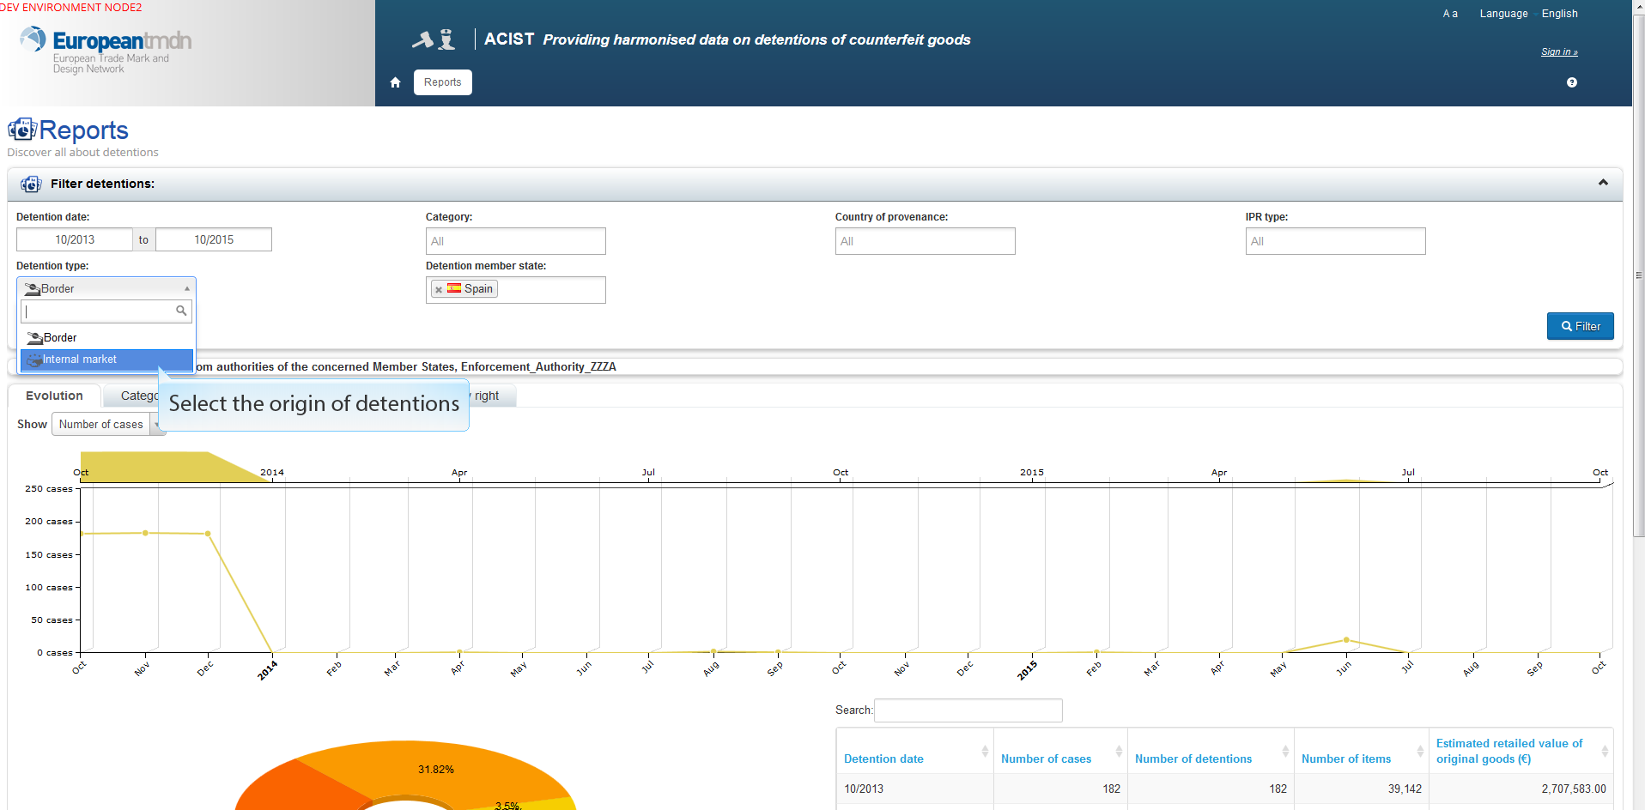
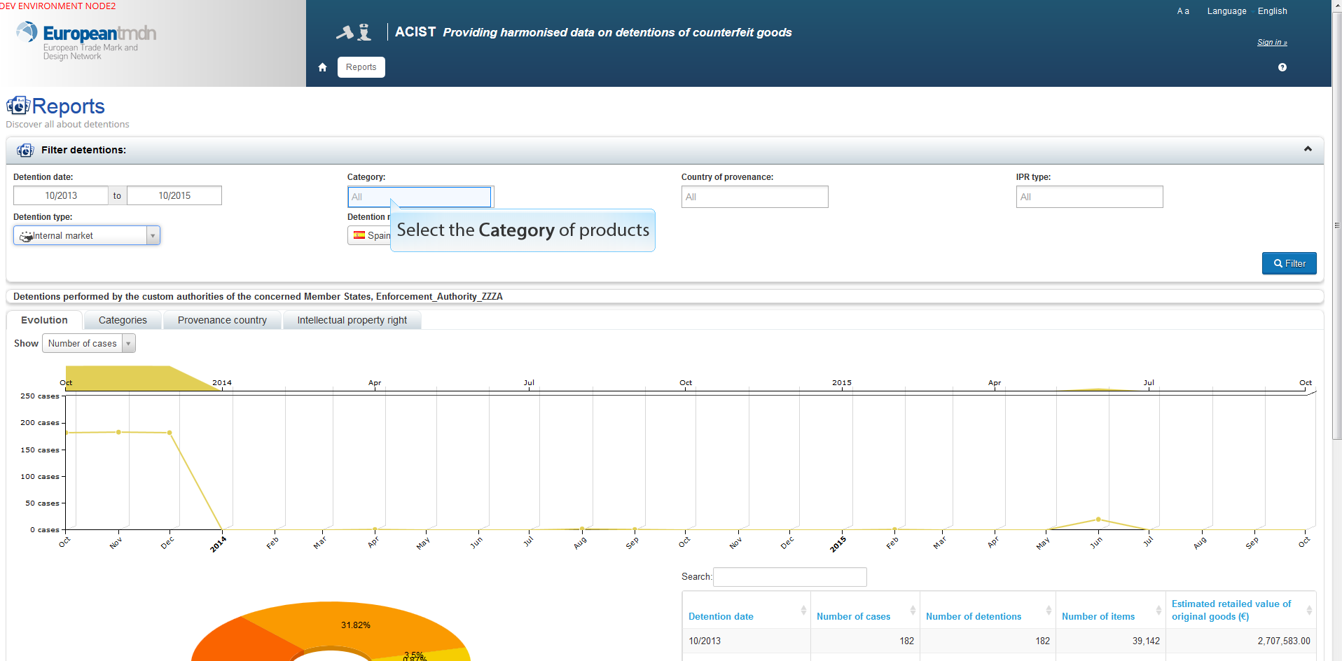
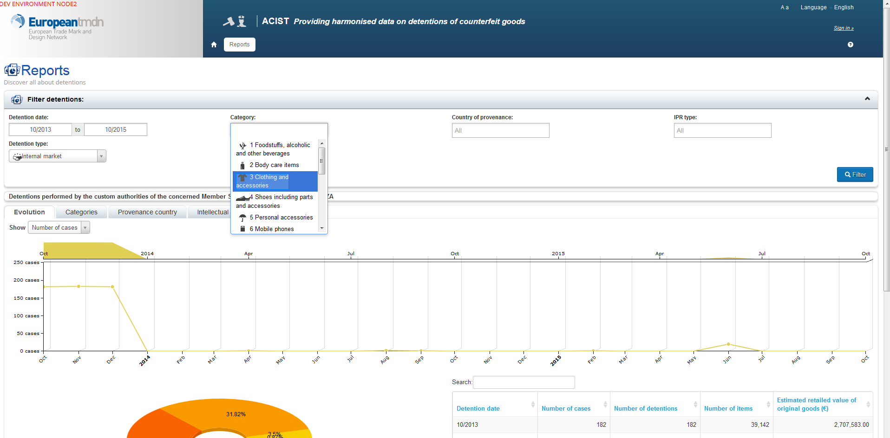
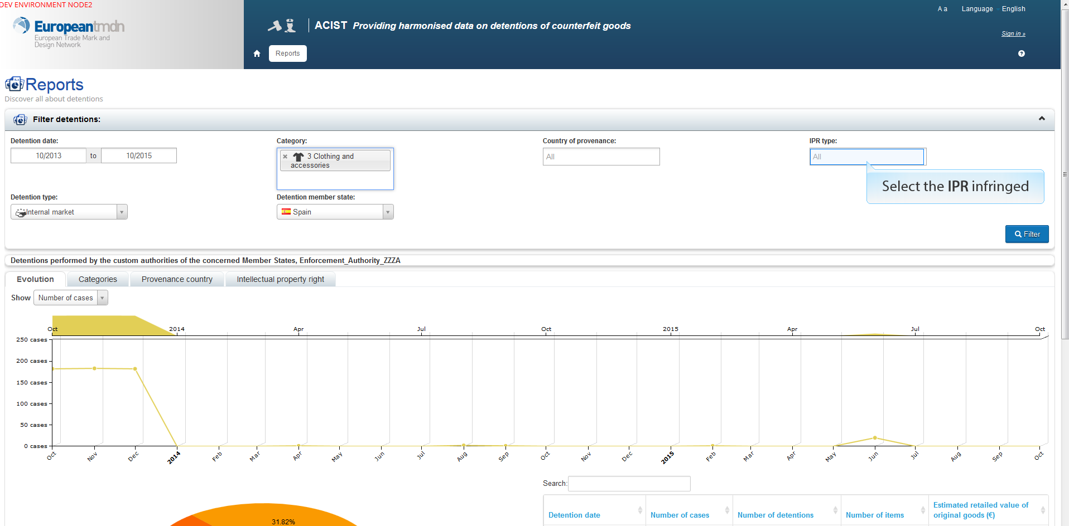
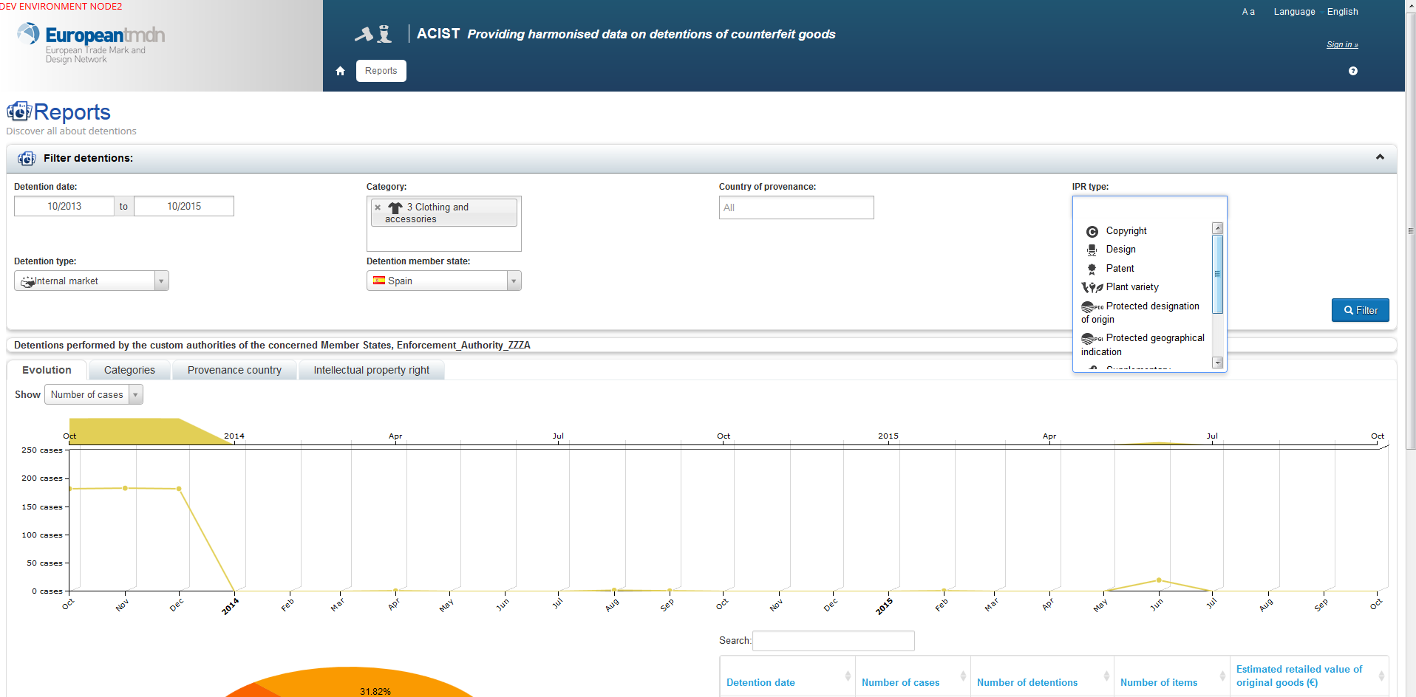
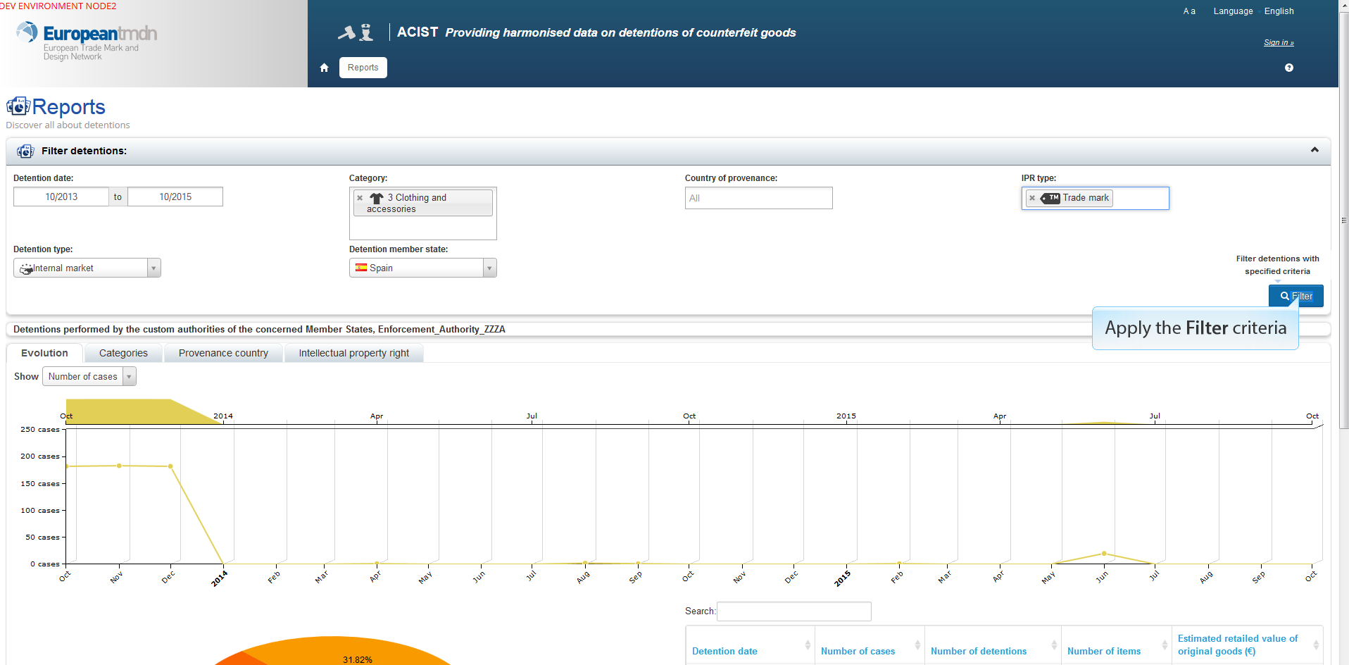
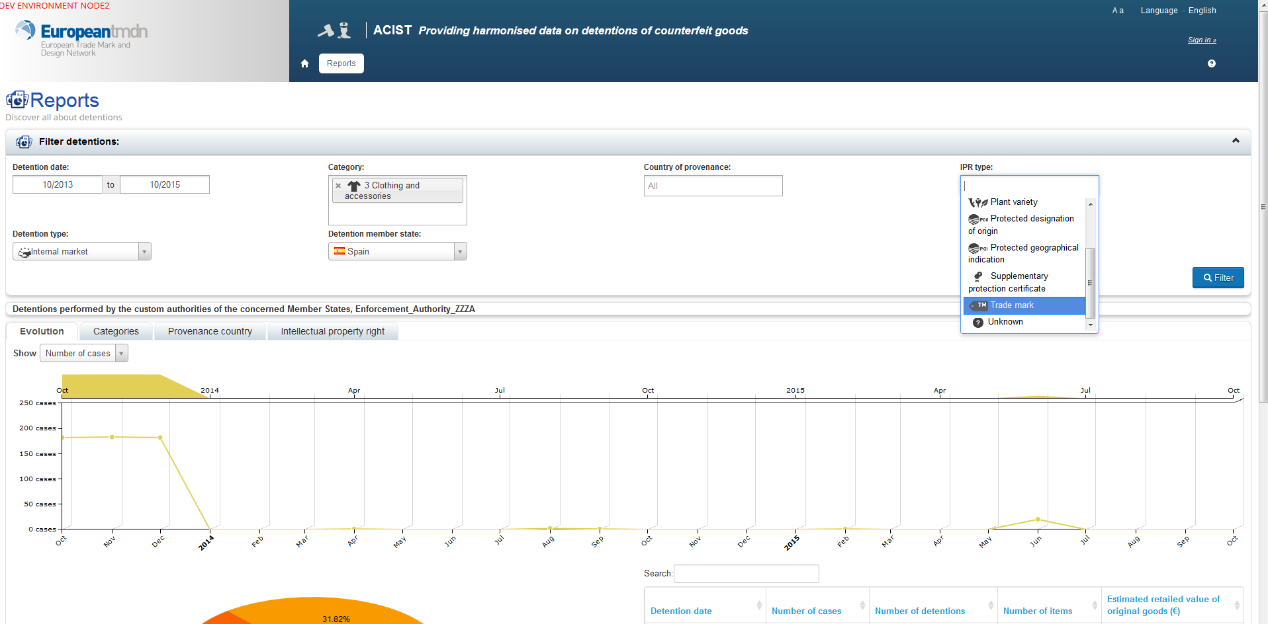
How to consult ACIST: start with filtering the detentions
Notes:
It is easy and user-friendly.
A mask appear, where simply you have to fill in the filters criteria, in order to make your own searc on the data uploaded in ACIST.
First steps: don’t forget to select a time frame and the LEA you are interested in, if you hav not yet entered the system selecting one aujtority (as shown before)
The complete the search criteria with:
The place of detentions you want di know (info that coincides with the type of sezizures carried out, whether at the EU borders or in the internal market
You can selct the product category in the relevant field. A drop-down menu appears, in order to avoid typing mistakes, and you can select among a first general classification of producst (TAXUD classification). More than one can be selected. We will see later that there is the possibility to make the products category search more detailled.
You can select one or more IPR in the relevant field
Now you can apply the filter and make the search

Slide 20
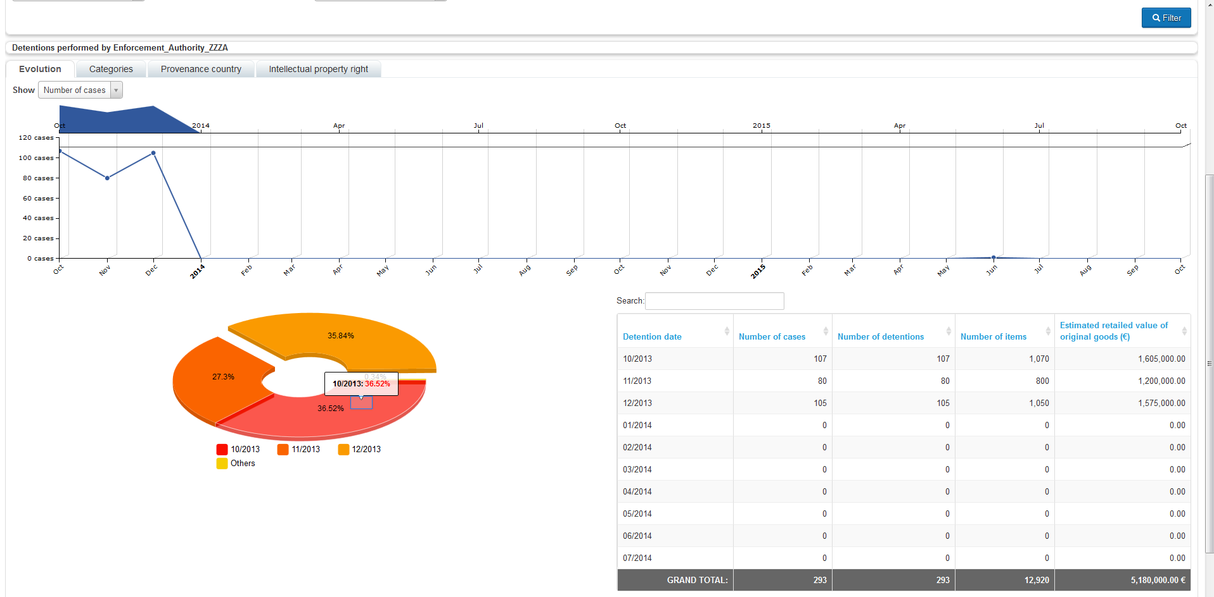
How to consult ACIST: look at the results
evolution of seizures
Notes:
And this is what you get from the research
Outcomes are by default shown under the tag EVOLUTION, showing how the searched seizures are distributed in the time period that has been selected. The results are displayed in an horizontal chart, in a cake chart and on the right in a table where they are detailed per:
Detention date
Number of cases
Number of detentions
Number of items seized
Economic retail value in the domestic market
In the chart, the number of cases is reported on the scale placed on the left axis of the chart, while on the horizontal axis the time frame is indicated

Slide 21
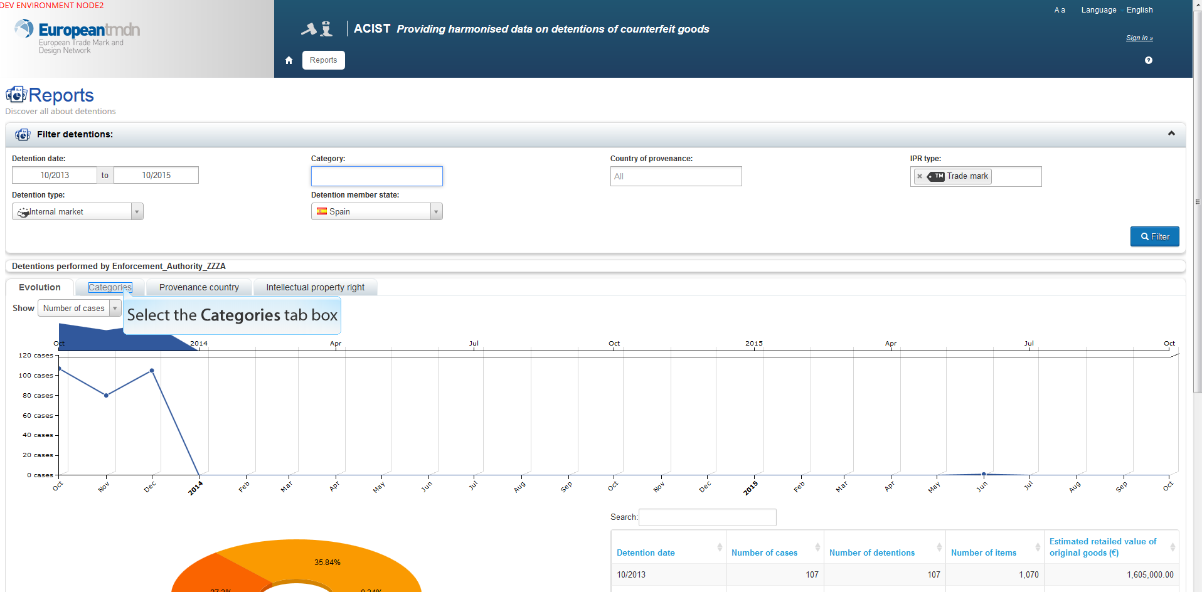
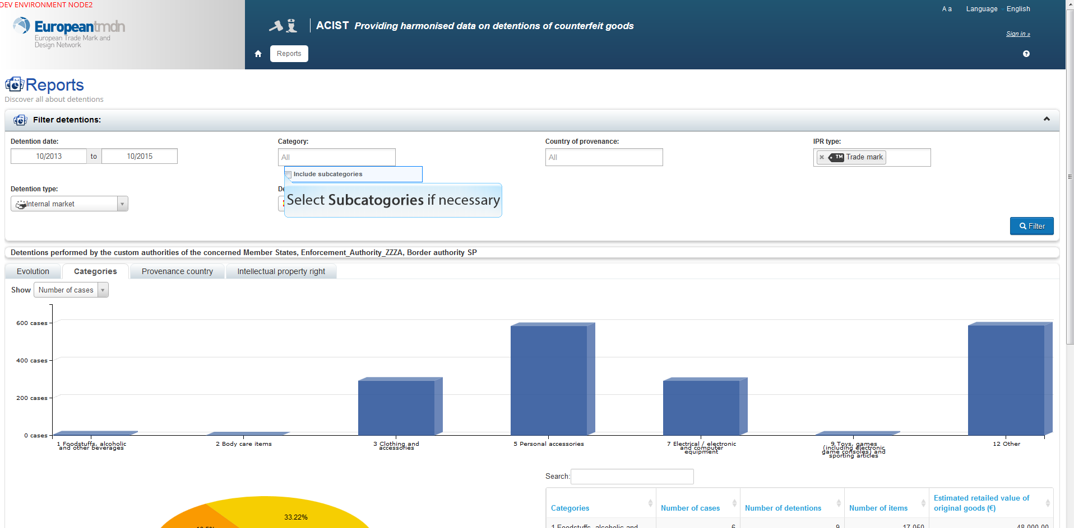
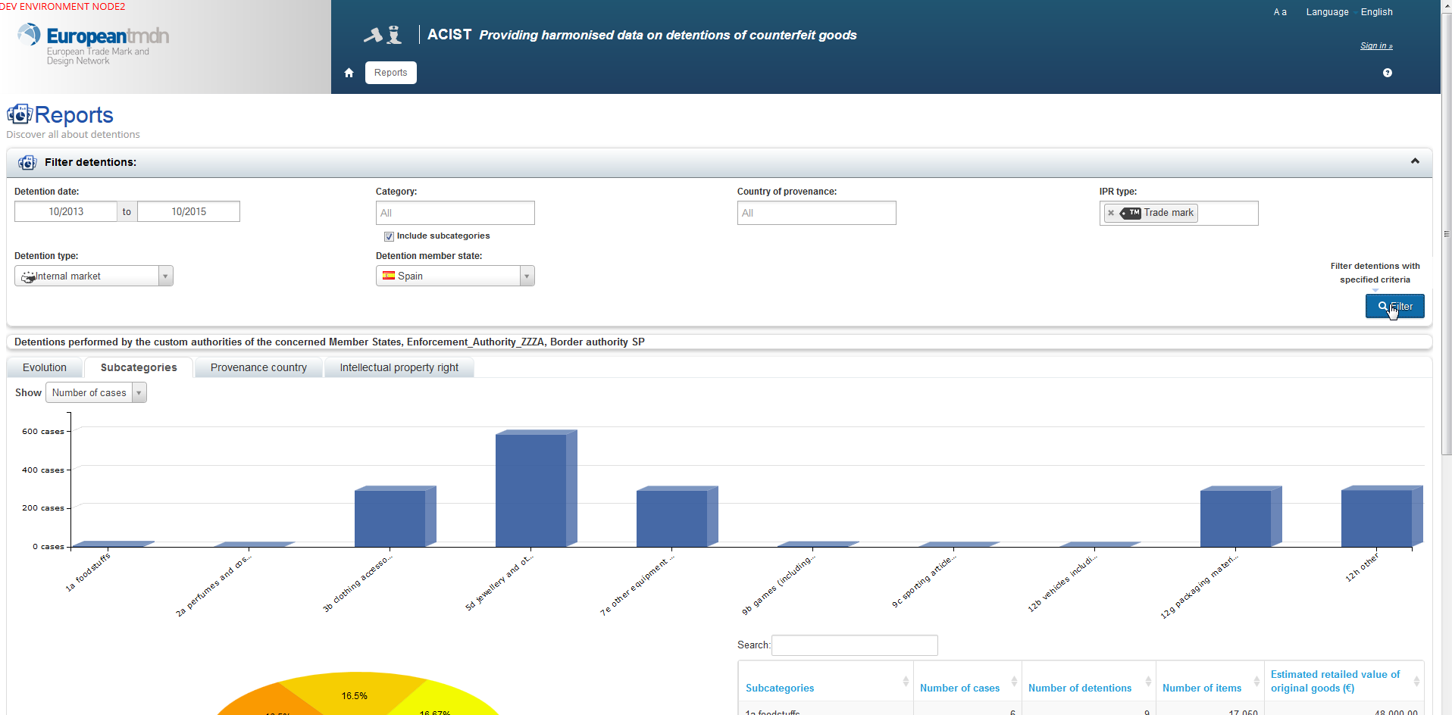
How to consult ACIST: look at the results
include sub-categories
data per product categories
Notes:
Results can then be shown per PRODUCT CATEGORIES.
In order to have a more detaled classification, just go back and select the option INCLUDE SUB-CATEGORIES of goods. The results will show the different sub-categories under each ocategory od seized products.
In this case, ithe chart, again the number of cases is reported on the scale placed on the left axis of the chart, while on the horizontal axis the single sub-categories of seized which were the subject of the seizures are indicated

Slide 22
How to consult ACIST: look at the results
data per provenance
data per IPR
Notes:
In the same way, different options can be activated on the resulta of the search, showing the outcomes:
PER COUNTRY OF PROVENENCE OF THE SHIPMENT
And PER INFRINGED IPR.
By clicking on the relavatn tag.

Slide 23
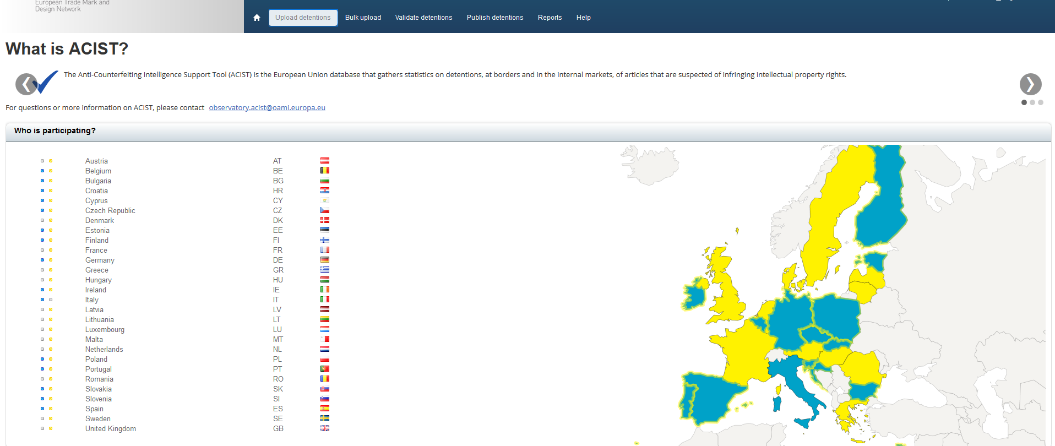
How to upload data in ACIST
log-in with your user profile and select «UPLOAD DETENTION» from the ribbon
Notes:
USER NEEDS TO OPEN AN ACCOUNT WITH HIS OWN PROFILE. THE REQUEST IS ADDRESSE TO OHIM/OBSERVATORY:
WHICH IS THE ACCOUNT OF OBSERVATORY TO ADDRESS THE REQUEST?
WICH ARE THE DIFFERENT PROFILES?

Slide 24
How to upload data in ACIST: add a new case
Notes:
OPEN THE “ADD A NEW CASE” FUNCTIONALITY BY CLICKING ON THE BUTTON “ADD A NEW CASE” (OK?)
Remember:
THE INFORMATION OF «DETENTION MEMBER STATE», «ENFORCEMENT AUTHORITY» AND «DETENTION TYPE» IS DEFINED BY DEFAULT FROM THE USER’S LOGIN SETUP

Slide 25
How to upload data in ACIST: add a new case
assign a reference number
Notes:
HOW IS THE REFERENCE NUMBER GENERATED?

Slide 26
How to upload data in ACIST: add a new case
add a detention region
then, select the place of detention
Notes:
DROP DOWN MENU? Or TYPE IN THE WORD, FOR REGION AND PLACE?

Slide 27
How to upload data in ACIST: add a new case
add a Country of provenance
Notes:
DID WE SOLVE THE PROBLEM OF THE EXACT MEANING OF PROVENANCE VS ORIGIN? (= THIS IS THE PROVENANCE OF THE SHIPMENT, NOT THE PLACE WHERE THE PRODUCTS WERE MANUFACTURED)
SHALL WE IN FUTURE ADD THE POSSIBILITY TO ADD THE COUNTRY OF ORIGIN?

Slide 28
How to upload data in ACIST: add a new case
select a Product type
Notes:
SAME APPROACH AS THE PRODUCT CATEGORY IN THE REPORT CONSULTING PAGE? = CATEGORIES FROM TAXUD CLASSIFICATION?

Slide 29
How to upload data in ACIST: add a new case
add an IPR type
Notes:
SAME APPROACH AS THE PRODUCT CATEGORY IN THE REPORT CONSULTING PAGE?

Slide 30
How to upload data in ACIST: add a new case
add the seized Quantity
Notes:
SAME APPROACH AS THE PRODUCT CATEGORY IN THE REPORT CONSULTING PAGE?

Slide 31
How to upload data in ACIST: add a new case
add Item value
Notes:
IT IS THE ESTIMATED VALUE PER ITEM: THIS MEANS THE RETAIL ESTIMATED VALUE IN THE INTERNAL MARKET? BUT WHICH INTERNAL MARKET? THE ONE EXPEC TED FOR THE RE-SALE…

Slide 32
How to upload data in ACIST: add a new case
now save the changes!

Slide 33
How to upload data in ACIST: you can duplicate a case…
duplicate detention case

Slide 34
How to upload data in ACIST: … and edit it
edit the detention
Notes:
THIS IS TO ALLOW UPLOADING OF DIFFERENT CASES DETECTED IN ONE SEIZURES:
EXAMPLE: DIFFERENT TYPE OF GOODS, OR DIFFERENT IPR SEIZED IN ONE SHIPMENT, OR BOX OR CONTAINER CHECKED.

Slide 35
Questions?
Notes:
THIS IS TO ALLOW UPLOADING OF DIFFERENT CASES DETECTED IN ONE SEIZURES:
EXAMPLE: DIFFERENT TYPE OF GOODS, OR DIFFERENT IPR SEIZED IN ONE SHIPMENT, OR BOX OR CONTAINER CHECKED.

Slide 36
information@oami.europa.eu e-businesshelp@oami.europa.eu
twitter/oamitweets youtube/oamitubes
www.oami.europa.eu
contact us:
Thank You

