Slide 1
Study on Infringing Business Models Online
Regional Seminar on Enforcement of Intellectual Property Rights
OHIM in cooperation with HIPO
Budapest
11-13 November 2015
Erling Vestergaard
13 November 2015
Version 2.0

Slide 2
Matrix
Research Study on Business Models used to Infringe IPR Online

Slide 3
Matrix
Research Study on Business Models used to Infringe IPR Online
Digital Platforms
Open Internet Infringer Controlled Website
Darknet Infringer Controlled Website
Open Internet Third Party Marketplace
Darknet Third Party Marketplace
Social Media, Gaming and Virtual World Website
E-mail, Blogs, Chatrooms and Newsgroups
Mobile Media, Smartphone and Tablet

Slide 4
Matrix
Research Study on Business Models used to Infringe IPR Online
Infringing Activity
Use of a Domain Name or Other Type of Digital Identifier Containing the Trademark of Another
Sale of IPR Infringing Products
Infringing Distribution and Dissemination of Copyright Protected Digital Content
Advertising and Other Actvities Contributing to IPR Infringing Activities
Phishing, Fraud and Dissemination of Malware
Sale of Access Codes and Other Accounts to Copyright Protected Digital Content

Slide 5
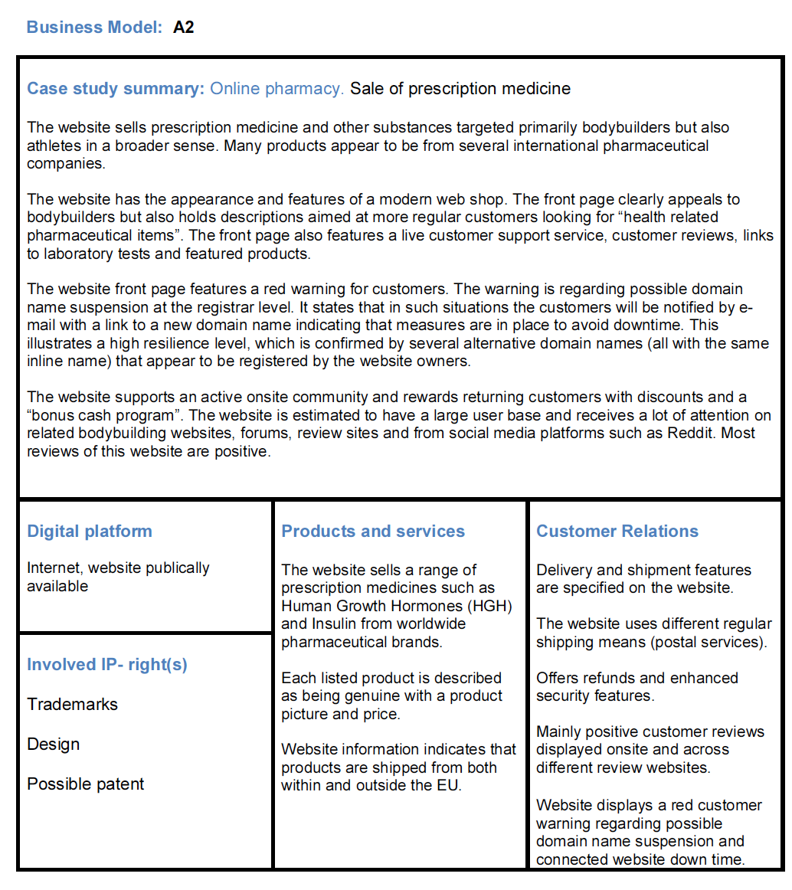
Canvas
Research Study on Business Models used to Infringe IPR Online

Slide 6
Mtrix
Research Study on Business Models used to Infringe IPR Online
Business Model Canvas Items
Summary
Digital Platform
Involved IP-Rights
Products and Services
Customer Relations
Marketing Channels
Revenue Sources
Identification of the website owener/admin
Customer Incentives

Slide 7
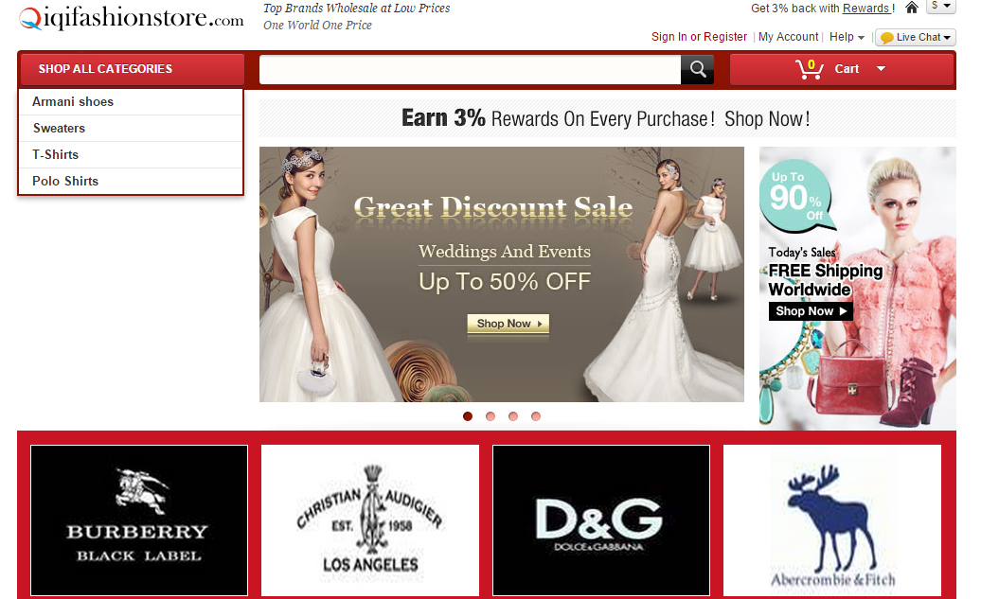
qiqifashionstore.com
Examples
Website dedicated to commercial activities using a domain name that is not related to the infringing activity

Slide 8
interioraddict.com
Examples

Slide 9
montblancpensonlineuk.com
Taxonomy

Slide 10
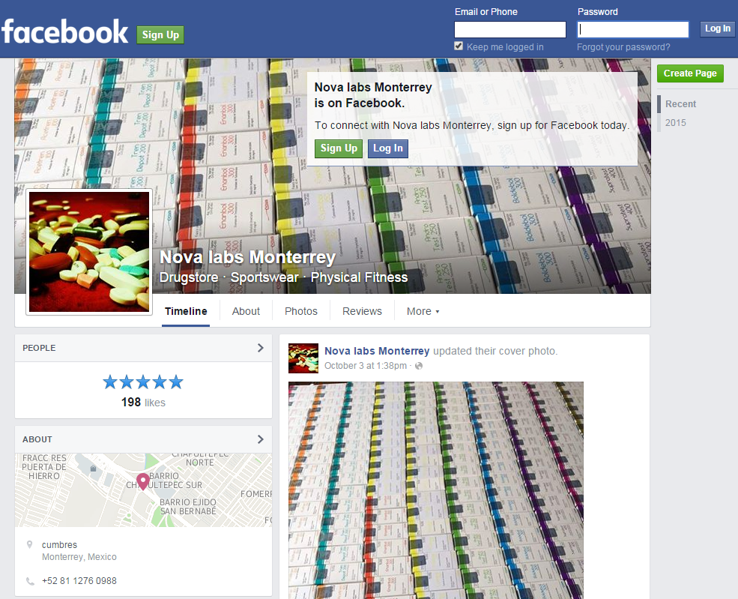
Taxonomy
Social networking website
Advertising on a social media for IP infringing activities on another website

Slide 11
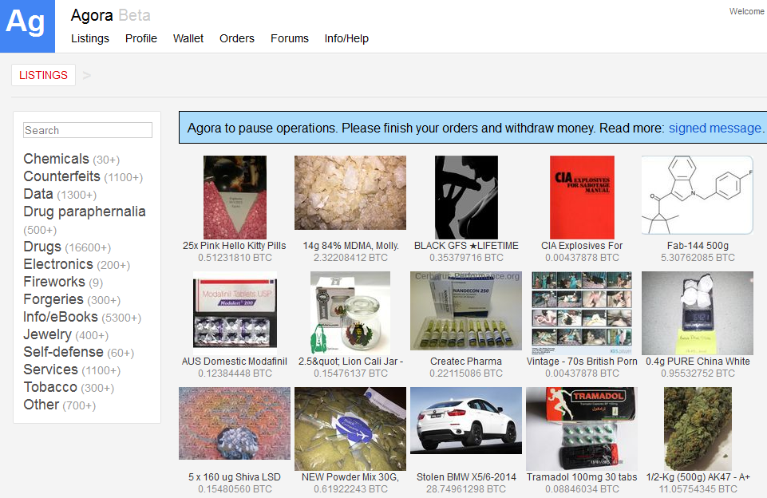
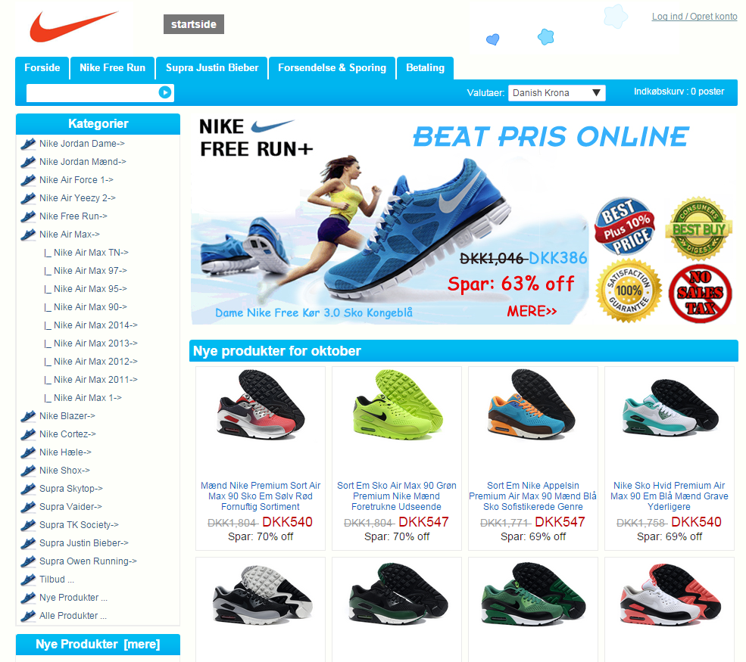
Examples of business models
Research on Business Models Used to Infringe Intellectual Property Rights Online

Slide 12
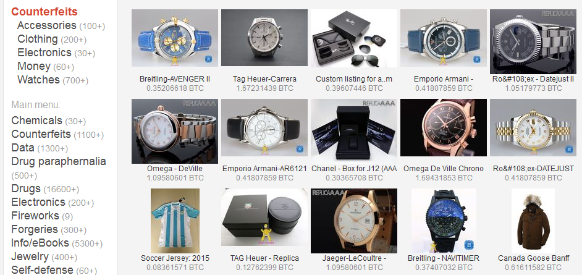
Examples of business models
Research on Business Models Used to Infringe Intellectual Property Rights Online

Slide 13
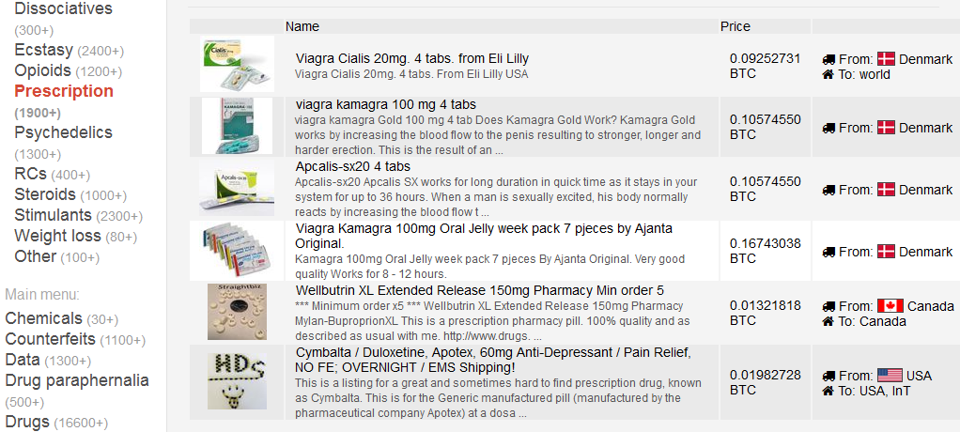
Examples of business models
Research on Business Models Used to Infringe Intellectual Property Rights Online

Slide 14
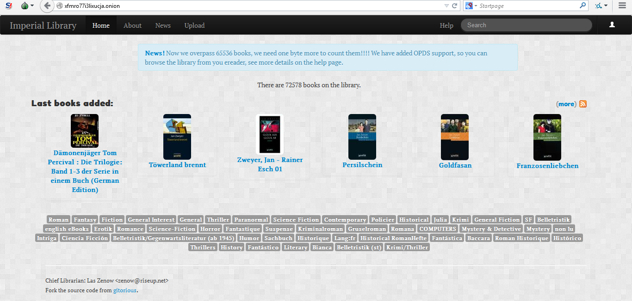
xfmro773i3lixucja.onion
Examples

Slide 15
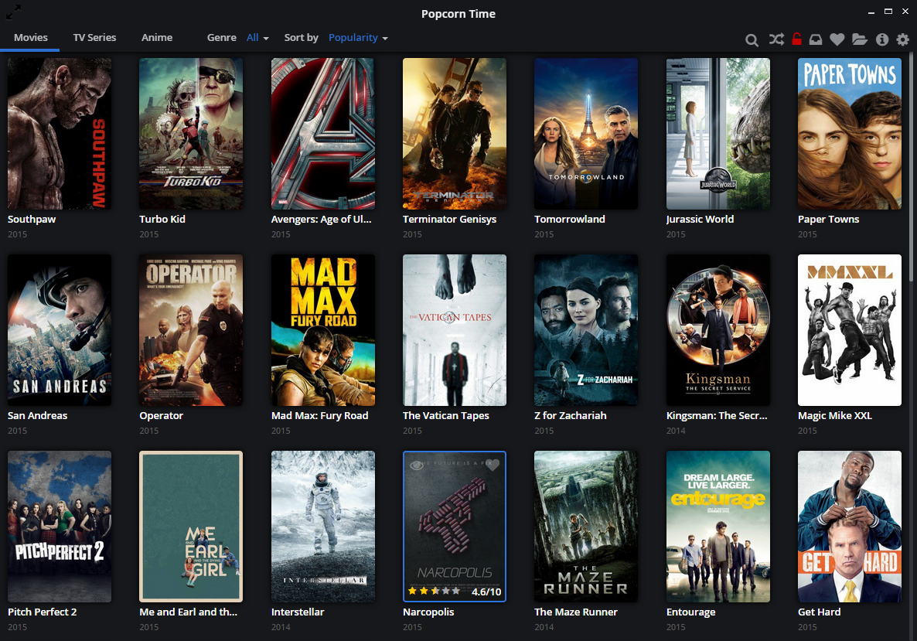
popcorntime.io
Examples

Slide 16
popcorntime.io
Examples
Website dedicated to commercial activities using a domain name that is not related to the infringing activity
Popcorn Time
Magazine
07.09.2015
‘Inside Popcorn Time - the world's fastest growing piracy site’
29 year old
Argentian
IT genius
Federico Abad
Illegally contributing to making copyright infringing content available to the public

Slide 17
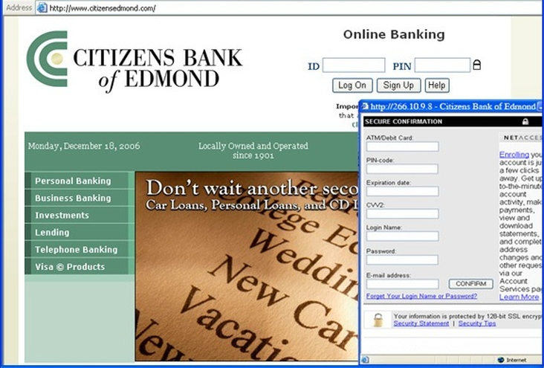
citizensedmond.com
Examples

Slide 18
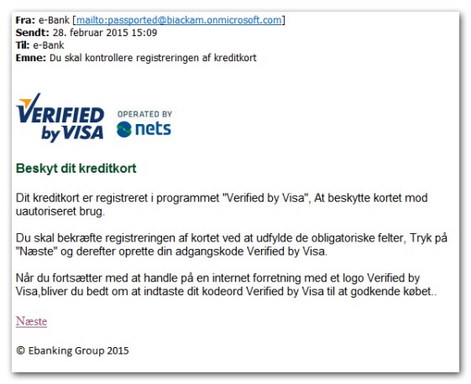
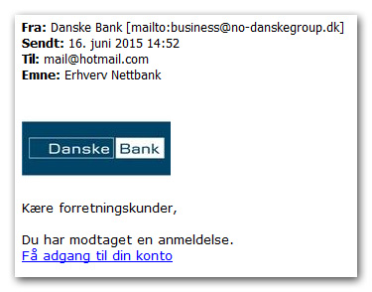
Examples

Slide 19
Official website for Danish Parliament,
accessed 21-10-2015
Examples
Organized Traffic Redirection Example

Slide 20
Subpage for former Foreign Minister,
accessed 21-10-2015
Examples
Organized Traffic Redirection Example
Link to http://leneespersen.dk

Slide 21
http://leneespersen.dk directs traffic to this
webshop,accessed 21-10-2015
Examples
Organized Traffic Redirection Example

Slide 22
http://leneespersen.dk directs traffic to this
webshop,accessed 21-10-2015
Examples
Organized Traffic Redirection Example
No contact information

Slide 23
Official webpage for .dk registry
dkHostmaster, accessed 21-10-2015
Examples
Organized Traffic Redirection Example

Slide 24
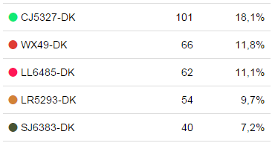
Examples
Whois information on dkHostmaster
Wepage for http://leneespersen.dk,
accessed 21-10-2015
Organized Traffic Redirection Example
Registrered by Chinese
Shan Jie on 15-12-2014

Slide 25
Thank You
for
Your Attention
(+ 34) 609 161 115 erling.vestergaard@ext.oami.europa.euu
https://oami.europa.eu
contact me:

