Slide 1
Experiences of prosecuting online IP infringements
Regional Seminar on Enforcement of Intellectual Property Rights
OHIM in cooperation with HIPO
Budapest
11-13 November 2015

Slide 2
Topics
Typical online infringements (reproduction and communication to the public)
Modus operandi (FTP, P2P, BitTorrent)
Procedural specialties, investigation
Coercive measures (search and seizure)
Role of experts
Issues on establishing the actual financial loss
Reasons and impact of legislative changes

Slide 3
Specific types of online IP infringements
FTP servers
Filesharing
BitTorrent
Hyperlinks

Slide 4
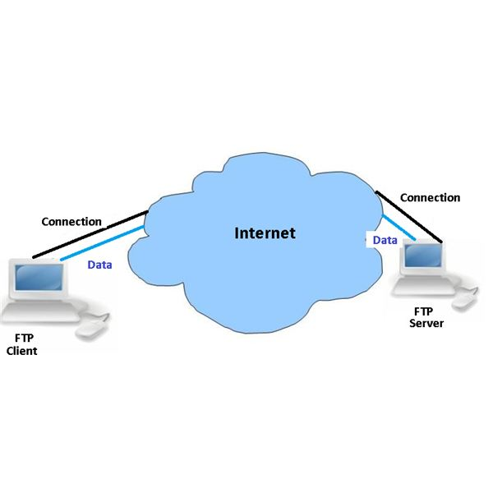
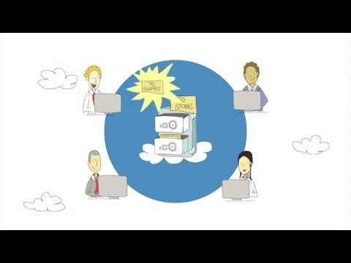
How FTP works

Slide 5
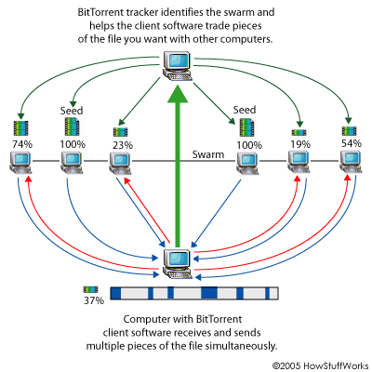
BitTorrent

Slide 6
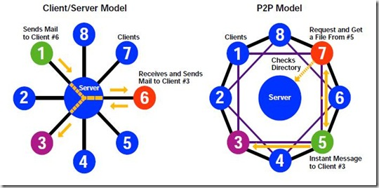
FTP / P2P

Slide 7
Hyperlinks
Hyperlink:
A navigation device which ensures connection between websites.
Clicking on a link we get to a website’s home or subsite.
On forums, in chatrooms,
in emails, on social media sites, via other sorts of communication channels
Should placing a link which points at a copyrighted content be considered as communication IP works to the public?
(Answer in European Court’s Svensson case )

Slide 8
Modus Operandi – Criminal Code
Act C of 2012 on the Criminal Code
Section 385 paragraph (1)
Any person who infringes the copyright or certain rights related to copyright of another person afforded under the Copyright Act, and thereby causing financial loss, is guilty of a misdemeanor punishable by imprisonment not exceeding two years.

Slide 9
Modus Operandi – Copyright Act
Act LXXVI of 1999 on copyright
Section 16 paragraph (1)
On the basis of copyright protection, authors have the exclusive right to utilize works in whole or any identifiable part, whether financially or non-financially, and to authorize each and every use. Unless otherwise stipulated in this Act, use permits can be obtained with use contracts.

Slide 10
Modus Operandi – Copyright Act
Section 16 paragraph (4)
Unless otherwise stipulated in this Act, authors are entitled to remuneration in return for granting permission to use their works. Remuneration must be in proportion to the income in connection with the use, barring any agreement to the contrary. Entitled persons must make explicit statements in order to waive remuneration. If the law requires a specific form for the validity of use contracts, the statement concerning the waiver of remuneration is also valid only in the specific form.
Section 16 paragraph (6)
Use is construed illegitimate especially if the law or the entitled person does not grant authorization for it in a contract or if the user makes use of the work beyond the limits of its entitlement.

Slide 11
Modus Operandi – Copyright Act
Section 17
The following, in particular, are considered uses of a work.
a) Reproduction of a work
b) Distribution of a work
c) Public performance
d) Presentation to the public by broadcast or some other manner
e) Retransmitting broadcast works to the public through an organization other than the original (Section 28)
f) Adaptation
g) Exhibition

Slide 12
Modus operandi – Copyright Act
Section 18 paragraph (2) – reproduction
Reproduction of works includes mechanical (print) or magnetic recording, recording on film or copying; making sound or video recordings; recording for public transmission by broadcast or cable; storing works digitally on electronic media; and producing works that have been transmitted over computer networks in a material form. In the case of architectural works, reproduction incorporates the execution of the work recorded in the plan as well as subsequent construction.

Slide 13
Modus Operandi – Copyright Act
Section 26 paragraph (8) – communication to the public
Authors also have the exclusive right to transmit their works to the public in manners other than broadcasting or those specified in Subsection (7), and they also have the exclusive right to authorize other persons to do so. This right extends, in particular, to the case in which works are made accessible to the public by cable or by any other means or in any other manner in a way in which the members of the public can determine individually the time and place of access.

Slide 14
Modus operandi – Copyright Act
Section 35 paragraph (1)
Any natural person is entitled to make copies of works for private purposes if such activity does not serve to generate or increase income in any way or form. This provision does not apply to architectural works, technical structures, software, computer-operated data banks, and the recording of public performances of works on video or audio media. Sheet music may not be reproduced by means of reproduction [Subsection (1) of Section 21] for private purposes even in the cases described in Paragraphs b)-d) of Subsection (4) below.

Slide 15
Modus operandi
Uploading a protected IP work
reproduction
communication to the public
Downloading a protected IP work
reproduction

Slide 16
Modus operandi
Ring of perpetrators
100% uploaders
Makers, operators, givers of central, tracker- and seed-servers
Administrators
Hosting providers
Owners of the domains
BUT:
Aiders and abettors (accomplices) must be aware of the infringement, as they facilitate the communication of protected IP works to the public without permission.

Slide 17
What about home users?
Copymakers who act for a private purpose (downloaders, reproducers) do not commit any offences, in case their activity is not intended for earning or increasing income even in an indirect manner.
Except in relation to architectural works, technical structures, software, computer-operated data banks, and the recording of public performances of works on video or audio media. [Copyright Act 35.§ (1).]
By pursuing home users proceedings may become mass and pointless. The purpose of the legislator was not this, but according to TRIPS convention the persecution of commercial scale piracy.

Slide 18
What about downloaders?
BitTorrent protocol: downloaders may realize uploading, i.e. besides/despite of their first intention they may communicate IP work to the public.
BUT
The piece of a file is not necessarily an identifiable work or part of it.
Downloading and uploading at once is a technological specialty. The primary purpose of the user is reproduction for a private purpose.

Slide 19
Explicite „decriminalisation”
Criminal Code Section 385 paragraph (5)
Any person who infringes the copyright or certain rights related to copyright of another person or persons afforded under the Copyright Act by means of private copying or by way of making available on-demand services shall not be considered to constitute the criminal offense referred to in Subsection (1), provided the act does not serve the purpose of generating income in any way or form.

Slide 20
Procedural law issues
Issue of jurisdiction and competence (where is the place of perpetration?)
Priority role of international cooperation – such as Mutual Legal Assistance requests – between law enforcement bodies and judicial authorities.
Absence of expertise, compulsion for enlisting experts

Slide 21
Difficulties of investigation
Technological development, mutability
Anonimity and organization at perpetrators’ side
Importancy of timefactor
Lack of usable clues (proxy, bounce servers)
Encrypted contents
Fake data, document forgery (hosting, bank accounts)
Limited possibilities for obtaining data
Foreign hosted servers
Hard-to-deny defense strategies

Slide 22
Coercive measures: searching, seizure
With or without experts?
Due to a strictly determined protocol (network topology, prudent documentation, invariability, credibility)
If the operator is known, or there is a suspect, devices for personal use are also must be seized

Slide 23
Coercive measures: searching, seizure
The issue of jurisdiciton when the data is stored on a server hosted in a foreign country (opened gmail account)
Seizure from the cloud?

Slide 24
Coercive measures: searching, seizure
Convention on Cybercrime – European Council, Budapest 2001
Article 19 – Search and seizure of stored computer data
Point 1:
Each party shall adopt such legislative and other measures as may be necessary to empower its competent authorities to search or similarly access:
a.) a computer system or part of it and computer data stored therein, and
b.) a computer data storage medium in which computer data may be stored
in its territory.

Slide 25
Coercive measures: searching, seizure
Point 2:
Each party shall adopt such legislative and other measures as may be necessary to ensure that where its authorities search or similarly access a specific computer system or part of it, pursuant to paragraph 1 a.) and have grounds to believe that the data sought is stored in another computer system or part of it in its territory, and such data is lawfully accessible from or available to the initial system, the authorities shall be able to expeditiously extend the search or similar accessing to the other system.
.

Slide 26
Coercive measures: searching, seizure
Article 32 – Trans-border access to stored computer data with consent or where publicly available
A Party may, without the authorization of another Party:
a.) access publicly available (open source) stored computer data, regardless of where the data is located geographically; or
b.) access or receive, through a computer system in its territory, stored computer data located in another Party, if the Party obtains the lawful and voluntary consent of the person who has the lawful authority to disclose the data to the Party through that computer system.

Slide 27
Role of experts
Should be enlisted for answering SPECIAL TECHNICAL questions, not for replacing digital illiteracy
Identifying the rightholders and establishing the pecuniary damage (actual, definite financial loss) is not necessarily a technical issue
Must not detract deliberating activity from the case judge
Very rarely sorts out the problems around main criminal law issues
Costs

Slide 28
The damage problem
Is there any actual financial loss? (Would the user ever buy the work in legal commerce?)
Is the financial loss definite or just an approximation by the rights holder/injured party ?
In practice we count with one work’s retail price, but establishing how many users downloaded the work is impossible

Slide 29
Testimony strategies
During the investigation most offenders do not cooperate, but before court they come up with a detailed, and usually – due to the elapsed time – irrefutable statement.
Admitting the ownership or operation of servers but denying the knowledge about the unlawful activity (hosting)
WiFi-theft
When the computer was used by more than one person
When more than one user acted as an admin

Slide 30
Difficulties of proof
If we do not have the servers, only the data of trial downloading may be used in terms of content.
If we have the servers but there are fake data on operation.
If we have the servers but no confession.
If the content is encrypted.
If the point of denying is hosting.
When the point of denying is that the computer was used by more persons.
If the point of defense is WiFi-theft.

Slide 31
Legislative changes
Establishing crime from 100.001 HUF financial loss
If there is no exactly determinable financial loss → no crime
Harming more rightsholders’ rights constitutes one offence
Causing „considerable” financial loss constitutes a qualified offence
Businesslike conduct is not an aggravating circumstance any more

Slide 32
Conclusion
The intention of the legislator – with particular regards to the en masse committed online infringements and the habits of home users – was to make procedures initiated against the operators of such systems, organized and serious crimes be tracked and pursued, and the minor infringements be pushed through to the world of misdemeanors.
Criminalising home internet users is neither possible nor reasonable, although their behaviour determines the activity of the supply side.

Slide 33
Solution?
Legal and cheap channels for downloading?
Rethinking of the entire criminal aspect of copyright law?
Re-regulation of the system of royalties?
(ISPs’, users’ public burden)

Slide 34
Thank you for attention.
Created by:
dr. Melinda Losonczi-Molnár
Chief Prosecutor’s Office of Budapest
Department of Priority and Financial Cases
Molnar.Melinda@mku.hu
Presented by:
dr. Gábor Ivanics
prosecutor
Metropolitan Chief Prosecutor's Office
Districts XIV. and XVI. of Budapest
ivanics.gabor@mku.hu

