Slide 1

Customs enforcement of intellectual property rights in Hungary
12th November 2015

Slide 2


National Tax and Customs Administration

Slide 3

Role of customs in IPR enforcement
Customs enforcement
  External border
  Airport (travellers, post, express couriers)
Inland controls
  Marketplaces, warehouses, shops, vehicles, etc.
Criminal investigations
  All IPR related cases
  Exception: medicines

Slide 4
Customs enforcement
New EU and national regulation as of 01/01/2014
  Regulation (EU) No. 608/2013 of the European Parliament and of the Council
  Regulation (EU) No. 1352/2013 of the European Commission
  556/2013. (XII. 31.) Government decree
Changes for both the customs and the right holders
Information material, trainings
Detailed internal directions on procedure

Slide 5
Customs enforcement - basics
On request (AFA) OR ex-officio
Goods suspected of infringing an IPR (according to Art. 2. point 1 of the Reg.)
Goods subject to customs supervision or customs control (within the customs territory of the EU)
Exceptions:
  Overrun
  Parallel importation
  Goods contained in travellers’ personal luggage (of a non-commercial nature)

Slide 6

Major changes
Shorter procedures
Destruction: part of normal procedure (obligatory)
  On consent of relevant parties
No need to determine infringement of IPR based on national law
Special procedure for small consignments
  Postal or express courier consignments
  3 units or less OR less than 2 kg
  Destruction: on request (in the AFA)
  Exception: perishable goods
Reducing administrative burden and costs
Increased efficiency

Slide 7
Application for Action (AFA)
Forms set out in Commission Implementing Regulation (EU) No 1352/2013 (application and request for extension)
Union / National application
Entitlement for submission (persons and entities)
Submission to a designated customs department
Decision within 30 working days
Validity max. 1 year
Free of charge
Contains all relevant data and undertakings

Slide 8
Procedure
Suspicion during customs control
⬧
Y
Suspension of release / detention of goods

Notification of declarant or holder of goods / RH 
Release of goods

Continue customs procedure
✓
N
Continue customs procedure
✓
Destruction

Legal procedure
§

Slide 9
Timeline of procedure – on request
Monday | Tuesday | Wednesday | Thursday | Friday | Saturday | Sunday
1 Day of suspension of release or detention | 2 Notification to the declarant or the holder of the goods | 3 Notification to RH (AFA granted) (also possible on previous day) | 4 | 5 | 6 | 7
8 | 9 Bank holiday | 10 | 11 | 12 | 13 | 14
15 | 16 | 17 Answer from the declarant or the holder of the goods | 18 Answer from the RH, or request for extension of detention | 19 | 20 | 21

Slide 10
Timeline of procedure – ex-officio
Monday | Tuesday | Wednesday | Thursday | Friday | Saturday | Sunday
1 Day of suspension of release or detention | 2 Notification to the declarant or the holder of the goods | 3 Notification to RH (also possible on previous day) | 4 | 5 | 6 | 7
8 | 9 Bank holiday | 10 Submission of AFA | 11 | 12 Decision on AFA | 13 | 14
15 | 16 | 17 Answer from the declarant or the holder of the goods | 18 Answer from the RH, or request for extension of detention | 19 | 20 | 21

Slide 11
Timeline of procedure – small consignments
Monday | Tuesday | Wednesday | Thursday | Friday | Saturday | Sunday
1 Day of suspension of release or detention | 2 Notification to the declarant or the holder of the goods | 3 | 4 | 5 | 6 | 7
8 | 9 Bank holiday | 10 | 11 | 12 | 13 | 14
15 | 16 | 17 Answer from the declarant or the holder of the goods | 18 Notification to RH if the declarant or the holder of the goods does not agree with destruction | 19 | 20 | 21

Slide 12
Destruction of goods
  In procedures on request or ex-officio
  Based on the consent of involved parties
  Agreement to destruction may be deemed
  Any type of goods
  For small consignments
  RH requests use of procedure in the AFA
  Based on the consent of involved parties
  Goods suspected of being counterfeit, transported in small consignments
  Non-perishable goods

Slide 13
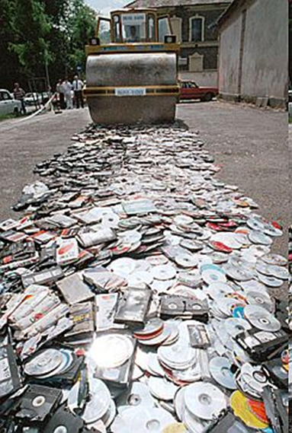
Destruction of goods
  Possibility to forward goods
  On the request of the RH
  Within the EU
  Transit procedure (supervision)
  Responsibilities
  Responsibility on RH
  Under customs supervision
  Costs: RH
Samples
  Eg. for training purposes
  Release into free circulation

Slide 14
Legal proceedings
When?
  No agreement on destruction
  Within 10 (+10) working days from notification
  Possibilities of the RH:
  Court proceeding
    Civil law
  Infringement or criminal proceeding
    Private motion (complaint by the injured party)
Information for customs
  Consequence: release of goods

Slide 15

Obligations of right holders
Undertakings in the AFA
  Notifications
  Updated information
  Liability
  Bearing costs
Quality information for customs
  In the AFA
  On request of customs

Slide 16
Sanctions
Misuse of information
  Revoking the decision
  Refusing to extend validity period
  Suspension of taking actions within validity period
Other failures concerning
  Notification of the competent customs department
  Returning samples
  Bearing costs and providing translations
  Initiation of legal proceedings
  Suspension of taking actions within validity period

Slide 17
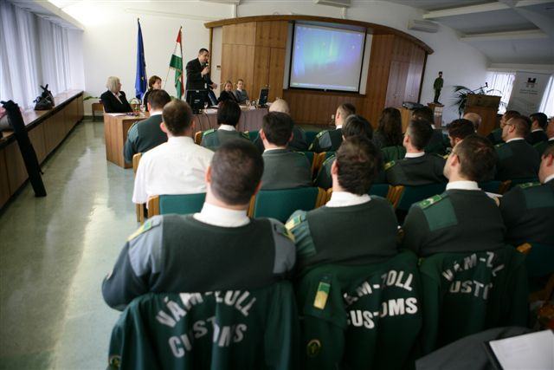
IPR trainings
Customs School – Part of general training
Quarterly seminars
  4 times a year
  For designated customs officers
  Presentations from RH and discussion
  Mixed topics, actualities
Thematic seminars
  1-2 times a year
  For a wider range of customs officers
  Presentations from RH
  Eg.: medicines, foodstuff, cosmetics, car industry, IT, sports
  International trainings
  Observatory (OHIM)
  DG TAXUD e-learning tool

Slide 18

Cooperation of NTCA
International
  Customs Code Committee – IPR Section & Expert Group
  World Customs Organisation – Counterfeiting and Piracy (CAP) Group
  Observatory (OHIM) – Enforcement Working Group
  Project groups
National
  Within NTCA
  NBAC – NTCA is member
  HIPO
  Associations, law firms, RH

Slide 19


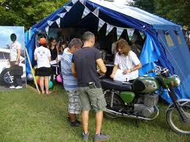
Information & awareness raising
Website: http://nav.gov.hu
Media
  Daily media
  Social media (Facebook)
  Application for mobile phones (NAV-Mobil)
  Information desk (KIOSK) at the Airport
Events
  Festivals
  Expositions

Slide 20
Challenges
Destruction of goods
  Against national legal framework
  Amendment of Criminal Code:
Section 388/A
In the cases provided for in Article 1(1) of Regulation (EU) No. 608/2013 of the European Parliament and of the Council of 12 June 2013 concerning customs enforcement of intellectual property rights and repealing Council Regulation (EC) No. 1383/2003, the criminal offenses defined in Section 385 and in Section 388* may only be prosecuted upon private motion, except for the case if any crime that is punishable not on private motion is also committed in connection therewith.
*Section 385 – piracy, Section 388 – counterfeiting
  Similar amendment of Code of Misdemeanour Procedure

Slide 21
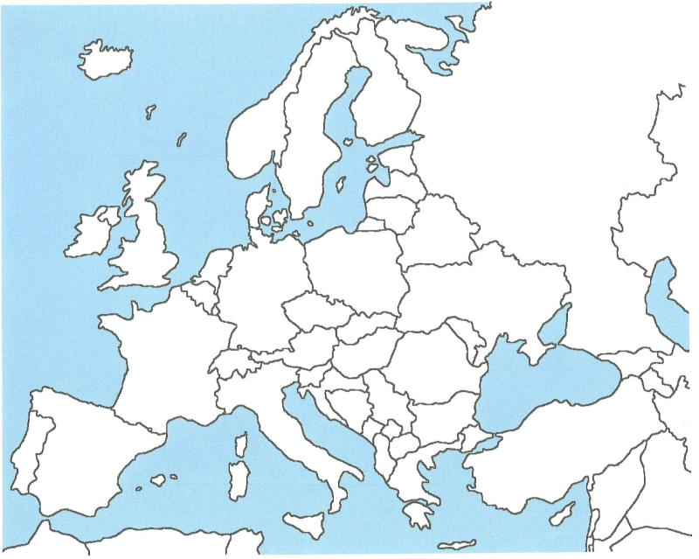







Challenges
Geographical location
Changing transport routes
e-Commerce

Slide 22

Points for consideration
International:
  e-Commerce
  Intra-EU trade
International/National:
  Active involvement of RH
Internal:
  Priorities
  Enhanced communication and cooperation
  Resources
  Effective control measures & risk analysis

Slide 23

Thank you for your attention!
Lt. col. Andrea Gróf
NTCA Central Office, Customs Department
Phone: +36 1 456 9528
E-mail: grof.andrea@nav.gov.hu

