Slide 1
National Tax and Customs Administration
Inspection of the market with respect to IPR Inland control
Mobile Control Activity

Slide 2
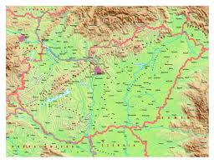
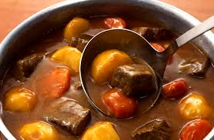
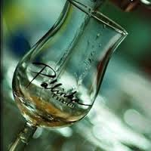
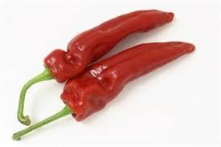
Welcome to Hungary

Slide 3
The organisation of NCTA
The Tax and Financial Control Administration and the Hungarian Customs and Finance Guard are merged into one single administration as of January 2011
Total personnel: 22 482
Customs officers: 5 636

Slide 4
Main features and functions
National authority in tax- customs- and criminal- cases
NATIONAL TAX AND CUSTOMS ADMINISTRATION
Three level structure
Central (Central Office)
Regional (Regional and Specialised Directorate Generals)
Local (District Directorates)
CUSTOMS
TAX
CRIMINAL AFFAIRS
IT
STRATEGY
Independent central budget organisation (independent chapter in national budget)
RESOURCE MANAGEMENT
INTERNATIONAL RELATIONS

Slide 5
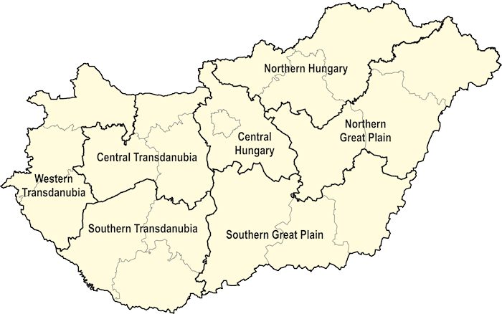
Regional structure of NTCA

Slide 6
Law enforcement task of the customs authority
On the basis of law on criminal procedures: prevention, detection and investigation of crimes within its competence
Detection of infringements and decisions on such cases
Customs control at the external border of the EU
In-depth control carried out by Mobile Units near
the internal and external border strip

Slide 7
Department for enforcement of the NTCA (Central Office)
Responsible for supervising and coordinating all activities related to the external border
And to inland control
Airport, borders, market, places, highways and motorways

Slide 8
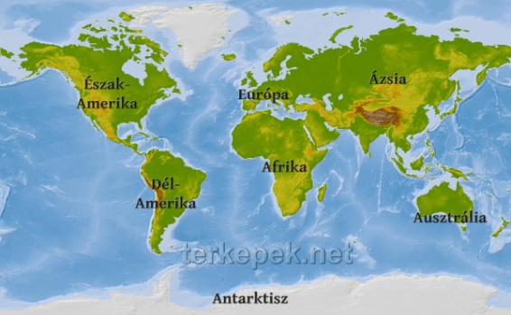
Department for enforcement of the NTCA (Central Office)
Responsible for organizing and coordinating national and international operations
We are in personal contact with the investigators and other authorities.
International partners: EUROPOL, INTERPOL, RILO, SELEC etc…

Slide 9
Department for enforcement of the NTCA (Central Office)
And other authorities in Hungary
POLICE
The Directorate General of National Institute of Pharmacy
National Food Chain Safety Office
Hungarian Intellectual Property Office
National Board Against Counterfeiting
Etc.

Slide 10
Department for enforcement of the NTCA (Central Office)
Improve our knowledge
We usually organize tranings and conferences for patrols, customs officers, and customs investigators
Feedback

Slide 11
Which are the most popular counterfeit products in Hungary?

Slide 12
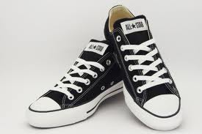
Clothes, shoes, and accessories

Slide 13
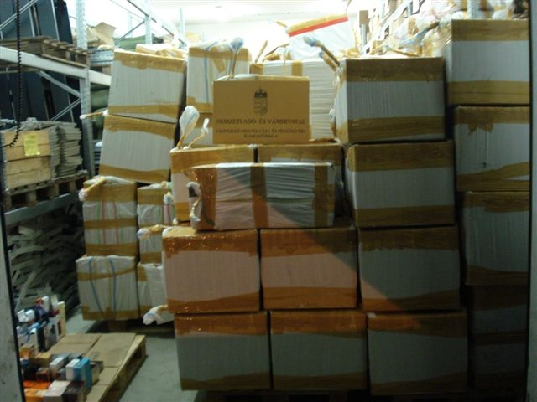
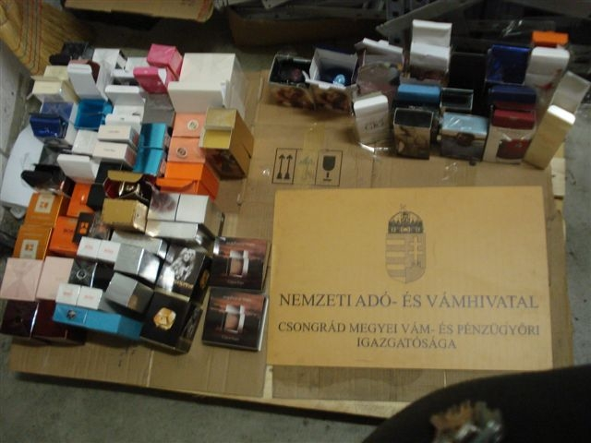
Perfumes

Slide 14
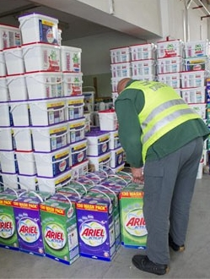
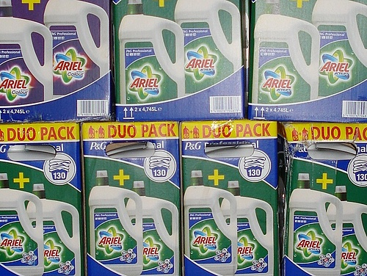
Washing powder
Huge business in Hungary and Central Europe
(Ariel, Persil, Lenor, Silan, etc…)

Slide 15
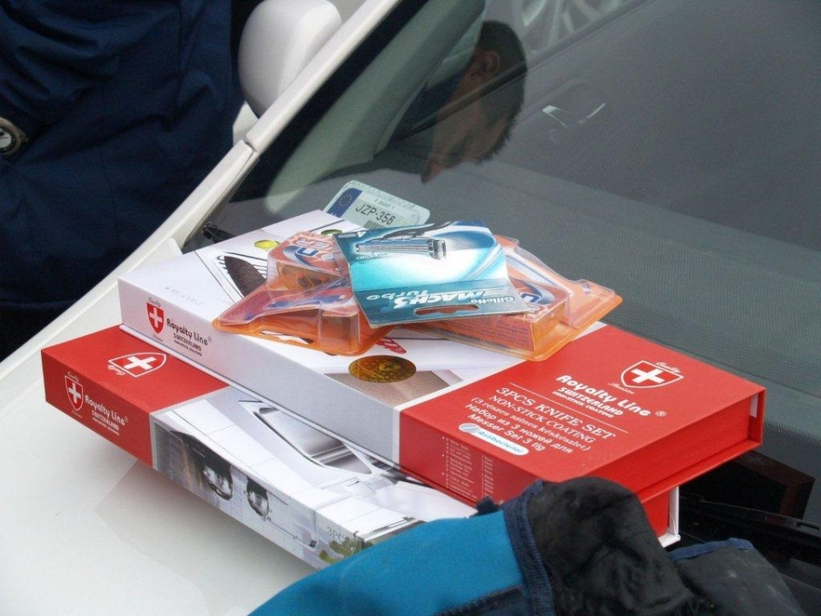
Toys and kitchen tools

Slide 16
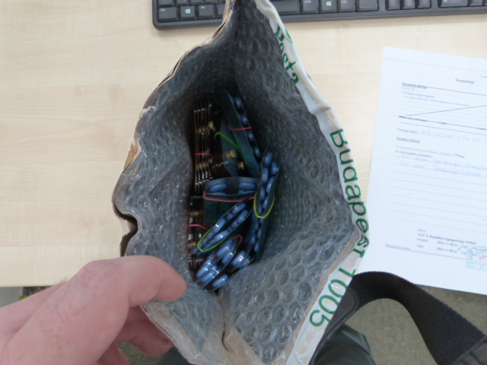
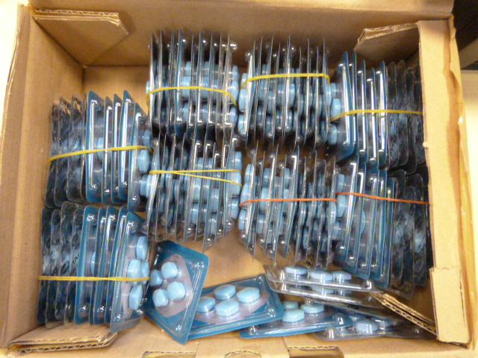
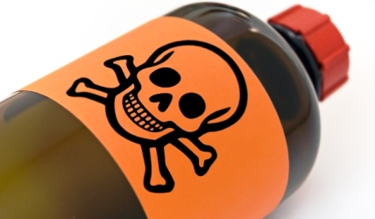
Medicines and food supplements
-Erectile disfunctions
-Testosteron

Slide 17
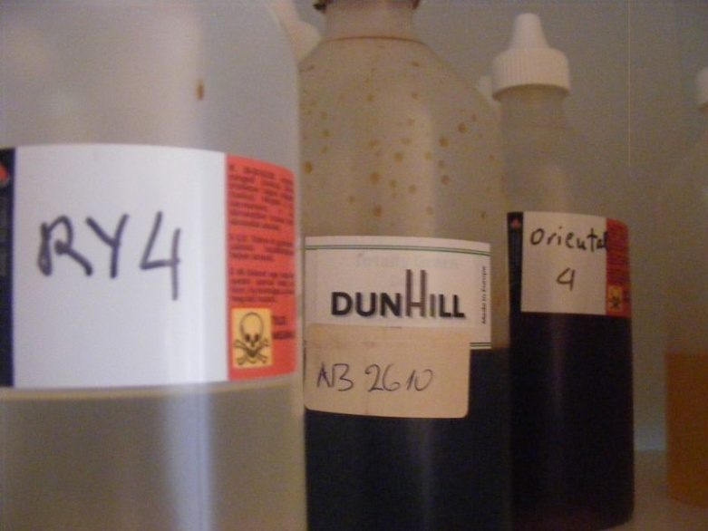
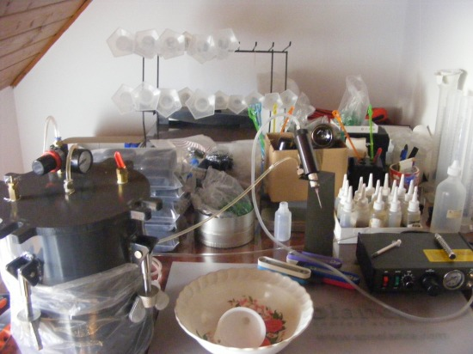
Medicines and food supplements
Problem of e-cigarettes

Slide 18
Legislation
CRIMES AGAINST INTELLECTUAL PROPERTY RIGHTS
OR MISDEMENAORS AGAINTS INTELLECTUAL PROPERTY RIGHTS
Infringement of Copyright and Certain Rights Related to Copyright
Infringement of Industrial Property Rights
Imitation of Competitors
2013. 06. 01. –New criminal code
Act C of 2012 on the Criminal Code
Act II of 2012 –about the misdemenaors

Slide 19
Legislation
Infringement of Copyright and Certain Rights Related to Copyright
(1) Any person who infringes the copyright or certain rights related to copyright of another person afforded under the Copyright Act, and thereby causing financial loss, is guilty of a misdemeanor punishable by imprisonment not exceeding two years.
(2) Any person who fails to pay the blank media fee or reproduction fee that is due to the author or the holder of a right related to copyright afforded under the Copyright Act in respect of copying for private purposes shall be punishable in accordance with Subsection (1).

Slide 20
Legislation
Infringement of Industrial Property Rights
1) Any person who infringes the industrial property right of the rightful holder afforded by law, international agreement promulgated by an act of Parliament, or under European Union legislation:
a) by imitating or copying the subject matter of protection;
b) by the marketing of goods produced by imitating or copying the subject matter of protection, or by way of obtaining or keeping such goods for the purpose of distribution;
thereby causing financial loss, is guilty of a misdemeanor punishable by imprisonment not exceeding two years.

Slide 21
Legislation
Infringement of Industrial Property Rights
(4) For the purposes of this Section:
a) industrial property rights shall cover:
aa) patents,
ab) plant variety rights,
ac) supplementary protection certificates,
ad) trademarks,
ae) geographical indications,
af) designs rights,
ag) utility models,
ah) topographies;
b) ‘goods’ shall mean any goods of a fungible nature that are capable of being delivered, including services

Slide 22
Legislation
CRIMES OR MISDEMENAORS AGAINST CONSUMER RIGHTS AND ANY VIOLATION OF COMPETITION LAWS
Imitation of Competitors
Any person who produces a product with distinctive appearance, packaging, labeling or name, from which a competitor or his product having distinctive features can be recognized, and who does so without the consent of such competitor, or who acquires such product for the purpose of placing it on the market, is guilty of a misdemeanor punishable by imprisonment not exceeding one year, insofar as the act did not result in another criminal offense.

Slide 23
Legislation CRIMES OR MISDEMEANOR?
That is the question
Misdemeanor=minor offences
Value limits for criminal offenses and their misdemeanor form Section 462
(2) The following shall be construed as misdemeanors rather than criminal offenses:
d) where the infringement of copyright and certain rights related to copyright:
da) involves a value of one hundred thousand forints or less in respect of blank media fees or reproduction fees,
db) results in a financial loss of one hundred thousand forints or less;
e) where the infringement of industrial property rights results in a financial loss of one hundred thousand forints or less;
f) where the marketing of substandard products and imitation of competitors involves a value of one hundred thousand forints or less.

Slide 24
Legislation CRIMES OR MISDEMEANOR?
100.000 HUF=320 EUR
How is the financial loss caused?
That is the question….
It depends on the case….
And it depends on the prosecutor’s opinion also….
We usually consider the price of the original product and the price of the fake product.

Slide 25
Legislation
Medicines
Falsification of Health Care Product Section 186
(1) Any person who:
a) falsifies health care products or produces falsified health care products;
b) supplies, offers, places on the market or deals with false or falsified health care products, or health care products which have not been authorized in Hungary;
c) imports or exports, or transports in transit through the territory of Hungary false or falsified health care products, or acquires and/or possesses such in unreasonable quantities;
d) acquires and/or possesses health care products which have not been authorized in Hungary in unreasonable quantities, or imports or exports, or transports in transit through the territory of Hungary such products;
e) uses an original document related to health care products for commercial purposes for reasons other than for which such document was intended;
is guilty of a felony punishable by imprisonment not exceeding three years.

Slide 26
Ju faleminderit për vëmendjen tuaj!
Thank you for your kind attention!
Linda Labancz
NTCA Central Office
Department for Enforcement

