Slide 1
Pharmacrime in Hungary
Ibolya Csákó dr.
Hungarian Police Headquarters

Slide 2
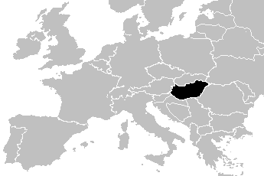
The Police of the Republic of Hungary
(We Serve and Protect)
2

Slide 3
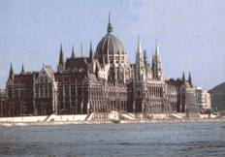
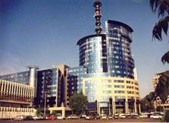
Direction of the Police
PARLIAMENT
GOVERNMENT
Ministry of Interior
National Police Headquarters
County
Police Headquarters
Budapest
Police Headquarters
Town Police
Stations
Town Police
Stations
District Police
Stations
District Police
Stations
Town Police
Stations
District Police
Stations
3
Notes:
3

Slide 4
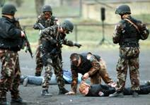
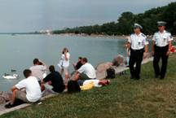
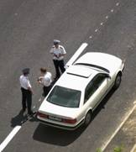
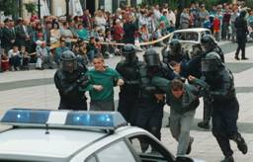
Service branches of the Police
Criminal investigation
Public order
Traffic enforcement
Police administration
Protecting persons and key facilities
Border policing
4
Notes:
4

Slide 5
U
N
I
T
S
S
U
P
E
R
V
I
S
E
D
B
Y
T
H
E
H
I
G
H
C
O
M
M
I
S
S
I
O
N
E
R
Central Complaints
Bureau
Dignitary
Protection
Service
Secretariat Div.
Status Management
Division
Crim. Invest.
Department
Div. for Discip-
linary
Matters
Dept. of Administr.
and Case Manag.
CID
CSI
Case Manag.
Div.
Div. of Accounting
and Controlling
Intelligence
Div.
Econ. Crime &
Money Counterf.
Div.
Dept. of Criminal
Analysis&Eval.
Div. of Law
Enforcement Analysis
and Evaluation
System IT Div.
Div. of Criminal
Analysis&Eval.
Div. for Network
and Cipher
Supervision
Div. for Victim
Prot. & Prevention
Div. of Coordination
Telecommunication
Division
CENT-RAL ORG.
International
Law Enforcement
Cooperation
Centre
National Bureau
of Investigation
Helpdesk
Institute of Policing
and Crime Prevention
FIELD ORG.

Slide 6
Generally
Counterfeit or falsified medicines are a growing criminal activity and a threat to public health worldwide.
Counterfeit medicines are channeled mainly through the internet and also on cargo and freight
Trafficking on counterfeit medicines has the highest profitability for very low investment and low risk for prosecution and punishment.
Trade of counterfeit medicines is much more profitable than trade in narcotics such as cocaine and heroin;

Slide 7
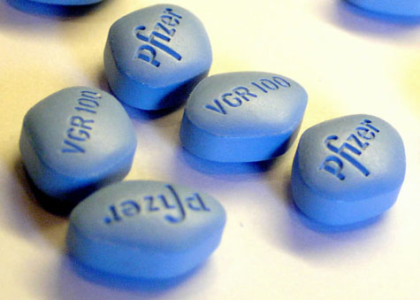
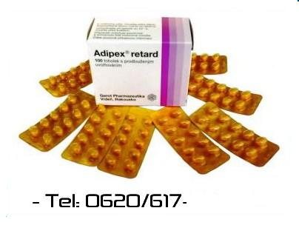
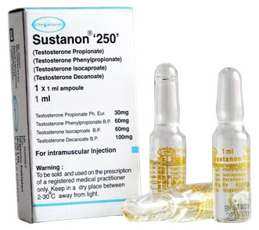
Typical counterfeit medicines
Counterfeit medicine available in the Hungary originally focused upon ‘lifestyle’ medicines, including erectile dysfunction and weight loss medicines.
Counterfeiters are now also focusing on ‘lifesaving medicines’ including cancer and heart medicines.

Slide 8
No fatalities have been attributed to counterfeit medicine in the Hungary, although numerous fatalities have occurred around the world.
Counterfeit medicine have not yet found in the legitimate Hungarian supply chain
Counterfeit medicines discovered in Hungary typically contain a reduced amount of the active pharmaceutical ingredient, although the wrong ingredient or no ingredient at all have been found less frequently.
But! All counterfeit medicines are dangerous

Slide 9
Hungarian situation
1st of July in 2013 came into affect a new Penal Code
New rules according to medicines:
Misuse of anabolic steroids
Counterfeiting of the medical products
This new rule is based by the Medicrime Convention

Slide 10
Medicrime Convention
This Convention concerns medical products whether they are protected under intellectual property rights or not,
or whether they are generic or not,
including accessories designated to be used together with medical devices,
as well as the active substances, excipients, parts and materials
designated to be used in the production of medical products.

Slide 11
Medicrime Convention
“medical product” shall mean medicinal products and medical devices;
“medicinal product” shall mean medicines for human and veterinary use, which may be:
any substance or combination of substances presented as having properties for treating or preventing disease in humans or animals;

Slide 12
Medicrime Convention
any substance or combination of substances which may be used in or administered to human beings or animals either with a view to restoring, correcting or modifying physiological functions by exerting a pharmacological, immunological or metabolic action, or to making a medical diagnosis;
an investigational medicinal product;

Slide 13
API-EXCIPIENT
the term “active substance” shall mean any substance or mixture of substances that is designated to be used in the manufacture of a medicinal product, and that, when used in the production of a medicinal product, becomes an active ingredient of the medicinal product;
the term “excipient” shall mean any substance that is not an active substance or a finished medicinal product, but is part of the composition of a medicinal product for human or veterinary use and essential for the integrity of the finished product;

Slide 14
Counterfeiting of medical product
Counterfeiting of medical products is seriously endanger public health
This crime focusing public health not the intellectual property rights

Slide 15
Counterfeiting of medical product
We focusing not only medicines, but medical devices as well such as brest implantatum,
not including food supplementary,
If food supplementary is containing API it is included

Slide 16
Medical device
Any instrument, apparatus, appliance, software, material or other article.

Slide 17
Counterfeiting of medical product
We focusing not only medicines, but medical devices as well
This crime is not including food supplementary,
BUT! If the food supplementary is containing API this food supplementary we handle as a counterfeit medicine
Counterfeit medicine have not yet found in the legitimate Hungarian supply chain

Slide 19
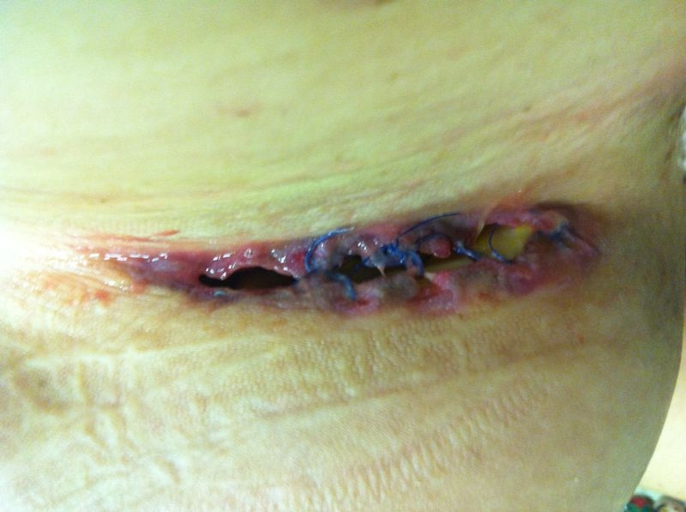

Slide 20
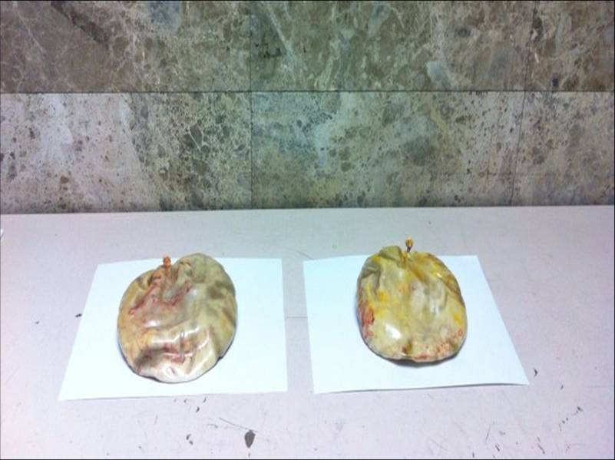
Breast implants containing a total of 1687 grams of cocaine after being extracted

Slide 21
What do we criminalise?
We criminalise certain acts: such as producing, manufacturing, trafficking, dealing, exporting, importing, transiting, supplying, offerring to supply, keeping in stock.
Falsification of documents
But our law is not criminalise those acts if somebody has a thousands of genuine medicines

Slide 22
Aggravating circumstances
The offence cause the death – we have no any information about counterfeit medicine cause death at all
Damage to the physical or menthal health
The offence was comitted by persons who work as maufacturers, suppliers,
The offence was committed by criminal organisation

Slide 23
Cooperation
Cooperate with custom, health authority,
Information exchange
Cooperate with stakeholder, private sector
It was launched a cooperation agreement between custom, police, health authority, civil sector from this summer
It was prepared by the Hungarian National Board Against Anticounterfeiting
Working group against Medicine Counterfeiting

Slide 24
Problems
Need for continuous coordination and for this need a lot of time
Huge amount of evidence we have to collect
High number of investigation home and abroad
Need for storage and registering
Need computer experts

Slide 25
Penalty
In a lot of country the penalty is not so high to retain it but the profit is huge

Slide 26
internet
Internet distribution is getting bigger
Criminals constantly changing host servers
often from websites that hide their physical identity

Slide 27
What can we do?
At national level, multidisciplinary and multi sectoral approaches are key elements for effectiveness of investigations. This calls for the involvement of Health, Customs, Police and industry under the umbrella of Justice sector;
At EU level, cooperation among competent authorities is very important and should be pursued including police and judicial cooperation. However it should be coupled with harmonization of legal procedures in order to increase effectiveness. In particular it is very important to start working on harmonization of legal definitions;

Slide 28
There is a crucial need to increase awareness and deliver trainings to those involved in the criminal justice system such as prosecutors and judges;
At international level, there is a need to make more use of existing international organizations such as EUROJUST, EUROPOL and INTERPOL to coordinate international law enforcement activities;
Effective investigations must include intelligence and financial investigations as well as covert operations and controlled delivery operations. Control delivery is a crucial tool available to enforcement authorities. Financial fraud investigations are often the most effective tool to prosecute criminal;

Slide 29
Internet
The internet plays a major role in the distribution of counterfeit medicines. There is a need to develop agreements with internet service providers, payment providers and domain registrars to facilitate actions against web sites involved in the promotion and selling counterfeit medicines;

Slide 30
The figures
150-200 cases
20.000 seized anabolic steroids ampulles
A lot of siezed Viagra
Alot of siezed nicotine containing e-cigarettes
Some food supplementary which containe API
Rivotril illegal producing laboratory

Slide 31
Counterfeit Rivotril case
information about a drug trafficking
Found a lot of bottle with Rivotril 604 bottles , 60.400 tablets Rivotril 2 mg
house searching in his premises
Another 76.800 tablets

Slide 32
The location
It was Buda side like a wine cellar
there was a fake wall, a hidden door, Like a movie, or a film
After we discovered a door, the perpetrator said how is it work
At the foreground of the building we found a lot of tobacco and cigarettes.

Slide 33
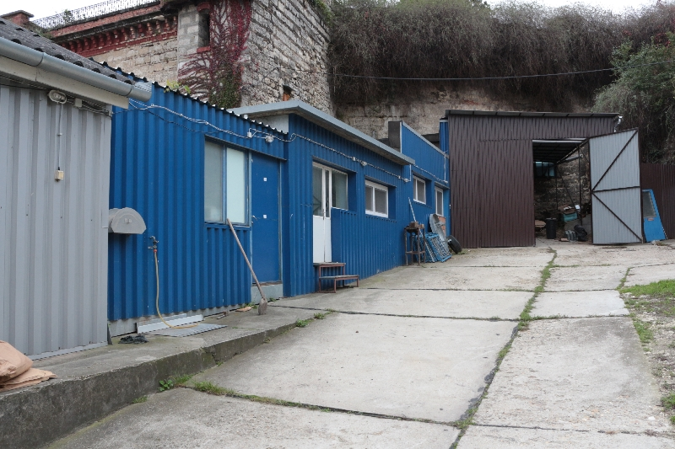

Slide 34
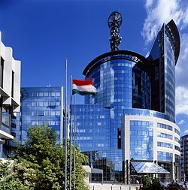

Slide 35
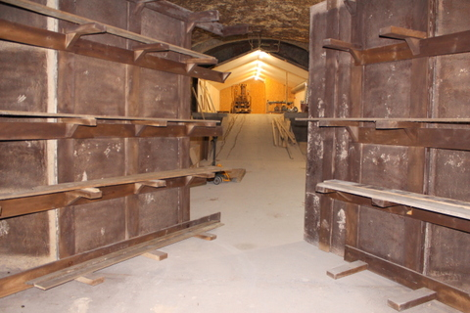

Slide 36
a „kitchen labor”
In 2010 he decided to produce it
His friend ordered an active pharmaceutical ingredients (clonazepam)

Slide 37
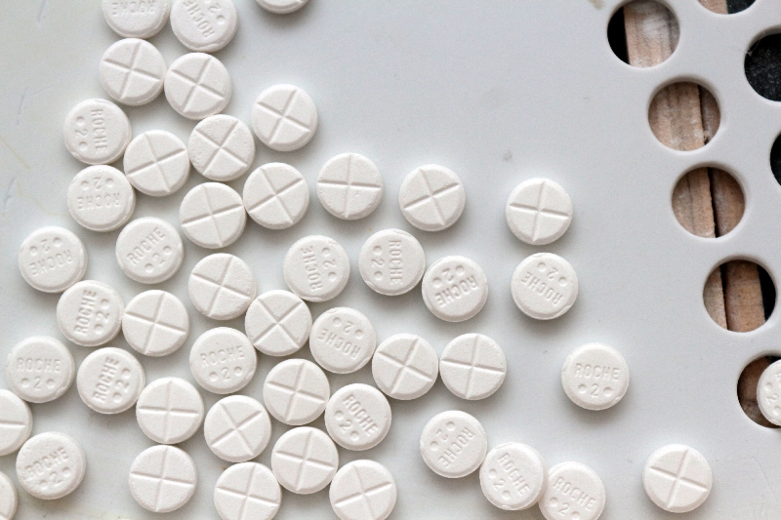

Slide 38
In 2011 or 2012 they ordered from China the tableting machine, the grinder, homogenizator and a mixer
3 months later was arriving
His friend – his profession was a food engineer – got a clonazepam
But he always tested by a firm this substances – it is about 6-8 occasion
It was only an intermediate
But they try it how to make a good pills

