Slide 1

Brand Protection Investigations
Investigation Techniques
Lukas DRLIK
Managing Director
VIS PROBANDI LIMITED

Slide 2

Lukas Drlik – The Founder
The Company
Former law enforcement professional
Former EMEA Anti-Counterfeiting Program Manager of Hewlett-Packard
Certified Fraud Examiner (by ACFE)
Professional Certified Investigator (by ASIS)
Founded in 2011
Investigation services provider focusing on Brand Protection and Anti-Counterfeiting
Operating in the CEE/SEE region
Own, In-House resources

Slide 3
In-House Resources/Area of Operations
Czech Republic
Poland
Hungary
Serbia
Slovenia
Romania
Bosnia & Herzegovina
Bulgaria

Slide 4
Investigations – What?
Retail
Wholesale
Import/Distribution
Production
Whole supply chain

Slide 5
Investigations – Who?
Brand Owner/Investigations Manager
In-House/Outside Counsel
Law Enforcement Agencies
Private Investigator

Slide 6
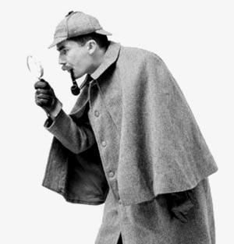
Investigations – When?
Law Enforcement efforts not enough
In-house resources not enough
Cases too complicated
Specialized skills needed
Need for distance (Safety)
Need for distance (Legal)

Slide 7
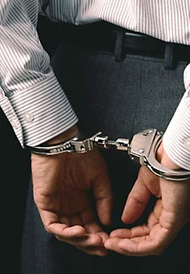
Investigations – Why?
Discovering the import/distribution/production level of counterfeit
Creating a gap of opportunities for the brand owner to increase the sales of legitimate goods
Protecting the consumer
Protecting the brand

Slide 8
Investigations – Where?
Online Environment
Open Markets
Brick & Mortar Shops
Wholesalers
B2B Sites

Slide 9
Investigations – How?
Market surveys and monitoring (online and field)
Background checks
Test purchases and evidentiary purchases
Surveillance
Undercover engagement
Cover facilities
Covert human intelligence sources management

Slide 10
Specialized Investigation Techniques
To obtain information that we would not be able to obtain otherwise
Highest risk for brand owner
Potentially highest benefits
Highest level of privacy breach
Highest costs
JaPaN principle (Justified, Proportionate, Necessary)

Slide 11
SIT - Surveillance
Static/dynamic
Human/technical
People/vehicles/premises

Slide 12
SIT - Undercover
Specially trained personnel
Cover story
What is the goal?

Slide 13
SIT – Cover Facilities
Virtual or real company
Phones, emails, domain names, websites
Delivery addresses
Offices and warehouses

Slide 14
SIT – Covert Human Intelligence Sources
Who they are?
What is their motivation?
What are the risks?
How much will that cost?

Slide 15
Thank you for your attention. Any Questions?
Lukas DRLIK
+420608994920
lukas.drlik@visprobandi.com

